Slide 1
Queen Elizabeth II Platinum Jubilee
Story Map – North East Region Images
Key Stage 2: History & Geography
Learning Aims and Outcomes
Pupils understand more about the role of the Queen by exploring the Story Map of some of her visits to different places across England
Pupils learn about the Queen’s visits to significant places/events in their region of the country through her 70-year reign
Pupils develop a sense of place through mapwork
Pupils can identify regions of England and locate places in the region they live in
Pupils take part in celebrating a significant historical event
This learning resource supports the Historic England Platinum Jubilee Story Map & Platinum Jubilee Activities PPT
Notes:
This resource is intended to be used with the Historic England Jubilee Story Map which documents some of the many places the Queen has visited throughout her reign. Pupils are able to explore the pins on the map of their region of the country to find out about the significant buildings and events the Queen has visited. The Story Map contains information about the visit, a brief history of the building and images of the Queen and the building.

Slide 2
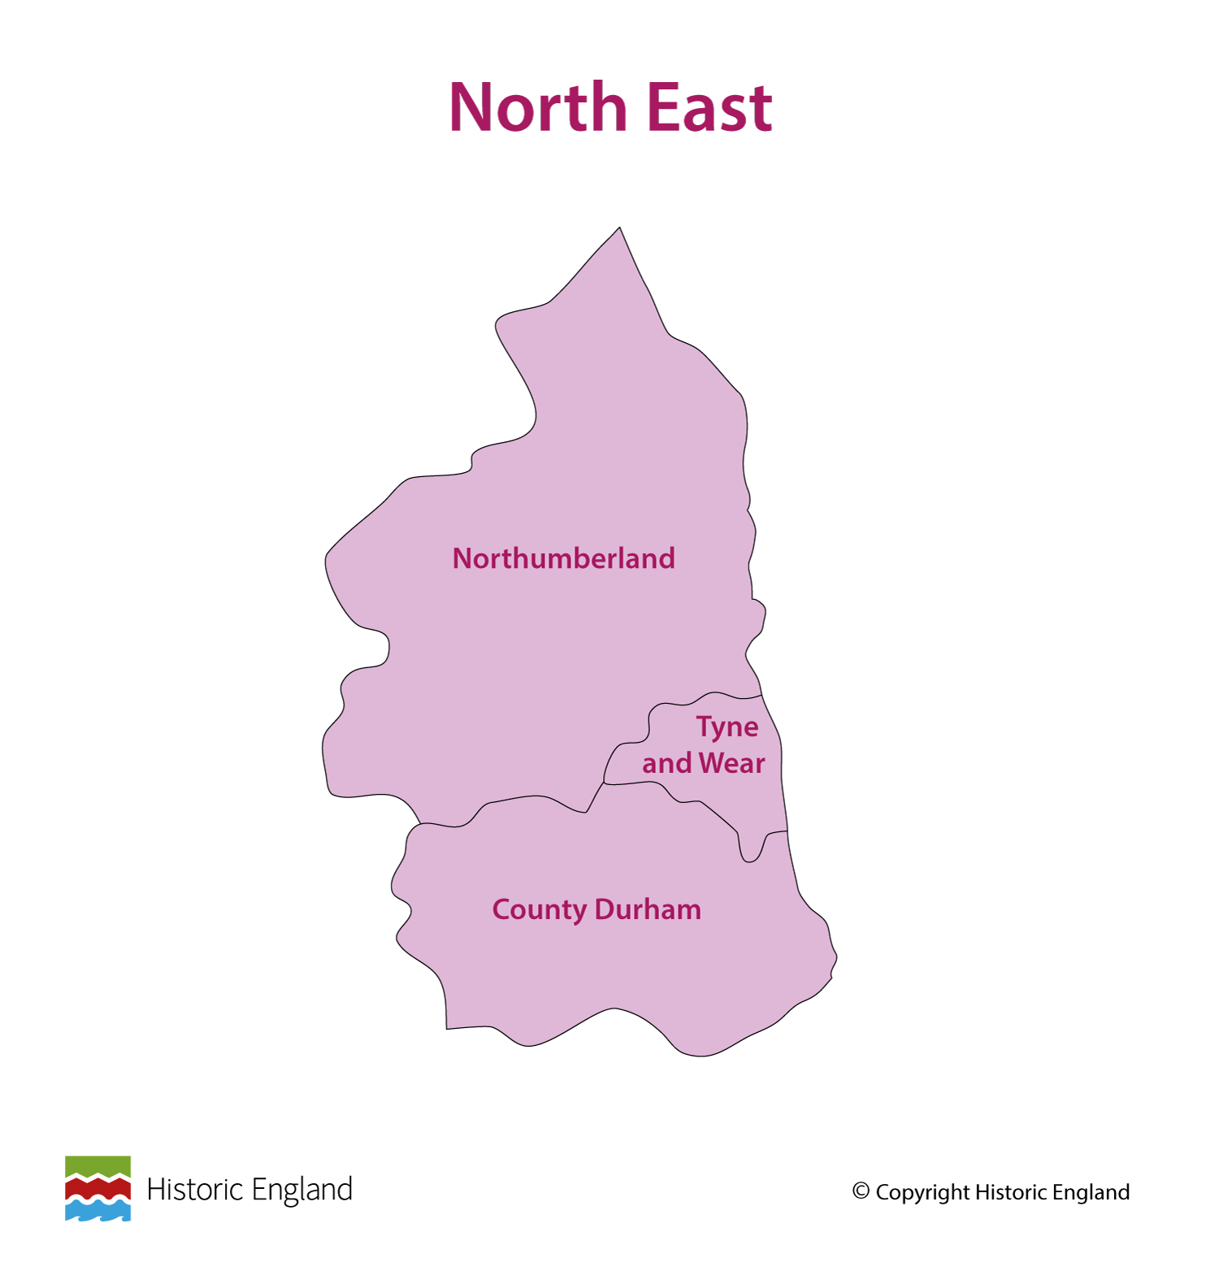
Notes:
Before following the link to your regional Story Map you may wish to discuss with pupils what counties are covered in your region.

Slide 3
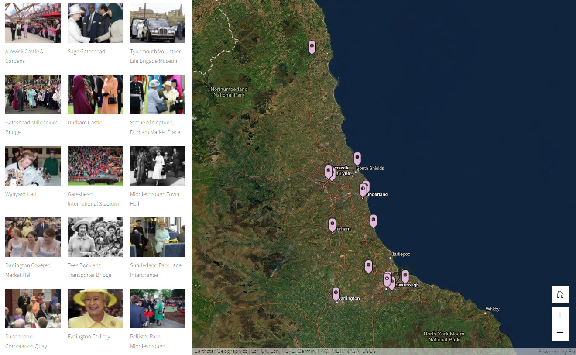
Notes:
Follow the link to your regional Story Map https://storymaps.arcgis.com/stories/fbf405bbf89643a9ae9cb1e852f56f7a

Slide 4
Alnwick Castle & Gardens
The Queen with the Duchess of Northumberland (centre) and Alan Shearer during a visit to Alnwick, Northumberland on 22 June 2011.
Alnwick Castle was built in the 11th Century to control and protect the border between Northumberland and Scotland. It is the seat of the 12th Duke of Northumberland. It is the second largest inhabited castle in the UK and has served as a military outpost, a teaching college, a refuge for evacuees, a film set, a family home.
Alnwick Gardens is an award-winning visitor attraction. The 12 acre site is home to the world’s largest Tai Haku Cherry Orchard. There is a spectacular cascading waterfall in the gardens and the world’s biggest tree house.
Find out more on the National Heritage List.

Slide 5
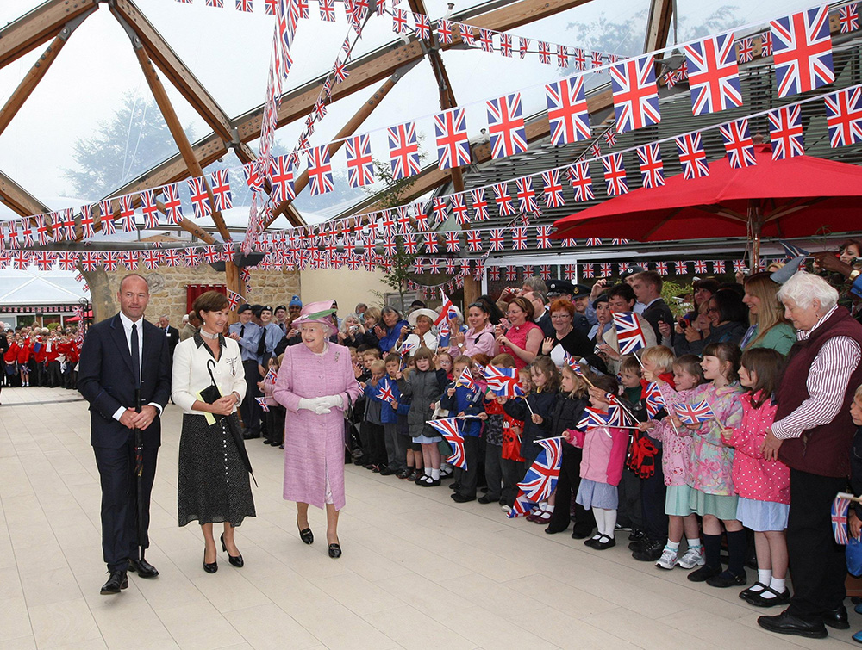
Notes:
The Queen with the Duchess of Northumberland (centre) and Alan Shearer walk past crowds of well-wishers waving Union Jack flags, during a visit to Alnwick. © Alamy - G4BH1H - 22 June 2011

Slide 6
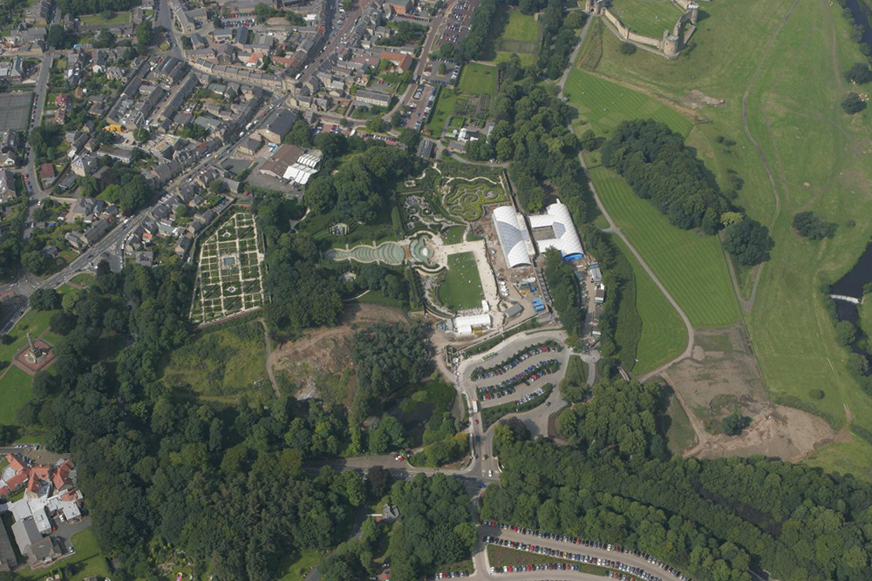
Notes:
An aerial view of Alnwick castle and gardens. © Historic England Archive - 20431_007-17 August 2005

Slide 7
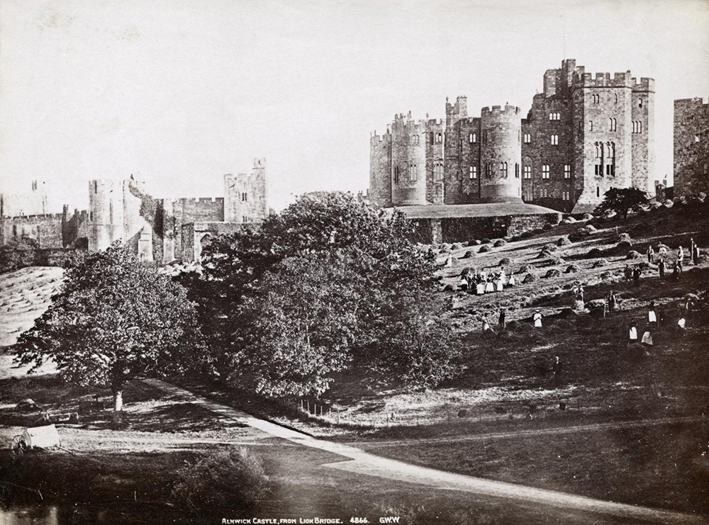
Notes:
A black and white image of Alnwick Castle from Lion Bridge. There are people gathering hay in the foreground. Source Historic England Archive - OP05253 - 1850 - 1900

Slide 8
Sage Gateshead
The Queen met Eram Javid, a member of the Kashmir community, at Sage Music Centre in Gateshead on Friday 14 October 2005.
The Sage is a concert venue and a centre for musical education, located in Gateshead. It opened in 2004. Every year The Sage welcomes more than two million visitors. More than 400 concerts featuring all kinds of local, regional and international music, take place all year round.
The iconic building was designed by renowned architects Foster + Partners and is home to Royal Northern Sinfonia.
Find out more about The Sage Gateshead.

Slide 9
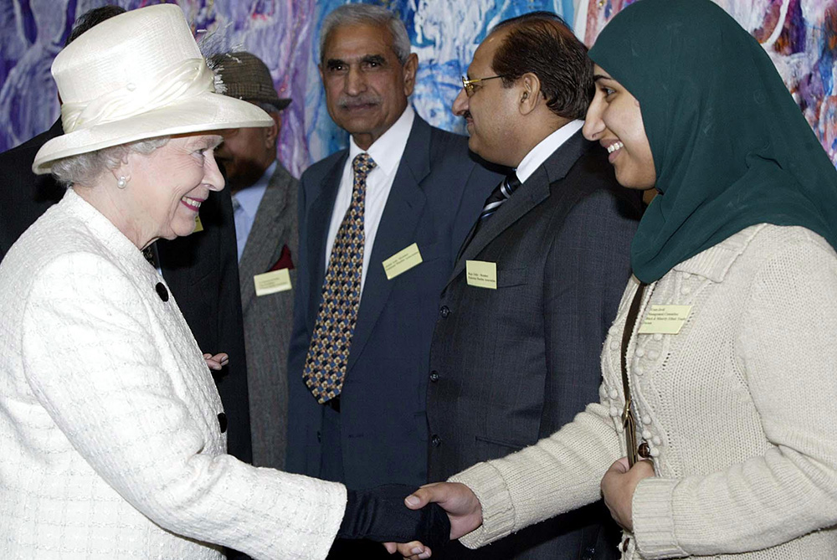
Notes:
The Queen shakes hands with Eram Javid, a member of the Kashmir community at Sage Music Centre in Gateshead. © Alamy - G8Y4A2 - 14 October 2005

Slide 10
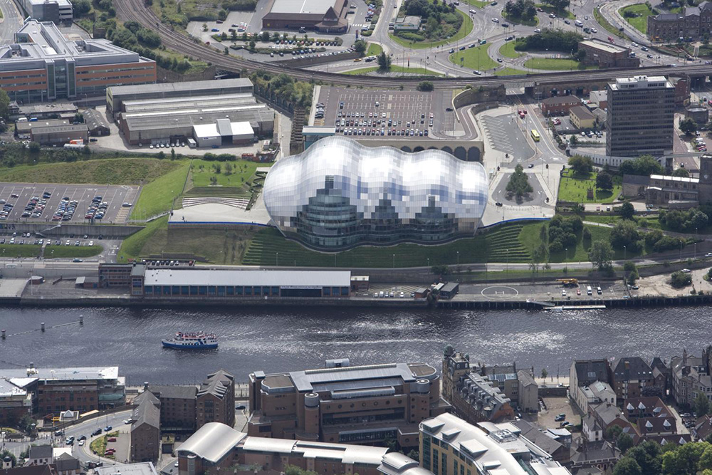
Notes:
An aerial view of The Sage centre on the banks of the River Tyne. © HistoricEngland Archive - 28096_008 – 19 August 2010

Slide 11
Tynemouth Volunteer Life Brigade Museum
The Queen arrives by car at the Tynemouth Volunteer Life Brigade Watch House and Museum in Newcastle on 14 Octyober 2005.
The TVLB was the first ever Volunteer Life Brigade to be formed, in 1864. It is still operational today. The Watch House Museum contains many artefacts that depict the history of lifesaving on the north east coastline.
The museum houses a working ¾ size version of breeches buoy rescue equipment (the TVLB were famous for utilising this equipment in ship to shore rescues in the past). The museum contains an amazing selection of unusual and unique items recovered from local shipwrecks including ships’ bells, figureheads and much more.
Find out more on the National Heritage List.

Slide 12
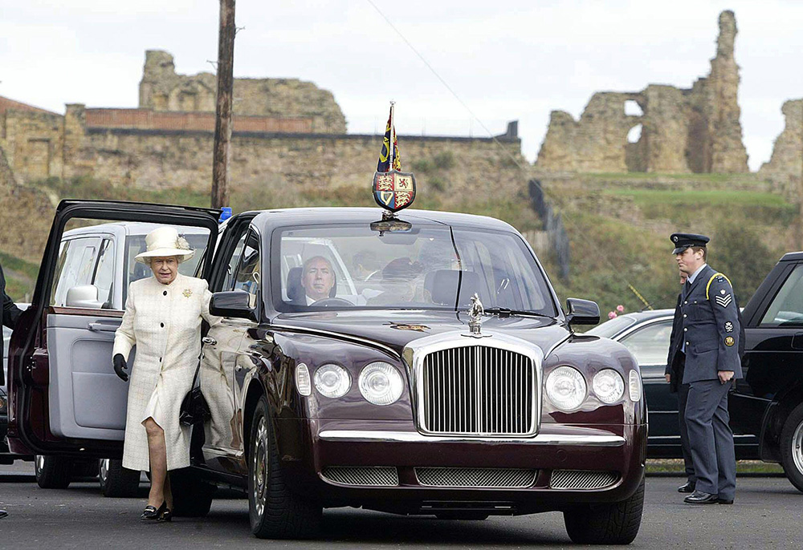
Notes:
The Queen stepping out of a car outside the Tynemouth Volunteer Life Brigade Watch House, with the ruins of Tynemouth Priory in the background. © Alamy - 2GX8RW3 - 14 October 2005

Slide 13
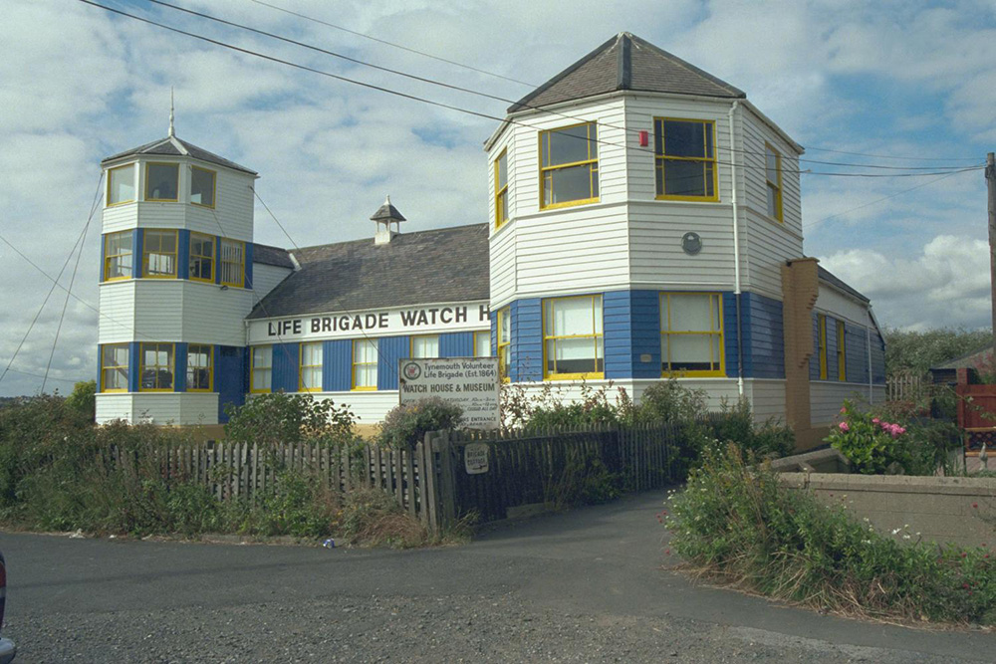
Notes:
A view of the Watch House, with it's two towers and covered in wooden cladding. It's painted white, with distinctive blue and yellow areas around the windows. © Mrs J.H. Black. Source: Historic England Archive - IOE01/00188/29 - 23 Aug 1999

Slide 14
Gateshead Millennium Bridge
The Queen on the Newcastle side of the Millennium Bridge, which links Gateshead to Newcastle, after officially opening it on 7 May 2002.
The bridge is for pedestrians and cyclists to cross the River Tyne between Gateshead and Newcastle upon Tyne. It was the first tilting bridge ever to be constructed and was designed by WilkinsonEyre. It has won many awards for design and lighting. It is sometimes called the 'Blinking Eye Bridge’ or the 'Winking Eye Bridge' due to its shape and its tilting method.
It opened to the public in 2001 and 36,000 people lined the banks of the river to watch it tilt for the first time in June 2001. It contains enough steel to make 64 double-decker buses and weighs more than 800 tonnes!
Find out more about the Gateshead Millennium Bridge.

Slide 15
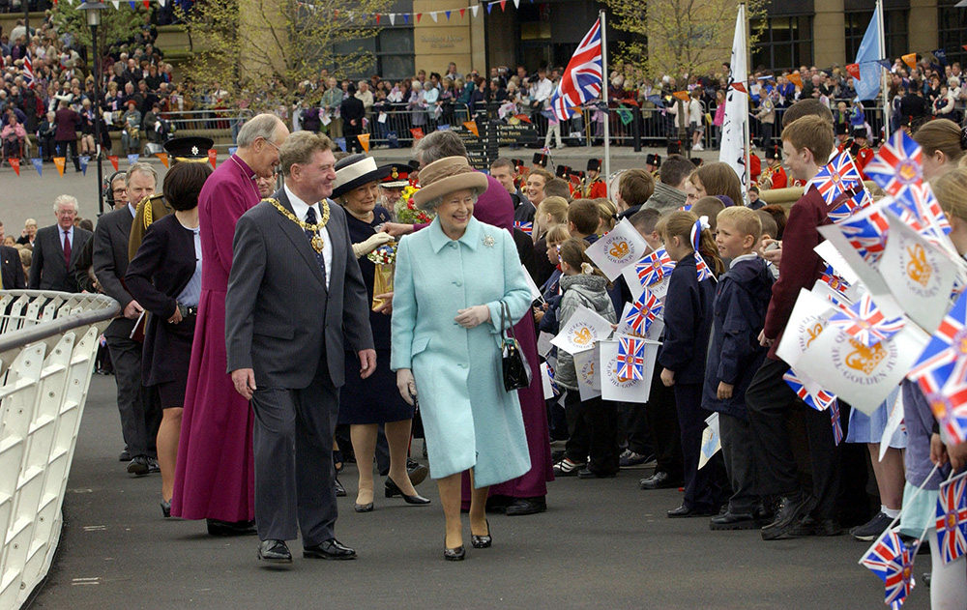
Notes:
The Queen, followed by local dignitaries, walks past a line of school children on the bridge waving Union Jack and Jubilee flags at her. © Alamy - G5TB5N - 7 May 2002

Slide 16
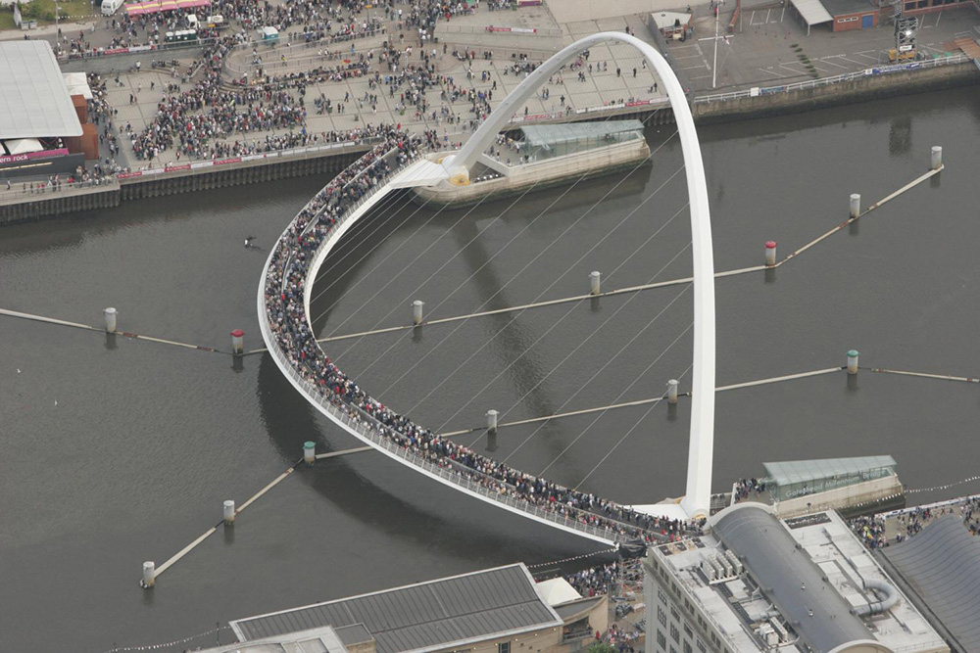
Notes:
An aerial view showing the bridge crowed with people crossing it. © Historic England Archive - 20399_008 – 27 July 2005

Slide 17
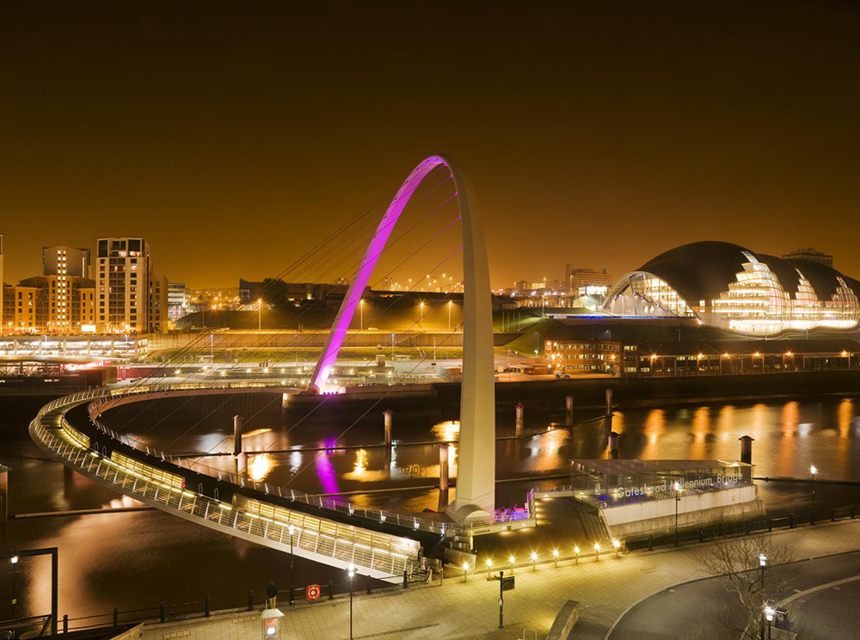
Notes:
A view of the bridge at night, showing the arch lit up in bright pink. © Historic England Archive – DP059192 - 15 Apr 2008

Slide 18
Durham Castle
The Queen talks to The Right Reverend Justin Welby, Bishop of Durham, as she arrives at Durham Castle, as part of her Diamond Jubilee visit to the North East on 18 July 2012.
The castle was begun in 1072, under the orders of William the Conqueror. It was built to protect the Norman rulers from the rebellious local population and potential invasions from Scotland. It consisted of a motte (mound) and an inner and outer bailey (fenced or walled area).
The castle was the residence of the Bishops of Durham. The position of Prince Bishop of Durham was very prestigious, with the role came the right to raise an army, mint your own coins and levy taxes. Since 1837, the castle has been the home of University College, the oldest of Durham University's Colleges. It was designated a World Heritage Site in 1986.
Find out more on the National Heritage List.

Slide 19
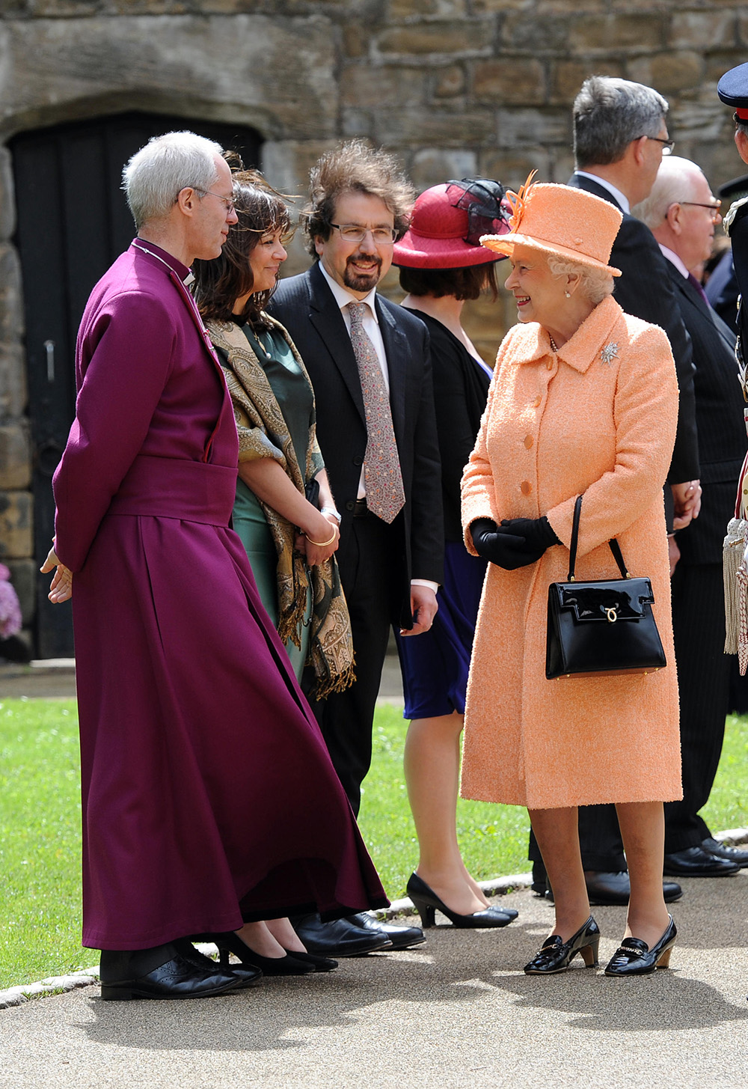
Notes:
The Queen talks to The Right Reverend Justin Welby, Bishop of Durham, and other local dignitaries at Durham Castle. © Alamy - G5B48C - 18 July 2012

Slide 20
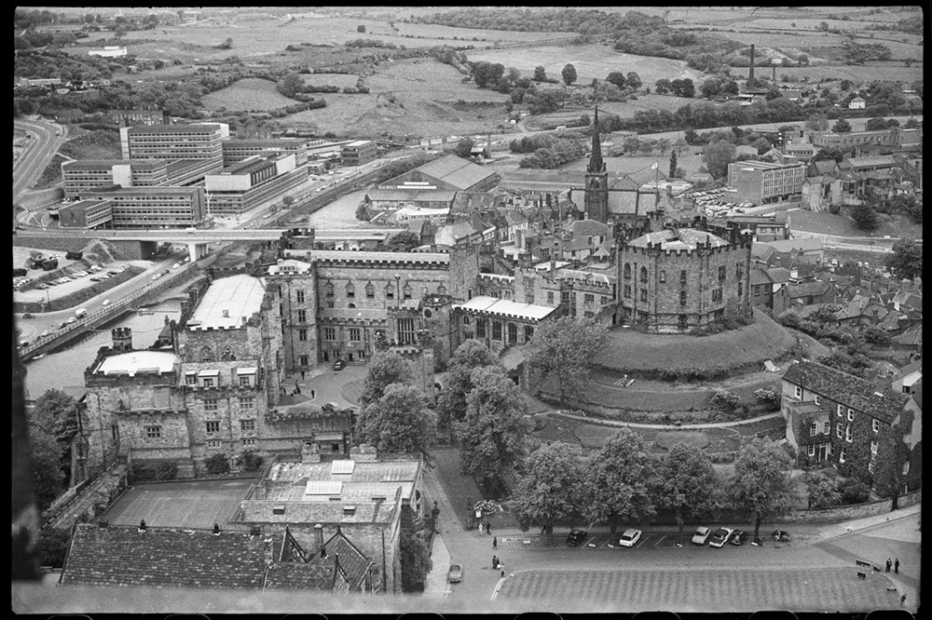
Notes:
A black and white view of Durham, seen from the top of the Cathedral's crossing tower, showing Durham Castle, Market Place with St Nicholas' Church and the River Wear with Milburngate House in the background. © Historic England Archive - UXC01/01/01/1414/13 - c1955-c1980

Slide 21
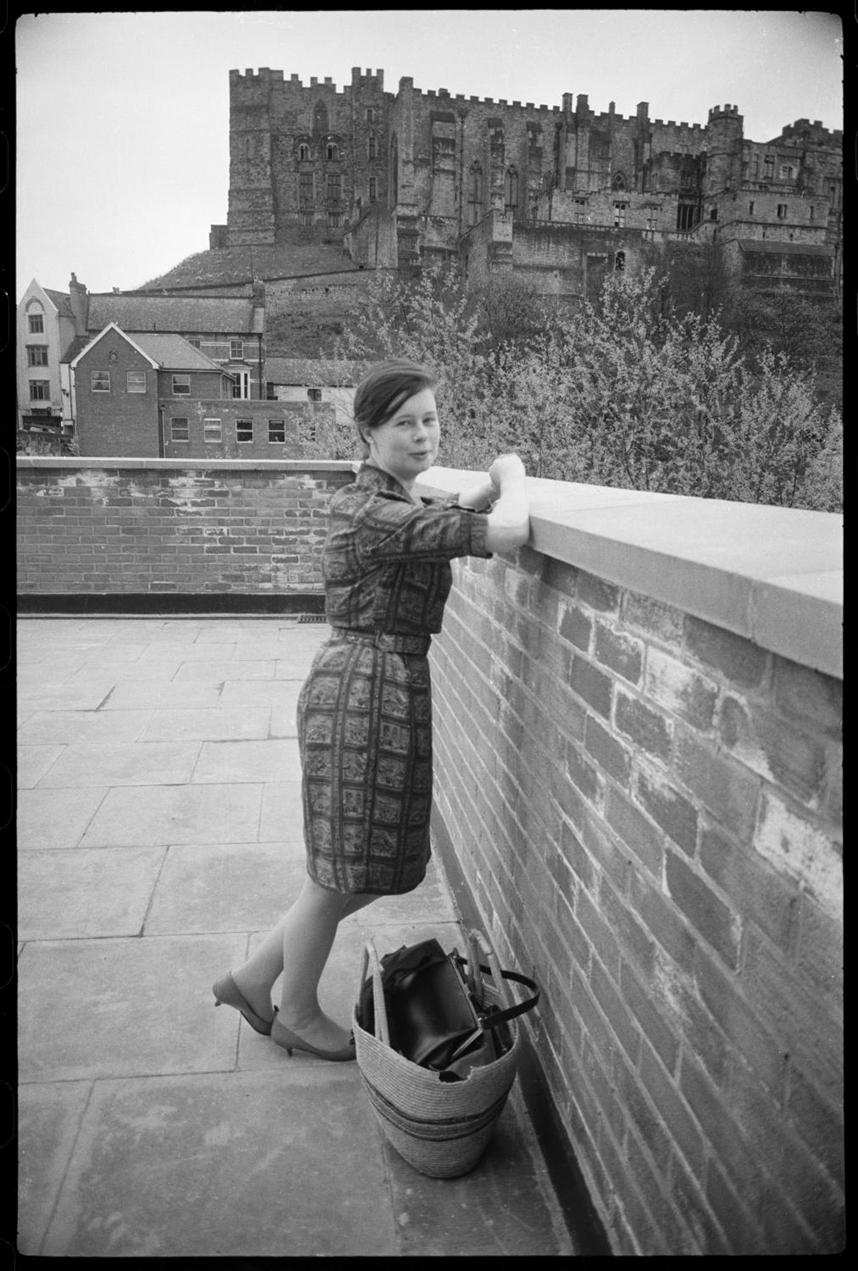
Notes:
A black and white portrait of the photographer Ursula Clark, with Durham Castle in the background, taken from near Bridge House on the western side of Framwellgate Bridge. © Historic England Archive - UXC01/01/01/0905/39 - c1955-c1980

Slide 22
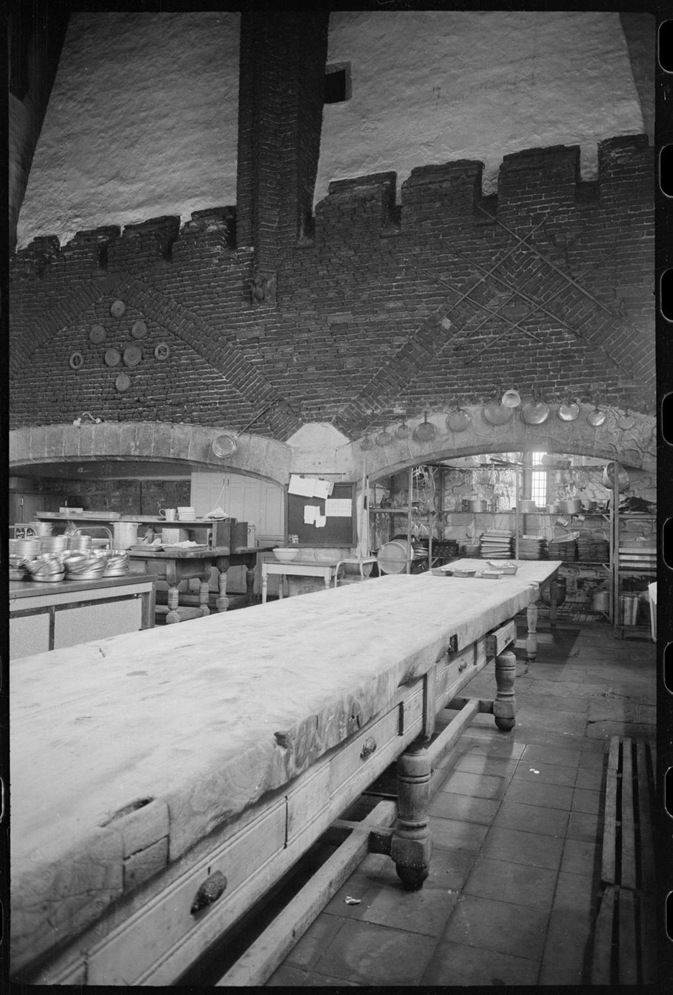
Notes:
A black and white view of Durham Castle's kitchen, showing the south wall, situated at the south-west end of the western range. © Historic England Archive - UXC01/01/01/1280/20 - c1955-c1980

Slide 23
Statue of Neptune, Durham Market Place
The Queen was given flowers, whilst standing in front of the Statue of Neptune, during a walkabout in Durham city centre on her Golden Jubilee tour of the North East on 8 May 2002.
The statue was given to the city in 1729 by George Bowes M.P. of Gibside and Streatlam. It was a symbol of the desire at the time to link Durham to the sea by improved navigation of the River Wear. The statue originally stood in the Market Place, on top of a large stone fountain, which supplied water, piped from Fram Well until 1923.
It was relocated to Wharton Park after the water fountain was no longer needed but returned to the Market Pace in 1986, following an appeal by the City of Durham Trust.
Find out more on the National Heritage List.

Slide 24
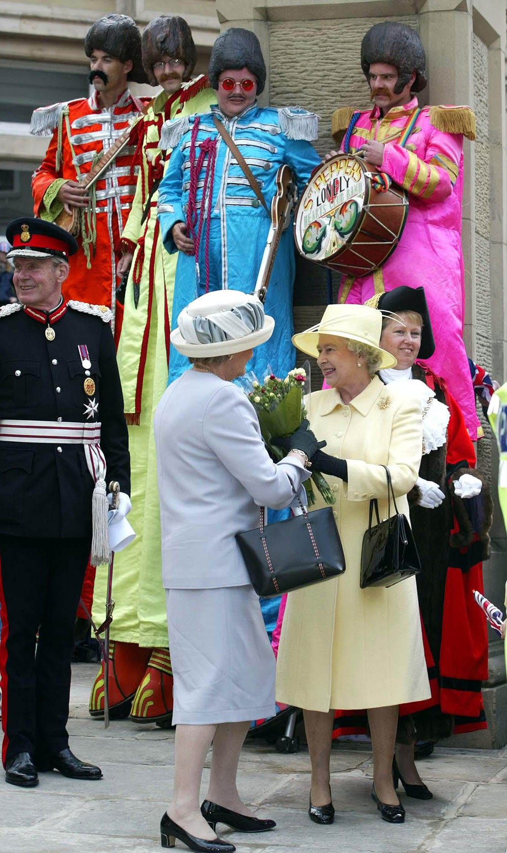
Notes:
The Queen is given flowers, whilst standing in front of the Statue of Neptune. Next to the statue are four people on stilts vibrantly dressed as the Beatles from the Sergeant Pepper's Lonely Hearts Club Band. © Alamy - G5TCKD - 8 May 2002

Slide 25
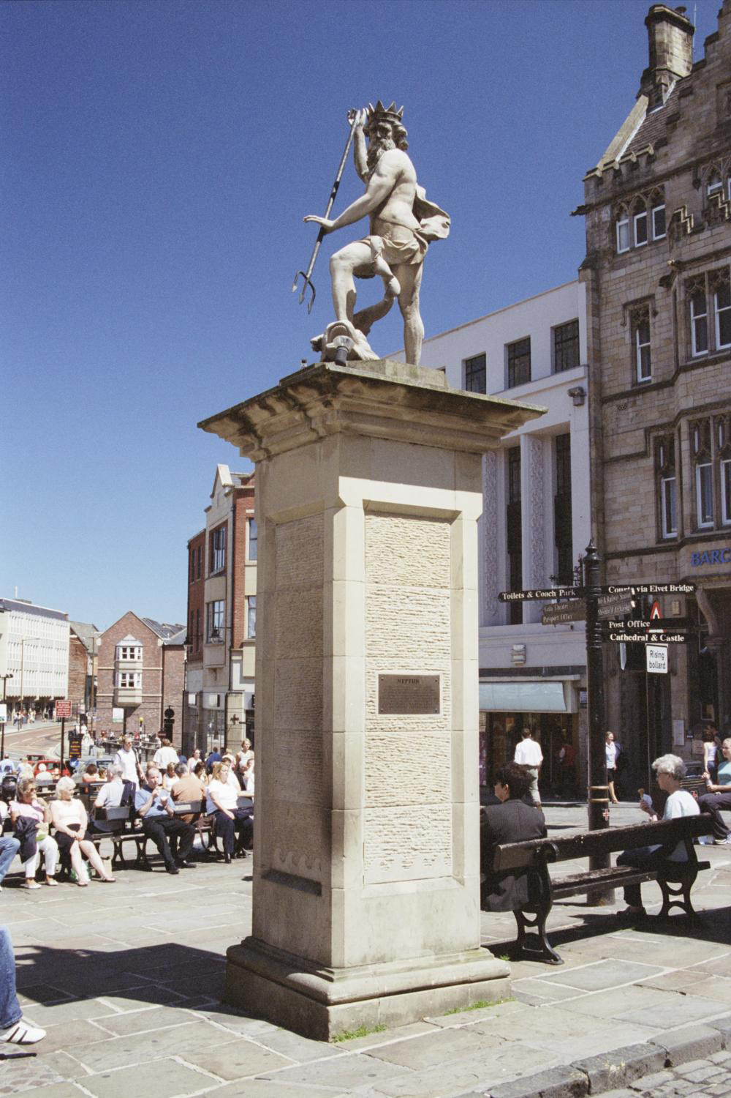
Notes:
A view of the square stone column, with a classical style stone statue of Neptune on the top, holding a metal trident fork. © Mr Bob Cottrell. Source: Historic England Archive - IOE01/14265/05- 23 Jun 2005

Slide 26
Wynyard Hall
The Queen watches the computer monitor assembly line at the new Samsung Factory. She had earlier opened the 450 million plant at Wynyard Park, Billingham, Cleveland on 13 October 1995. Wynyard Park was part of the estate associated with Wynyard Hall.
Wynyard Hall is a large country house that used to be the family seat of the Vane-Tempest-Stewart family, Marquesses of Londonderry. The house was designed by Philip Wyatt and built between 1822-28.
It was paid for with coalfield profits at a cost of £80,000. Over the years the estate has hosted many famous people such as Charles Dickens and Prime Ministers Benjamin Disraeli and Winston Churchill. It was sold to Sir John Hall in 1987.
Find out more on the National Heritage List.

Slide 27
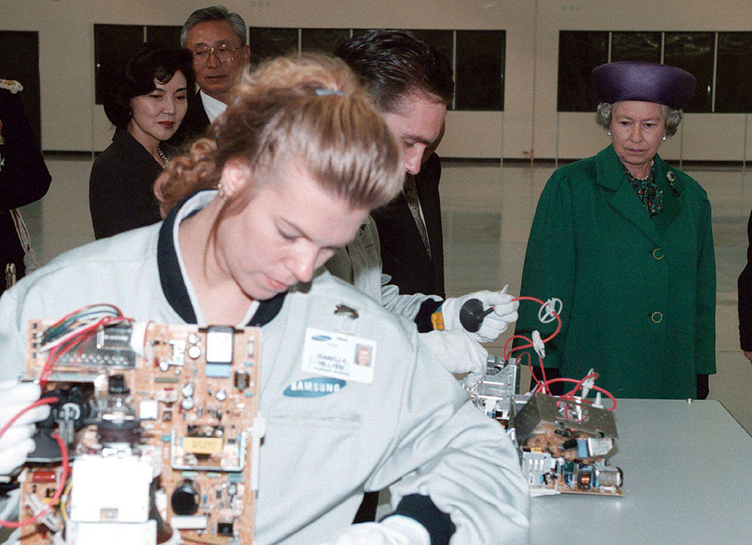
Notes:
The Queen looks on as workers put together new computer monitors the new Samsung Factory where she had earlier opened the 450 million plant at Wynyard Park, Billingham. © Alamy - 2D2WR49 - 13 October 1995

Slide 28
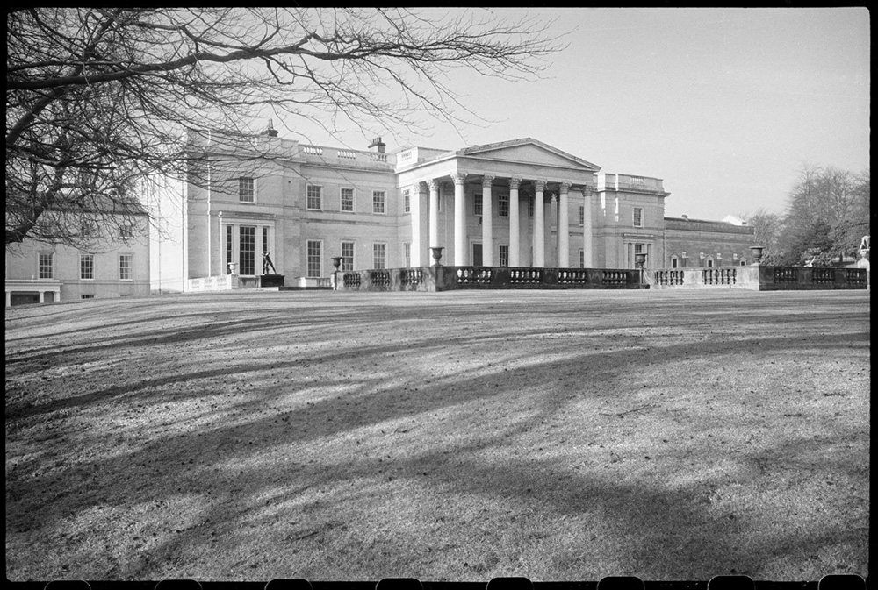
Notes:
A black and white view of the front elevation of Wynyard Hall, a Georgian house, now hotel, seen from the east. © Historic England Archive - UXC01/01/01/1271/04 - c1955-c1980

Slide 29
Gateshead International Stadium
The Queen and Prince Phillip arrive for their visit to Gateshead International Stadium as part of her Diamond Jubilee visit to the North East on 18 July 2012.
It is a multi-purpose venue with a capacity of 11, 800. The stadium was built in 1955 on former industrial land at a cost of £30,000. It has since been extensively re-developed over the years.
It is the current home of several sports teams such as Gateshead Football Club and Gateshead Harriers. Five world records have been set at the stadium. Over the years, it’s also been the main stage for major rock and pop concerts, hosting such famous faces as Bon Jovi and Tina Turner.
Find out more about Gateshead International Stadium.

Slide 30
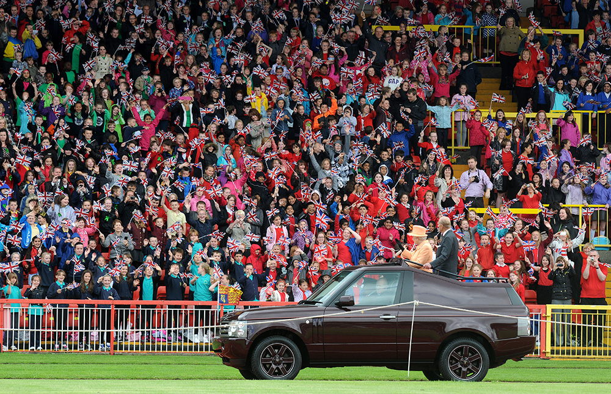
Notes:
The Queen and Prince Phillip standing up and waving to crowds in the back of their specially converted Land Rover, at Gateshead International Stadium. © Alamy – DRCKFC - 18 July 2012

Slide 31
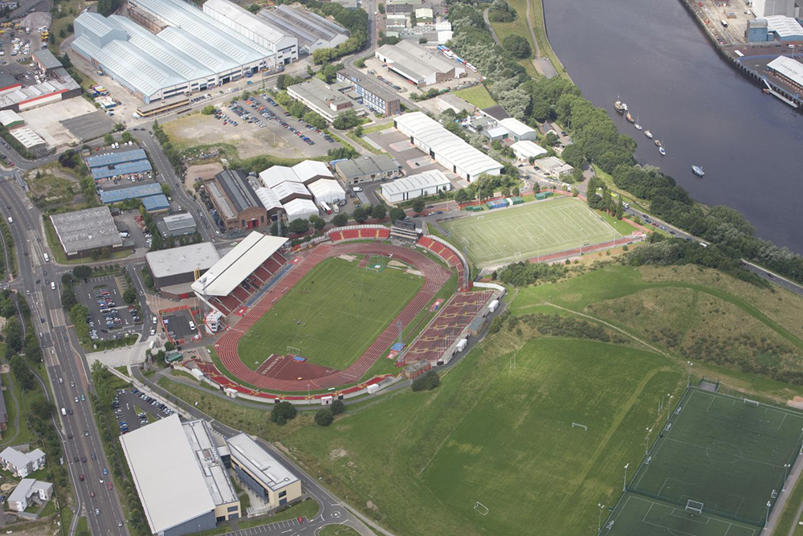
Notes:
An aerial view of the International Stadium, close to the banks of the River Tyne. © Historic England Archive - 20925_062 – 6 August 2009

Slide 32
Middlesbrough Town Hall
The Queen turns to smile and wave to the crowd as she leaves the Town Hall in Middlesbrough, accompanied by the Mayor, Alderman F. Manton, and Prince Philip on 5 June 1956.
The foundation stone for Middlesbrough Town Hall was laid in 1883. It was designed by G G Hoskins of Darlington. It was officially opened by the then Prince and Princess of Wales on 23 January 1889.
One part of the building housed the Mayor as well as the police station and cells, courtroom, library and fire station. The other part was as a respected entertainment venue. The Town Hall is still an entertainment venue and has played host to many performers over the years.
Find out more on the National Heritage List.

Slide 33
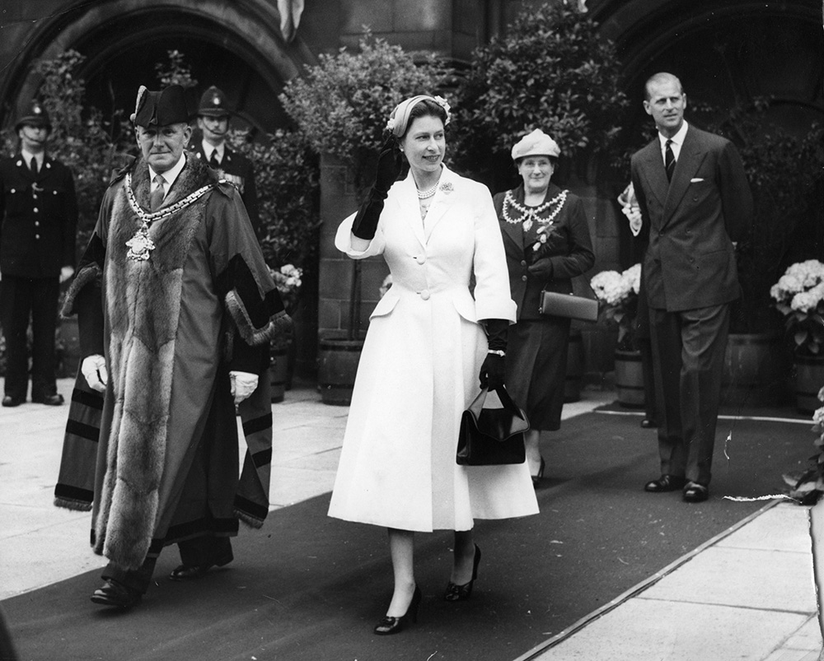
Notes:
A black and white image of the Queen turning to smile and wave to the crowd, accompanied by the Mayor, Alderman F. Manton, and Prince Philip. © Alamy - G4PPY0 - 5 June 1956

Slide 34
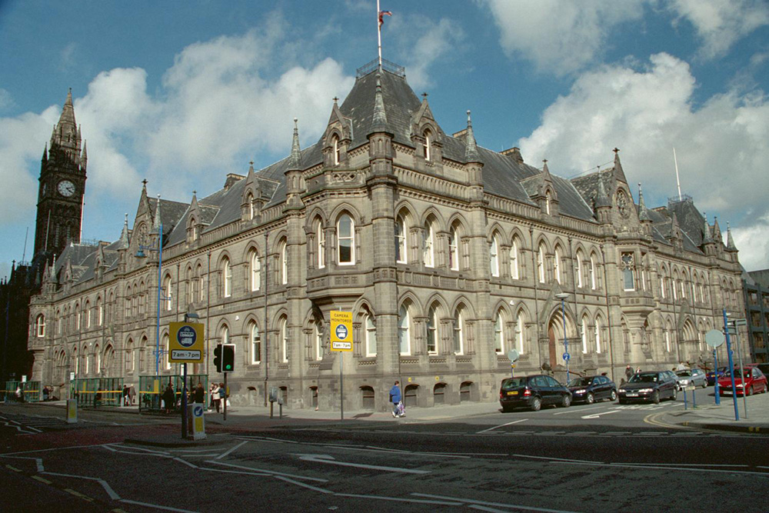
Notes:
A view of the impressive Gothic style stone built Town Hall. © Mr Bob Cottrell. Source: Historic England Archive - IOE01/05180/31- 9 Apr 2002

Slide 35
Darlington Covered Market Hall
The Queen watches schoolgirls from a local dance group in Darlington perform on the second day of her Golden Jubilee tour of north-east England on 8 May 2002.
The Victorian Market Hall was built in 1860. The Market sits alongside the famous Clock Tower, which at the time housed the sister bells to Big Ben. The market was designed by Alfred Waterhouse, who was also responsible for Rockliffe Hall in Hurworth. He also designed the Natural History museum in South Kensington, London.
The market has lots of shops and restaurants in it. Many of the stallholders have been trading for over 50 years, with a lot of the shops being passed down from generation to generation.
Find out more on the National Heritage List.

Slide 36
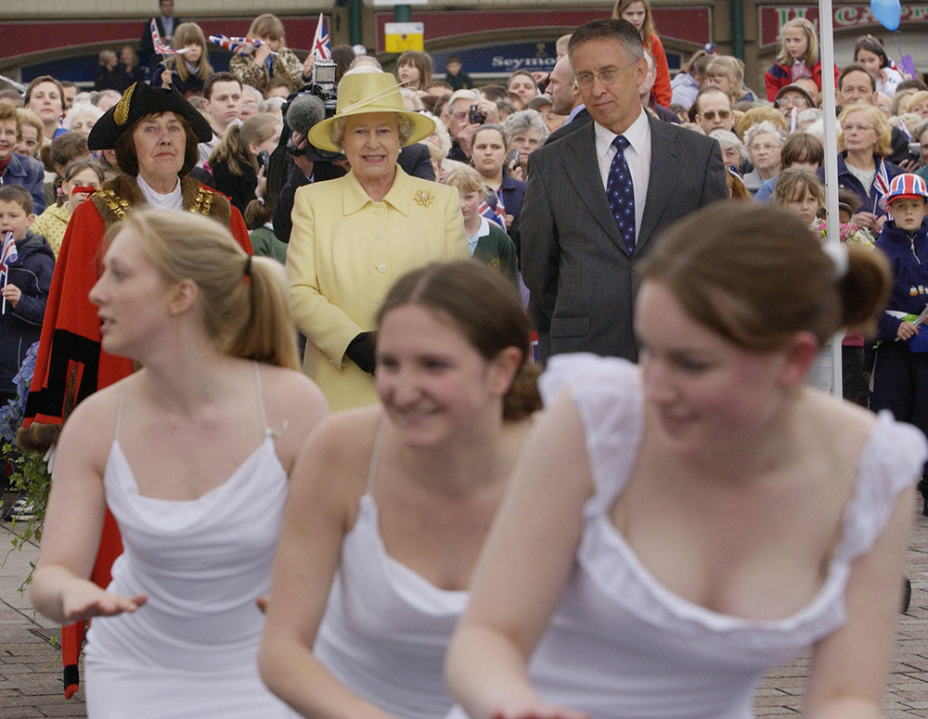
Notes:
The Queen, next to the Lady Mayor and crowds of well-wishers watch schoolgirls from a local dance group in Darlington performing. © Alamy - G5TD25 - 8 May 2002

Slide 37
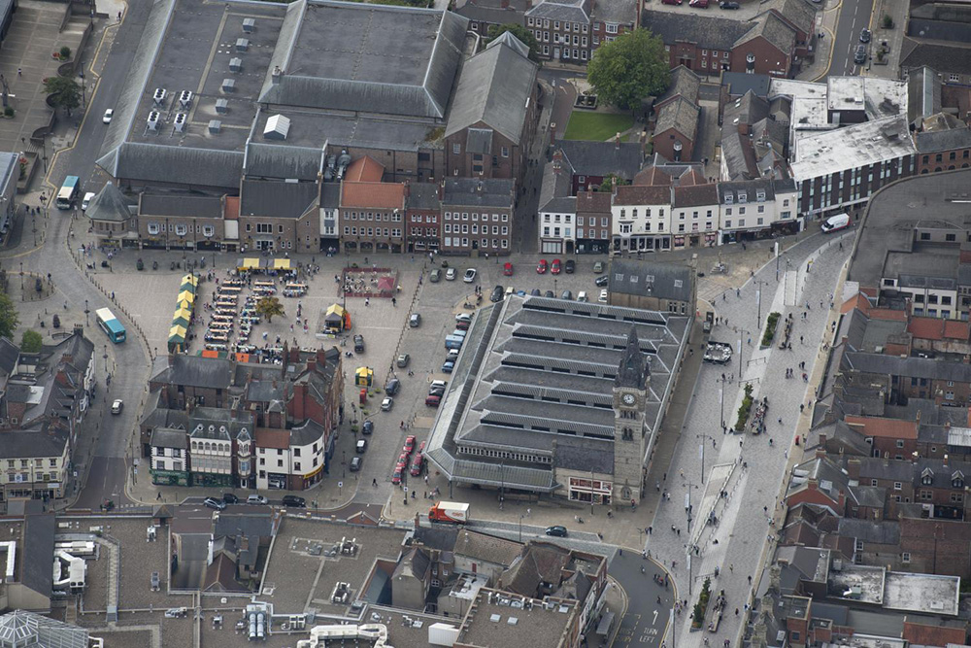
Notes:
An aerial view of the Covered Market in the centre of Darlington. © Historic England Archive - 28211_038 – 17 August 2011

Slide 38
Tees Dock and Transporter Bridge
Smiles all round as the Queen arrives at Tees Dock, Middlesbrough, at the start of her Cleveland Silver Jubilee tour on 14 July 1977.
The Tees Transporter Bridge is a local landmark. It was opened in 1911. It is the longest working transporter bridge in the world and a symbol of Teesside's industrial heritage. It carries a travelling 'car', or 'gondola', suspended from the bridge, across the river in 9 seconds. The gondola can carry 200 people, 9 cars, or 6 cars and one minibus.
During the First World War Middlesbrough was bombed by an L11 Zeppelin. During this raid it was reported that a bomb fell through the bridge before hitting the river below. During the Second World War the bridge was hit by a bomb.
Find out more on the National Heritage List.

Slide 39
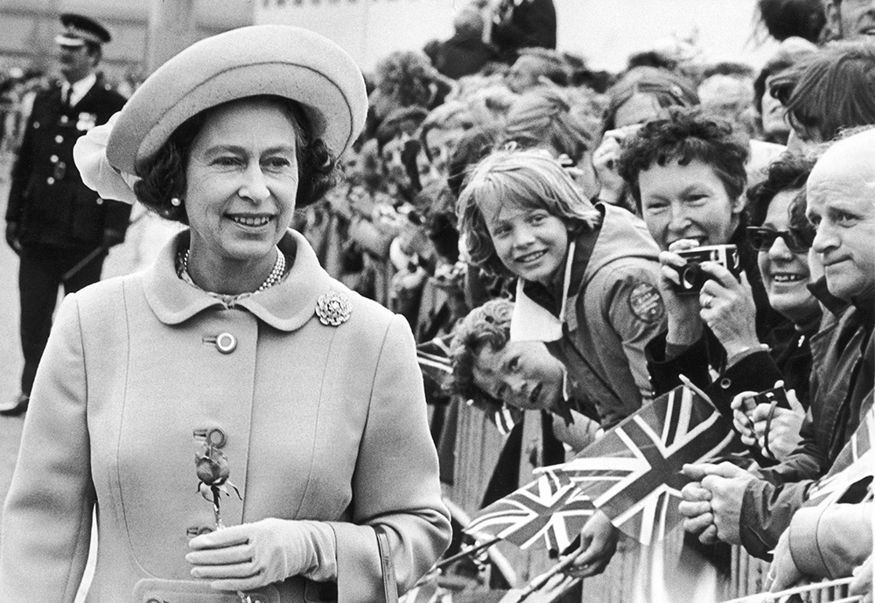
Notes:
A black and white image of the Queen smiling as she's greeted by crowds waving Union Jack flags. © Alamy - ERT91K - 14 July 1977

Slide 40
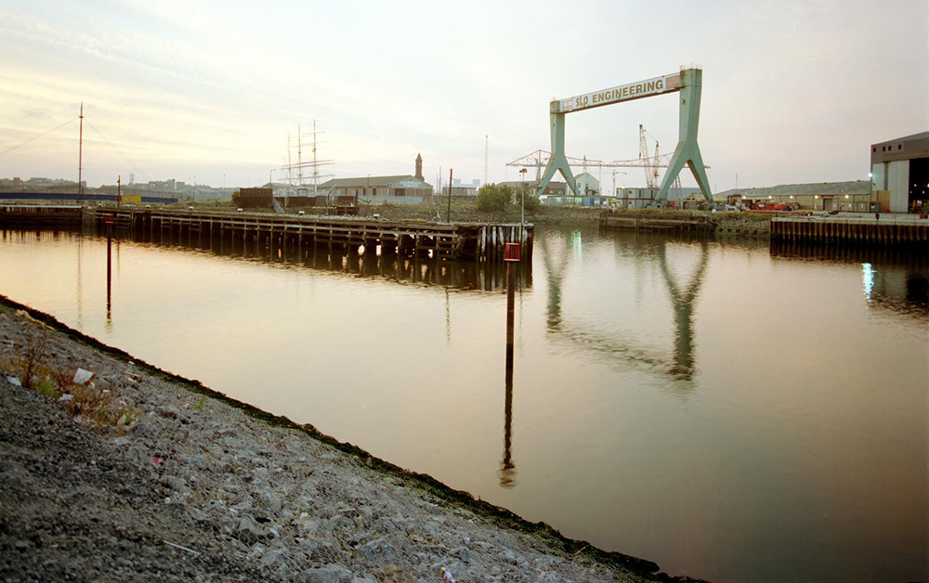
Notes:
A general view of the docks and Transporter Bridge, from the east. © Crown Copyright. Historic England Archive - AA97/07171 - 24 Sep 1997

Slide 41
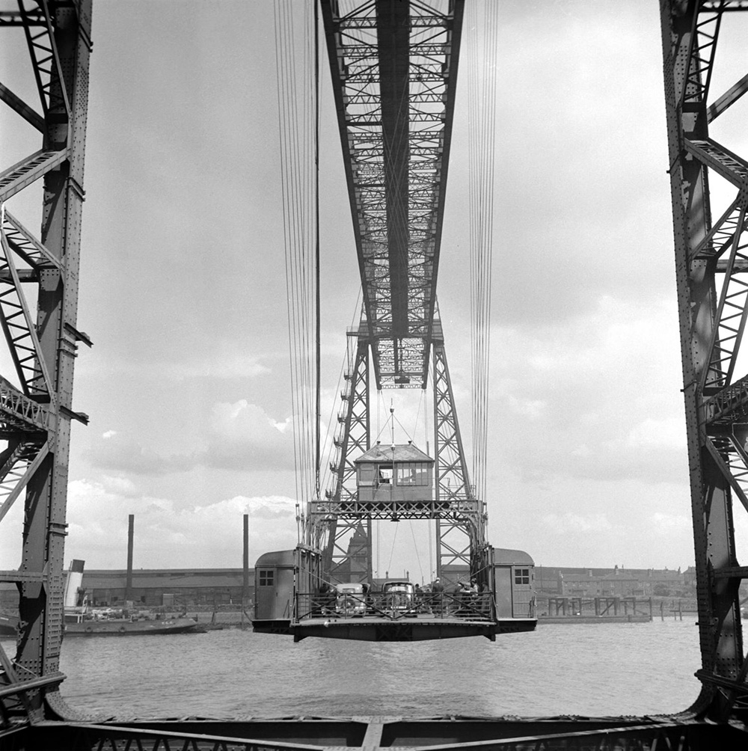
Notes:
A black and white view of the Middlesbrough Transporter Bridge in motion, seen from between the two towers at one end. © Historic England Archive - AA55/04344 - 1945 - 1955

Slide 42
Sunderland Park Lane Interchange
The Queen rides on the new Sunderland to Newcastle Metro Link after officially opening it at the Park Lane interchange, Sunderland. The Queen arrived in Sunderland on the second leg of her nationwide Golden Jubilee tour on 7 May 2002.
Park Lane is a Tyne and Wear Metro Station, serving Sunderland. It joined the network on 28 April 2002, following the opening of the extension from Pelaw to South Hylton.
The station is located below Park Lane Bus Station, which opened in May 1999 and replaced the former Sunderland Central Bus Station. It is fitted with vitreous enamel panels designed by artist Morag Morrison.
Find out more about Park Lane Interchange.

Slide 43
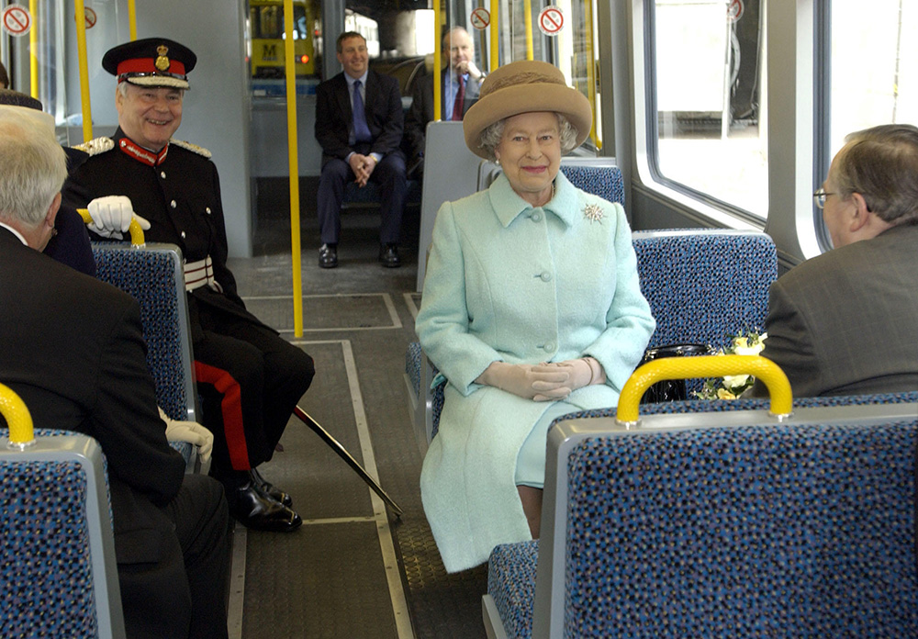
Notes:
The Queen smiles as she sits on a Metro train with other dignitaries. © Alamy - G5TBGW - 7 May 2002

Slide 44
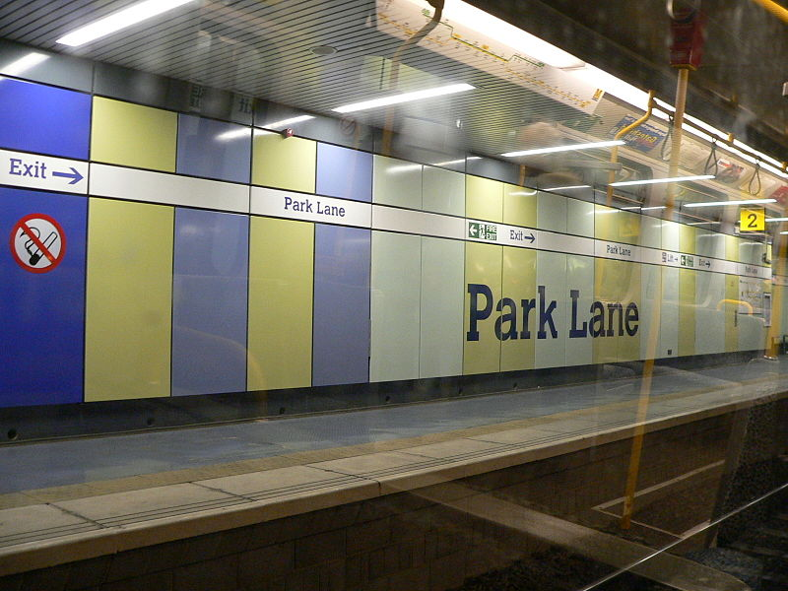
Notes:
A view of the platform with its colourful panels, at Park Lane station in Sunderland. Chris McKenna (Thryduulf), CC BY-SA 4.0 , via Wikimedia Commons

Slide 45
Sunderland Corporation Quay
The Queen views a street party as she tours a Diamond Jubilee exhibition celebrating the 60 years of her reign at Corporation Quay, as part of her Diamond Jubilee visit to the North East on 18 July 2012.
Corporation Quay is the Port's principal deep-water river berth situated on the west side of the Port estate on the south side of the River Wear. Corporation Quay was opened on 10th October 1934.
The ceremony was attended by the Mayor and Mayoress of Sunderland and by 500 guests, The Quay was officially opened by Sir John Priestman, who is noted as one of Sunderland's greatest philanthropist. He arrived by boat & formally opened the facility by cutting a red silk ribbon with a pair of silver scissors.
Find out more about Sunderland Docks.

Slide 46
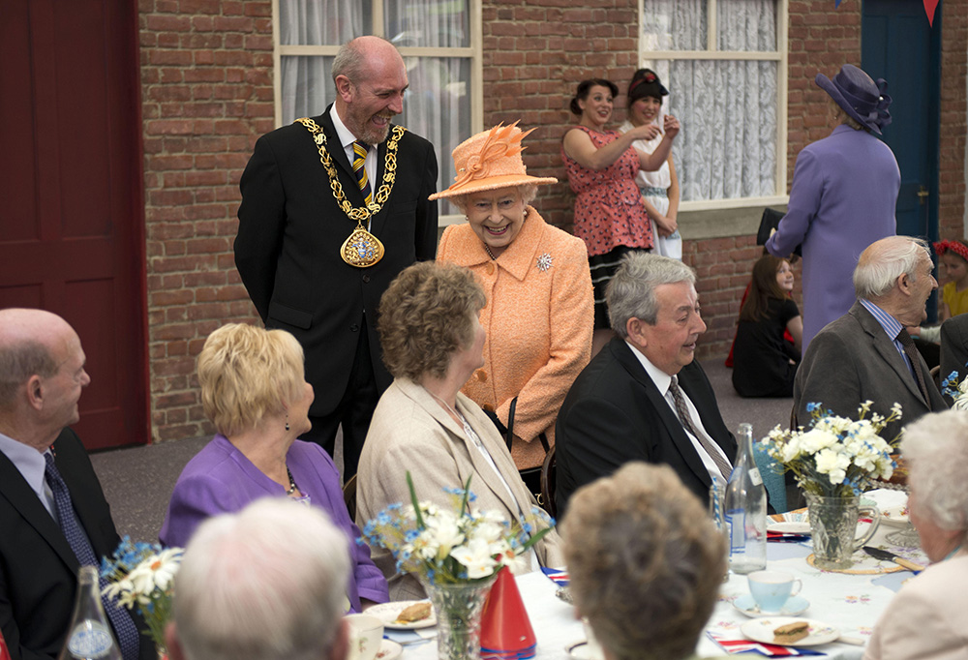
Notes:
The Queen, with the Mayor behind her, smiles as she meets people sat at a long table for a street party. © Alamy - G5B436 - 18 July 2012

Slide 47
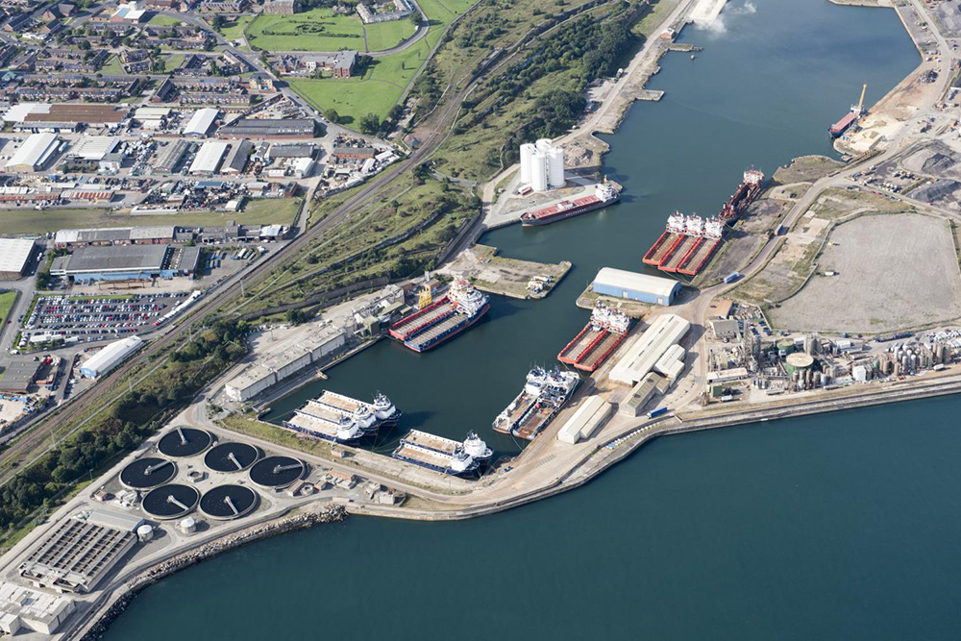
Notes:
An aerial view of Sunderland's main Quay and Docks. © Historic England Archive - 28959_028 – 6 September 2017

Slide 48
Easington Colliery
The Queen arrived at Easington, County Durham, on the second day of her Golden Jubilee tour of north-east England on 8 May 2002. Easington Colliery is a town in County Durham, known for its history of coal mining. The pit was sunk in 1899 and closed in May 1993, with the loss of 1,400 jobs.
The town suffered one of the worst mining accidents in Britain on 2 May 1951. An explosion in the mine resulted in the deaths of 83 men (including 2 rescue workers). The explosion was caused by a spark from a coal cutting machine igniting gas at the coal face.
The death toll was so high because the explosion happened as shifts were changing over so there were two sets of workers underground at the time. The site of the former colliery has been designated as a local nature reserve.
Find out more about Easington Colliery.

Slide 49
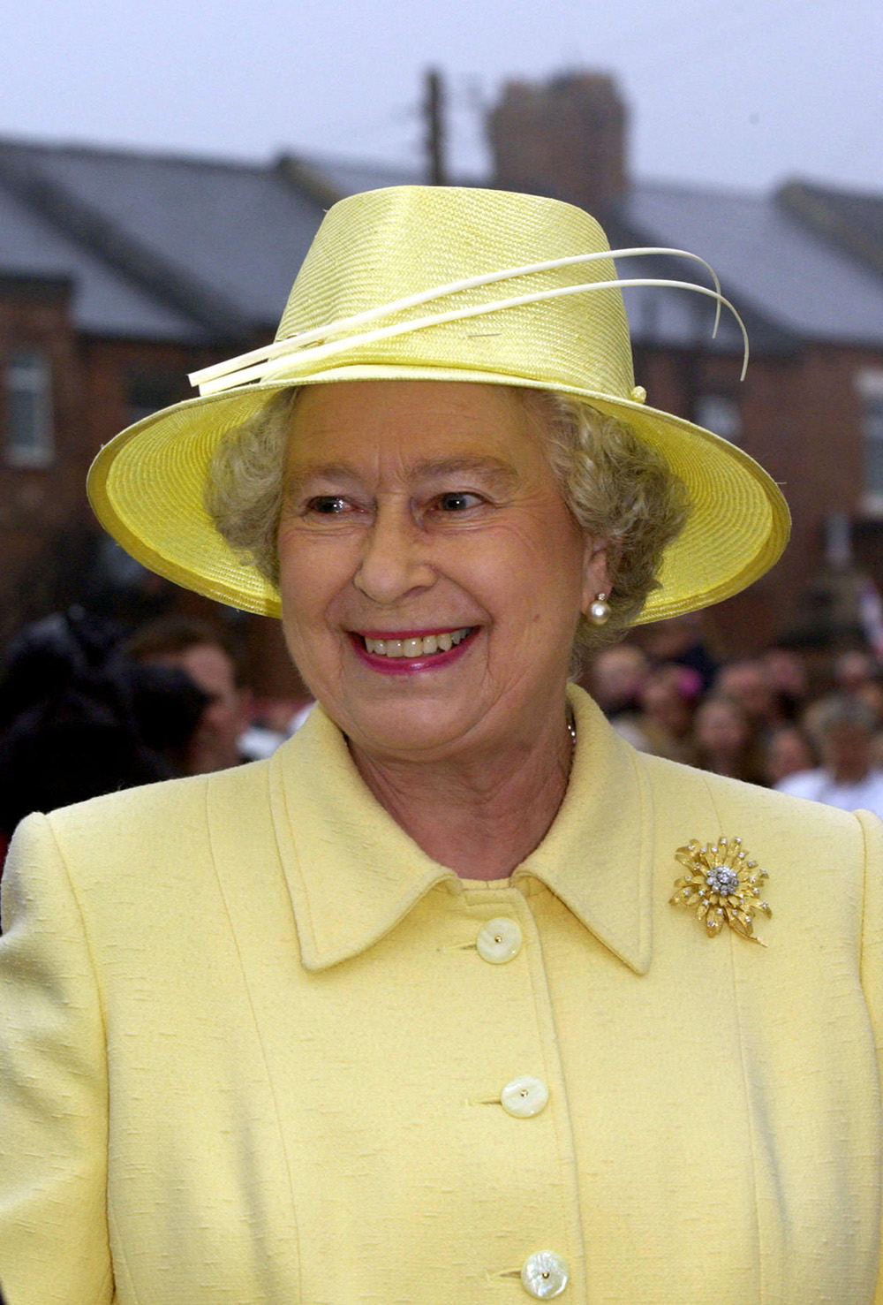
Notes:
The Queen smiling with terraced houses and crowds of people in the background. © Alamy - G5TC57 - 8 May 2002

Slide 50
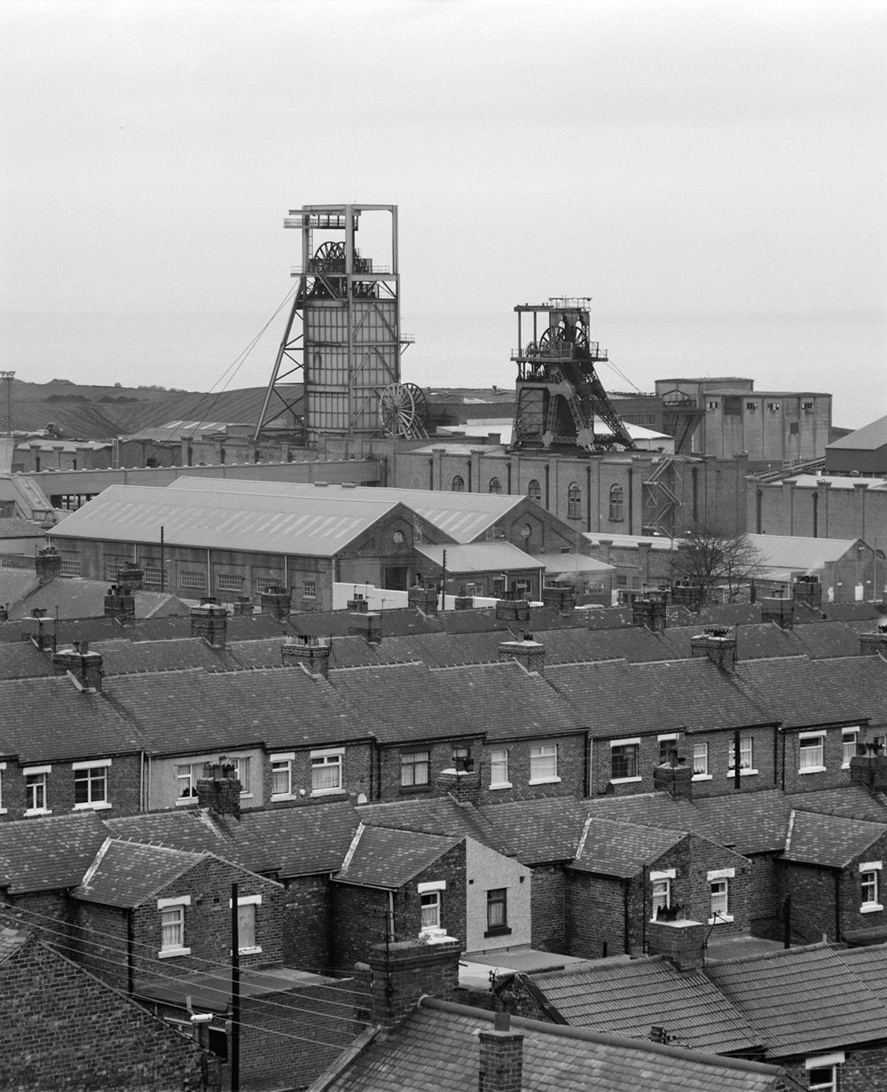
Notes:
A black and white view of terraced housing, with the mine buildings and colliery headstocks in the background. © Crown Copyright. Historic England Archive - AA92/07043 - 4 Nov 1992

Slide 51
Pallister Park, Middlesbrough
The Queen visited Middlesbrough on 18 May 1993 to re-open Pallister Park after a major restoration of the park, where she met the general public and talked to some of the local children.
Land for an ornamental park and recreation ground was given to the town by Councillor and Mrs J G Pallister. The park was first opened in 1929, and included hard tennis courts, bowling greens and a putting green.
It is known locally as the 'leisure centre without a roof', reflecting the fact that most activities take place outdoors, such as football and bowls. However, it does also offer indoor activities and caters for a wide selection of the community.
Find out more about Pallister Park.

Slide 52
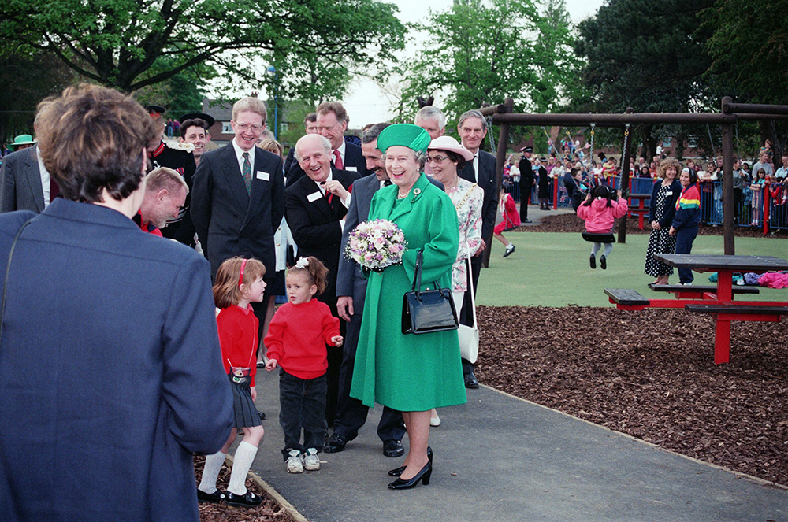
Notes:
The Queen, surrounded by dignitaries and children smiles as she holds a bunch of flowers, in Pallister Park. © Alamy - EWTR1E - 18 May 1993

Slide 53
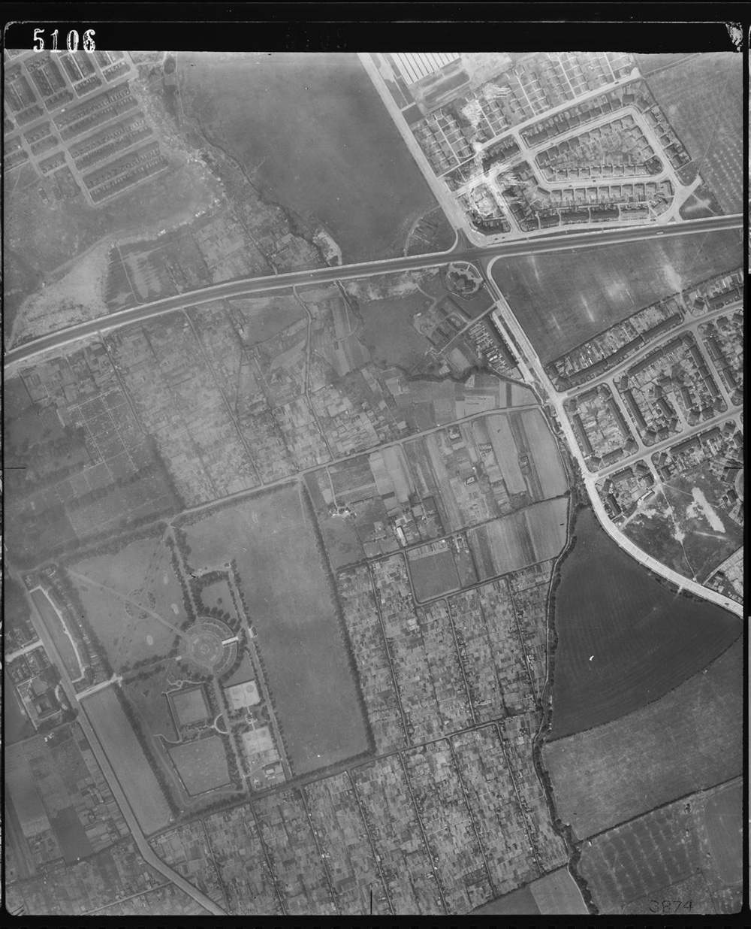
Notes:
A black and white aerial view of Pallister Park in 1948. Source Historic England Archive (RAF photography) – RAF_58_B_59_VP1_5106 - 30 July 1948

Slide 54
Clayport Library, Durham
The Queen with school children in Durham Clayport Library, which she officially opened in Durham city centre on 8 May 2002.
Durham Clayport Library is an innovative state of the art building on 3 floors situated opposite the Gala Theatre in Millennium Place, just off Claypath.
The library formed part of the Durham Millennium City Project and was awarded the Public Library Building Award 2003, for the best new public library in the United Kingdom and Ireland, in the large new library category.
Find out more about Clayport Library.

Slide 55
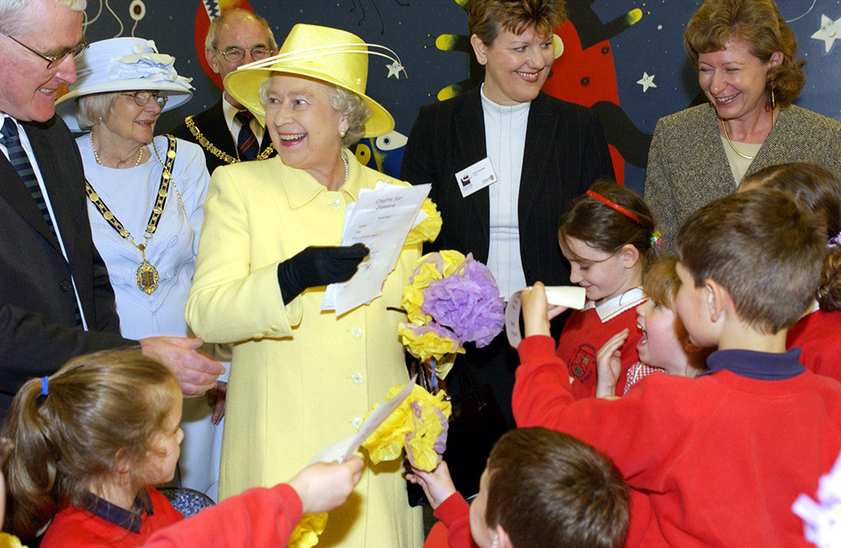
Notes:
The Queen smiles whilst standing amongst local dignitaries and school children. © Alamy - G5W6HW - 8 May 2002

Slide 56
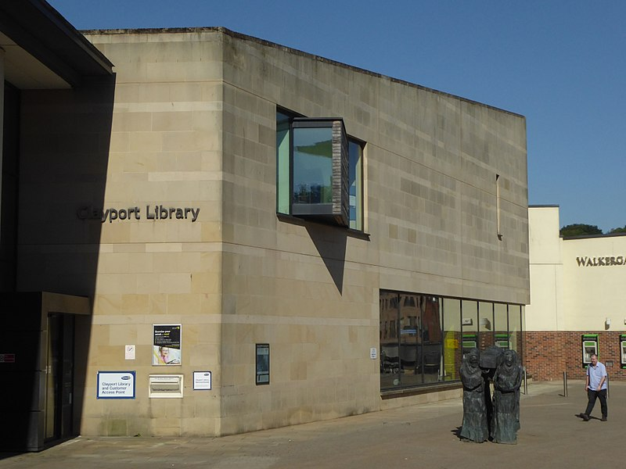
Notes:
A view of the 2 storey stone built library, with its glass panelled frontage. Roger Smith / Clayport Library / CC BY-SA 2.0 - 25 July 2007

Slide 57
Wilton International
The Queen pauses to look at a dress, made of 100% Terylene, as she tours an exhibition of goods made from the synthetic fibre at the Imperial Chemical Industries' works at Wilton, near Middlesbrough on 5 June 1956.
Wilton International is a 2,00 acre multi-occupancy industrial site in Redcar. The site was formerly wholly owned and operated by ICI, a large chemical company who opened the site in 1949.
The site one of the UK’s leading process manufacturing clusters. It is now home to eight global chemical giants, as well as numerous smaller firms that supply vital maintenance and engineering services.
Find out more about Wilton International.

Slide 58
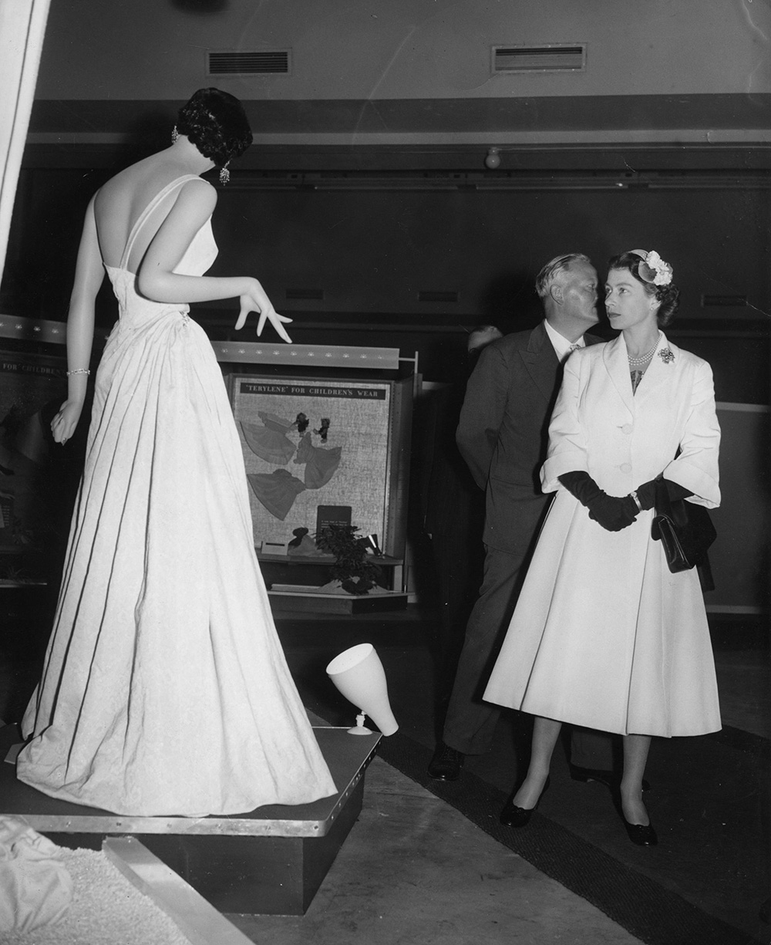
Notes:
A black and white image of the Queen looking at a model wearing a floor length, sleeveless, dress made from synthetic fibres. © Alamy - G4PPXT - 5 June 1956

Slide 59
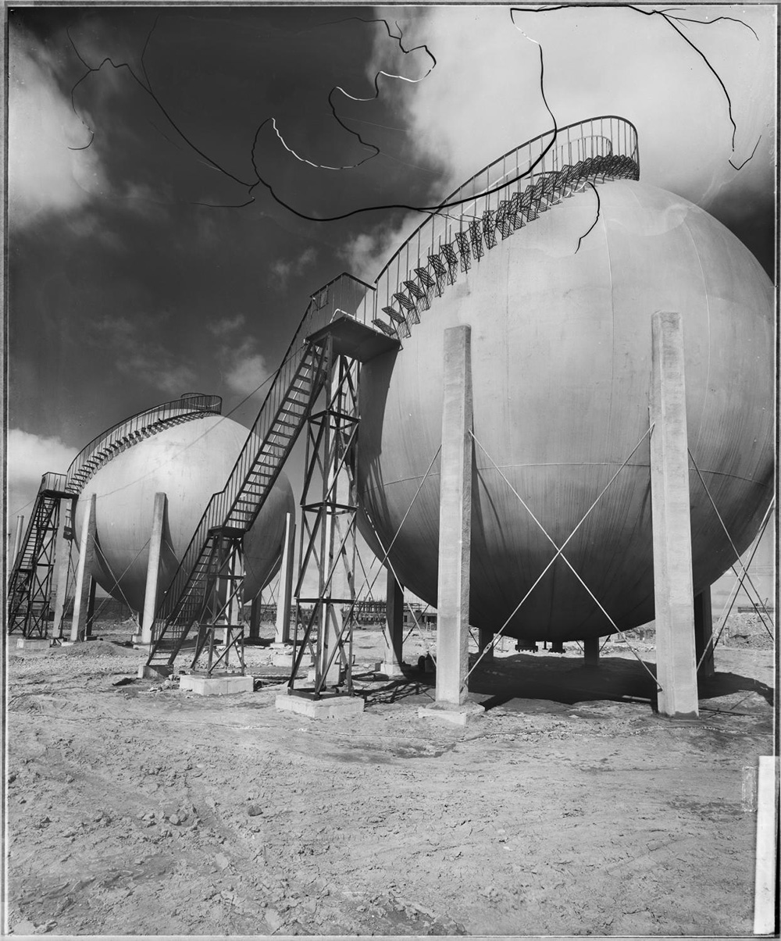
Notes:
A black and white image of massive concrete spheres, called 'Hortonspheres', at ICI's Wilton Works. Each sphere is supported on concrete posts or legs and has a spiral staircase twisting around its exterior to reach to the top of the sphere. (NB: The ‘swirly’ bits across the top of the image are caused by cracks in the original glass-plate negative on which the photo was taken) Source: Historic England Archive - BL39467 - 1 May 1950 - 6 May 1950

