Slide 1
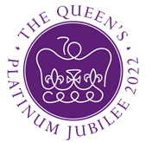
Queen Elizabeth II Platinum Jubilee
Story Map – East Midlands Region Images
Key Stage 2: History & Geography
Learning Aims and Outcomes
Pupils understand more about the role of the Queen by exploring the Story Map of some of her visits to different places across England
Pupils learn about the Queen’s visits to significant places/events in their region of the country through her 70-year reign
Pupils develop a sense of place through mapwork
Pupils can identify regions of England and locate places in the region they live in
Pupils take part in celebrating a significant historical event
This learning resource supports the Historic England Platinum Jubilee Story Map & Platinum Jubilee Activities PPT
Notes:
This resource is intended to be used with the Historic England Jubilee Story Map which documents some of the many places the Queen has visited throughout her reign. Pupils are able to explore the pins on the map of their region of the country to find out about the significant buildings and events the Queen has visited. The Story Map contains information about the visit, a brief history of the building and images of the Queen and the building.

Slide 2
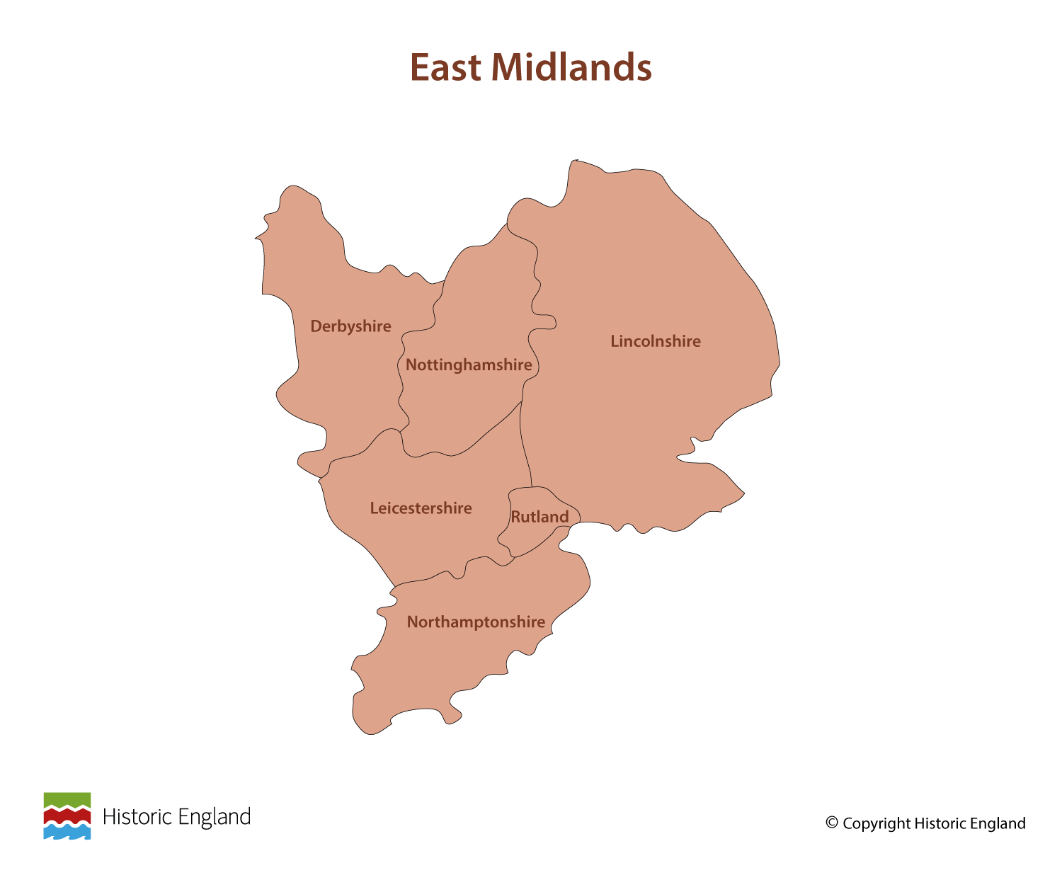
Notes:
Before following the link to your regional Story Map you may wish to discuss with pupils what counties are covered in your region.

Slide 3
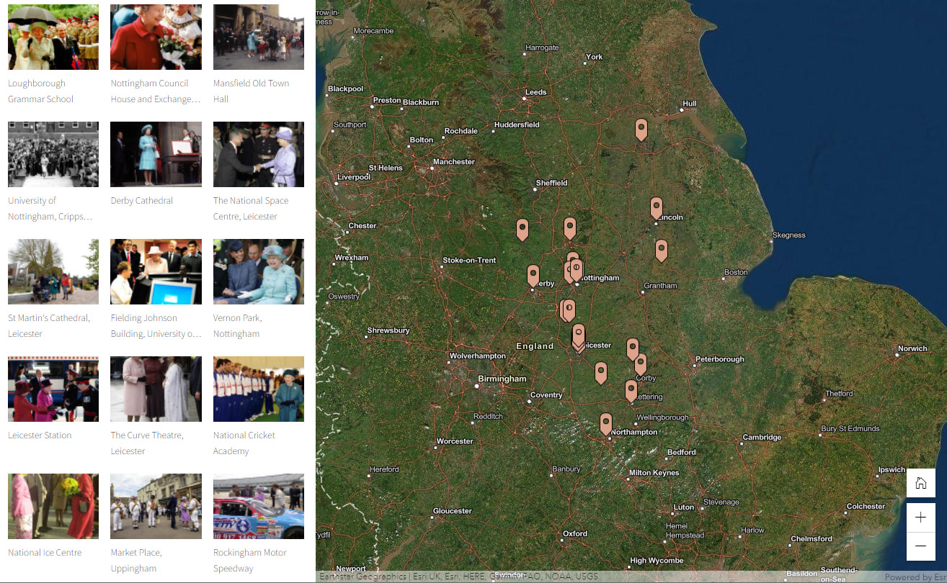
Notes:
Follow the link to the East Midlands Story Map https://storymaps.arcgis.com/stories/86a3a5067c2f4748b8826823c8f27bbc

Slide 4
Loughborough Grammar School
On 28 June 1996 the Queen officially opened a new English and Drama Centre at the school. It was built as part of its Quincentenary, which it celebrated in 1995.
Founded in 1495, by Thomas Burton, a prosperous wool merchant, Loughborough Grammar Schools is one of the oldest schools in the country.
It was originally founded in the Parish Church in the centre of Loughborough but moved to its present site in 1852. The buildings were Grade II listed in the 1980’s.
Find out more on the National Heritage List.

Slide 5
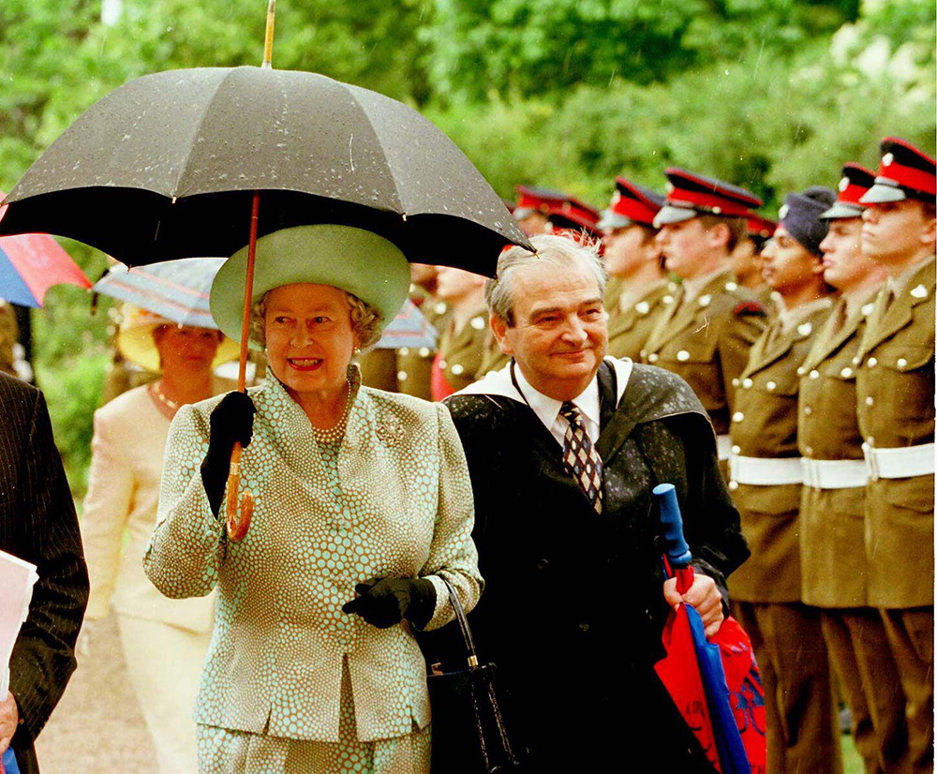
Notes:
The Queen holding an umbrella as she arrives with headmaster Neville Ireland at Loughborough Grammar School to help celebrate its quincentenary. © Alamy - 2D2X6YJ - 28 June 1996

Slide 6
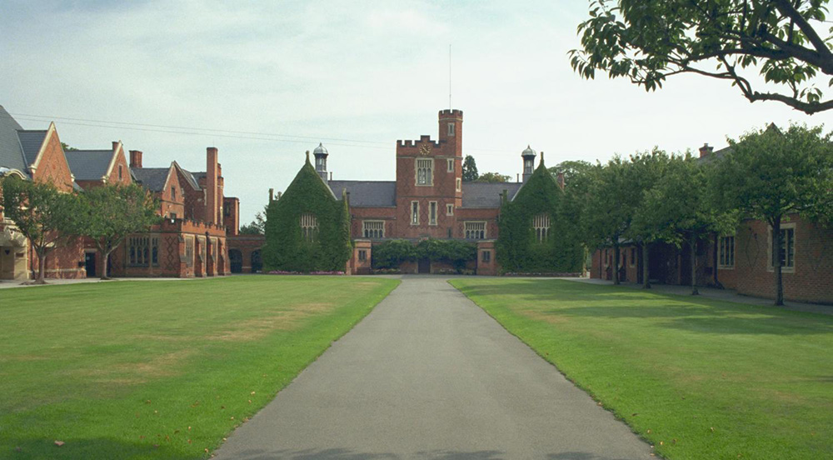
Notes:
A general view of the lawns, surrounded by some of the magnificent red brick buildings that make up the school. © Mr Brian R Vollar. Source: Historic England Archive - IOE01/02118/32- 29 Aug 1999

Slide 7
Nottingham Council House and Exchange Buildings
On 21 March 1997, the Queen visited the Council House Buildings to mark the granting of Nottingham’s ‘City Status’.
The building was designed in 1927, in the ‘Neo-Baroque’ style by the famous Nottingham architect T Cecil Howitt, who also designed many of the city’s famous buildings. The building also incorporated a shopping arcade and office accommodation.
It was officially opened in March 1929 by the Prince of Wales, who later became King Edward VIII.
Find out more on the National Heritage List.

Slide 8
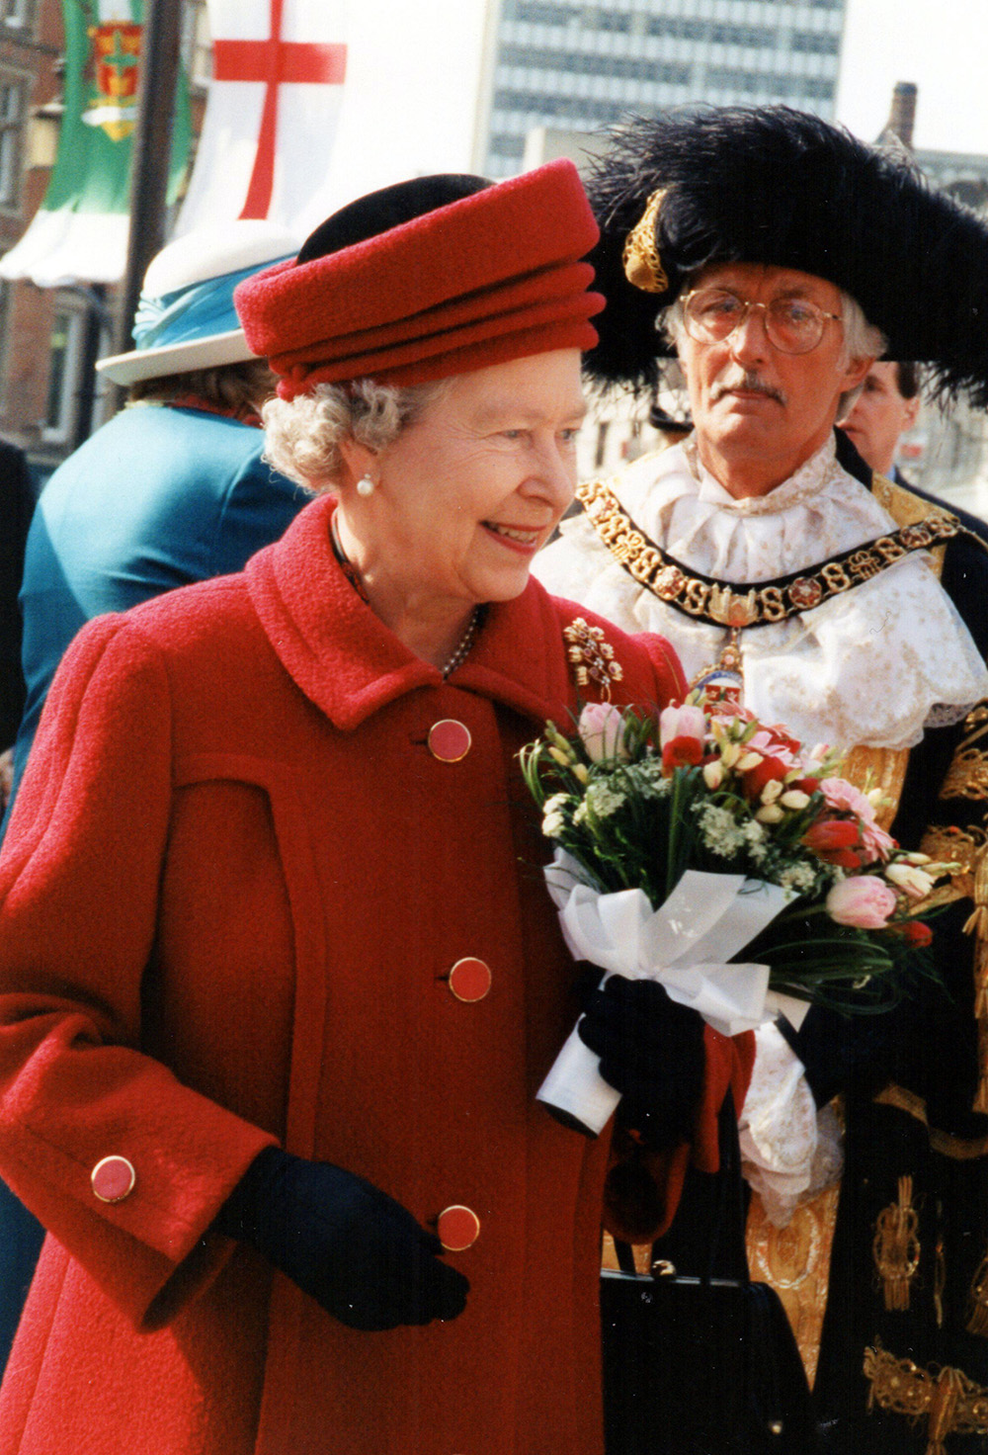
Notes:
The Queen smiles whilst holding a bunch of flowers, as the Mayor of Nottingham walks behind her. © Alamy - HW51K2 - 21 March 1997

Slide 9
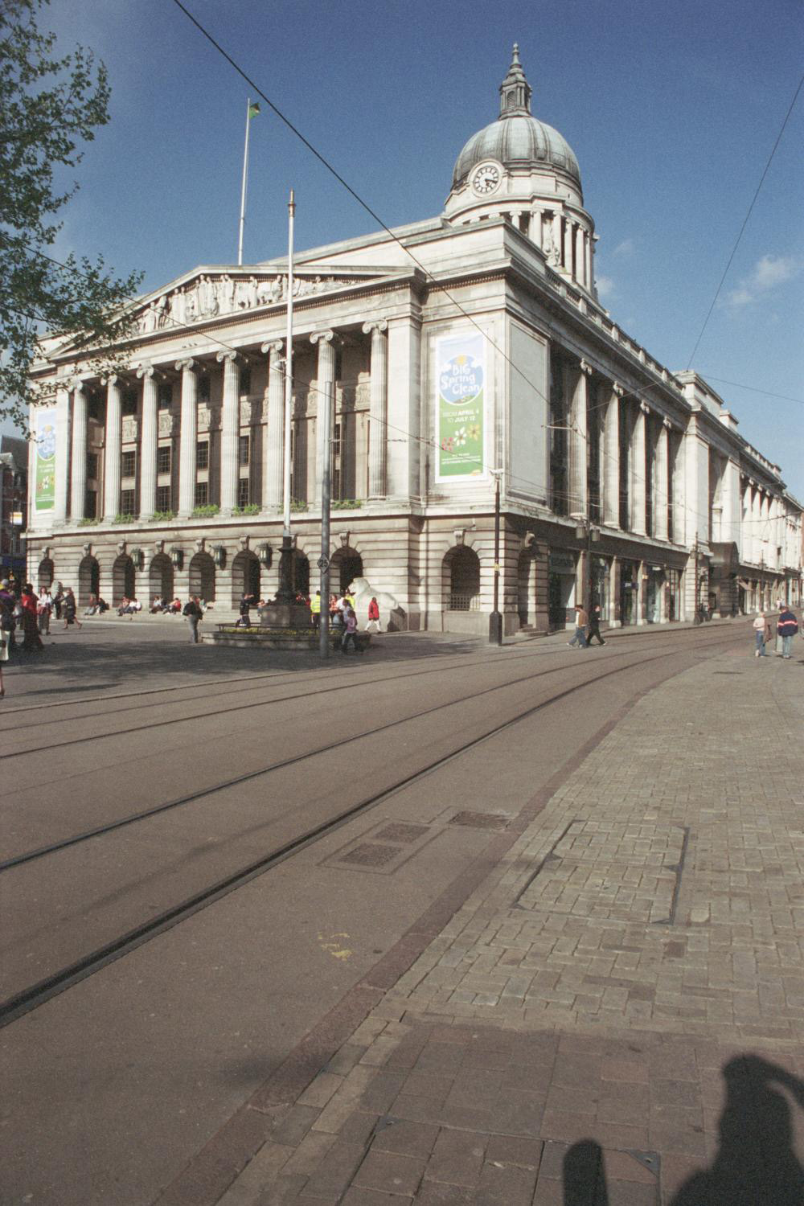
Notes:
A general view of the classically styled stone building which houses the Council House. © Mr Peter Holt. Source: Historic England Archive - IOE01/05003/26 - 4 May 2005

Slide 10
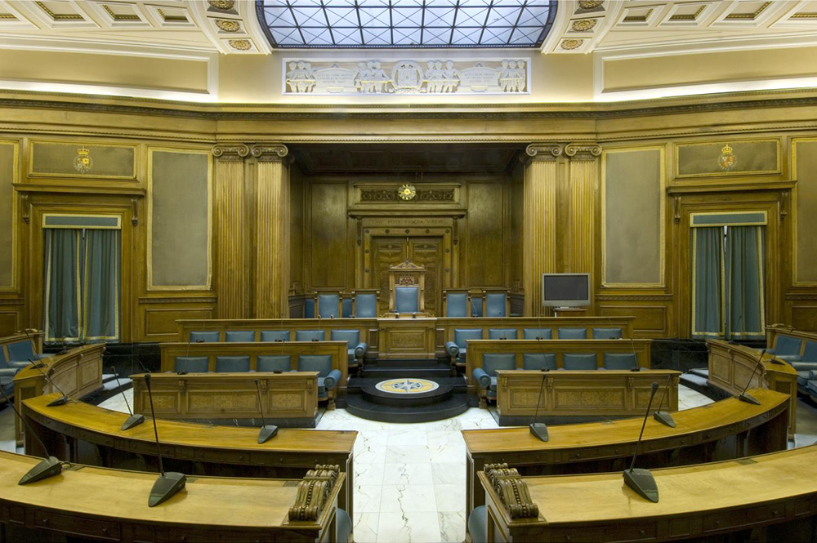
Notes:
Interior view showing the second floor council chamber of Council House, Nottingham. © Historic England Archive - DP046324 - 27 Sep 2007

Slide 11
Mansfield Old Town Hall
The Queen and Prince Philip went on a walkabout along West Gate, stopping outside the Old Town Hall, on the occasion of her Silver Jubilee on 28 July 1977. Later she officially opened the new Mansfield Library.
The Old Town Hall was completed in 1836 and replaced the old Moot Hall. The building was visited by George V and Queen Mary in 1914 and again in 1928.
With the development of coal mining in the early 20 th Century the town grew and the Town Hall became the headquarters of the new Borough Council. It was requisitioned in the Second World War by the War Office and became the seat to the District Council in 1974.
Find out more on the National Heritage List.

Slide 12
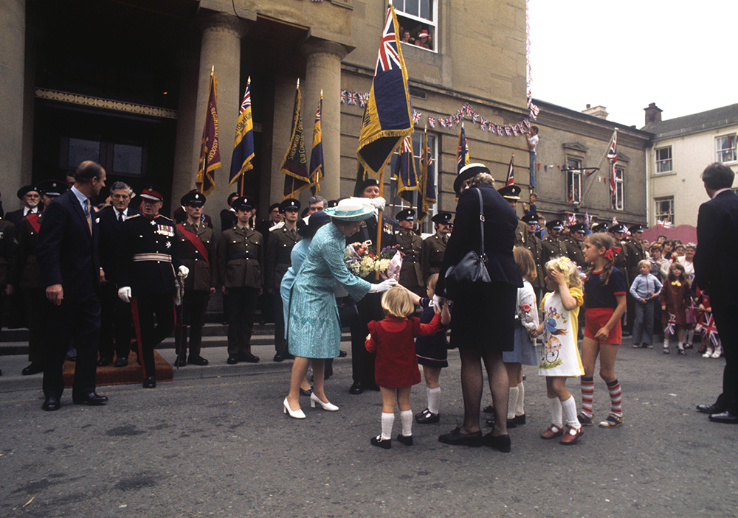
Notes:
A policewoman shepherds young children as they present posies to the Queen a walkabout in Mansfield. © Alamy - G80X9E - 28 July 1977

Slide 13
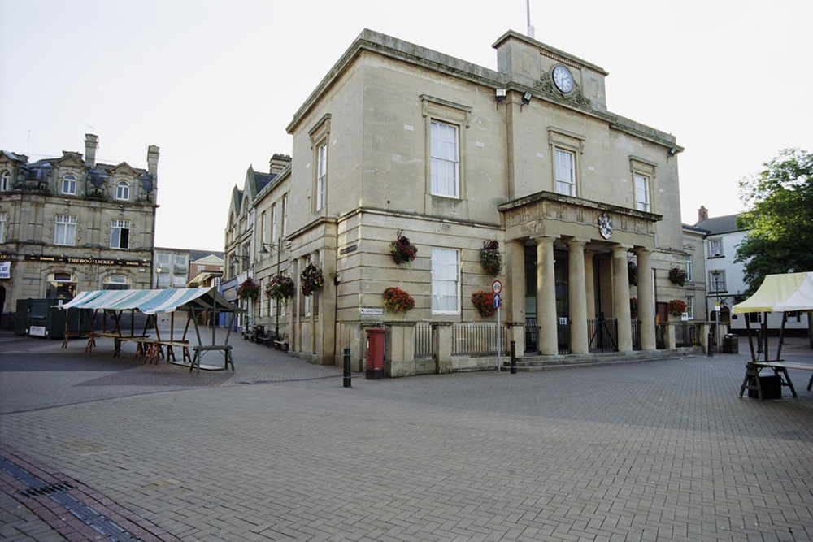
Notes:
A general view of the classically styled, stone built, Town Hall. © Mr Derek E. Wharton. Source: Historic England Archive - IOE01/12593/25 - 1 Sep 2004

Slide 14
University of Nottingham, Cripps Hall
The Queen originally visited the University Park Campus in July 1977. She visited the university again on 5 June 1981 to unveil a plaque to commemorate the foundation of University College and returned in 1999 to open the University Jubilee Campus.
The Cripps Hall of residence was built between1957-59. It was designed by Farquaharson, McMorran & Whitby and endowed by Cyril Thomas Cripps. Sir Cyril Thomas Cripps (1892-1979), established the family firm, Pianoforte Supplies Limited, in 1919. The firm made metal components for pianos, and subsequently grew into a major supplier of metal fittings for other trades, especially the motor industry.
The Cripps family established the Cripps Foundation in 1956. The charity has made many large gifts to universities, colleges, schools, churches, hospitals and museums, including the University of Nottingham.
Find out more on the National Heritage List.

Slide 15
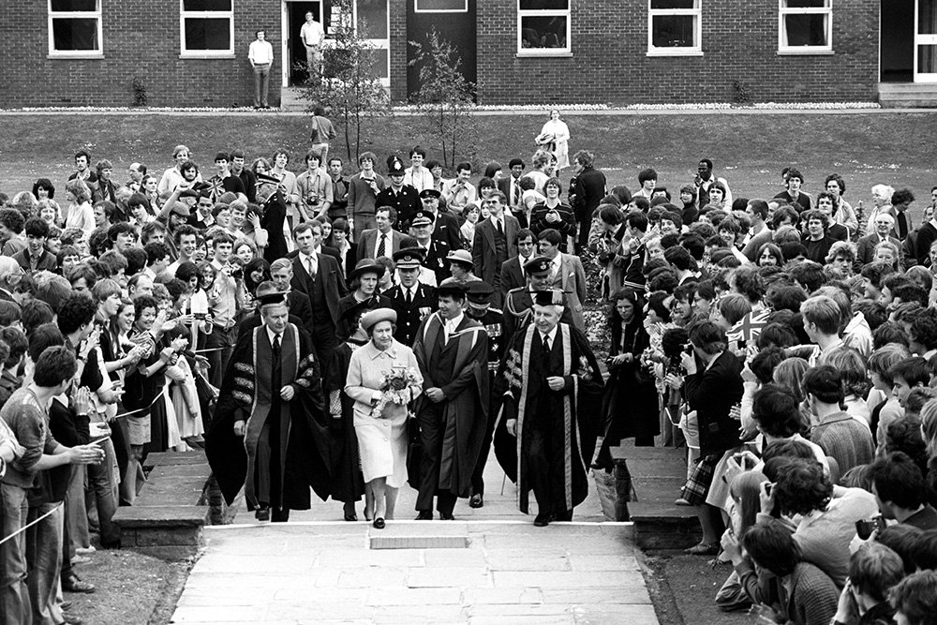
Notes:
A black and white image of the Queen walking with dignitaries through a crowd of students within the grounds of the university. © Alamy - G7EDPD - 5 June 1981

Slide 16
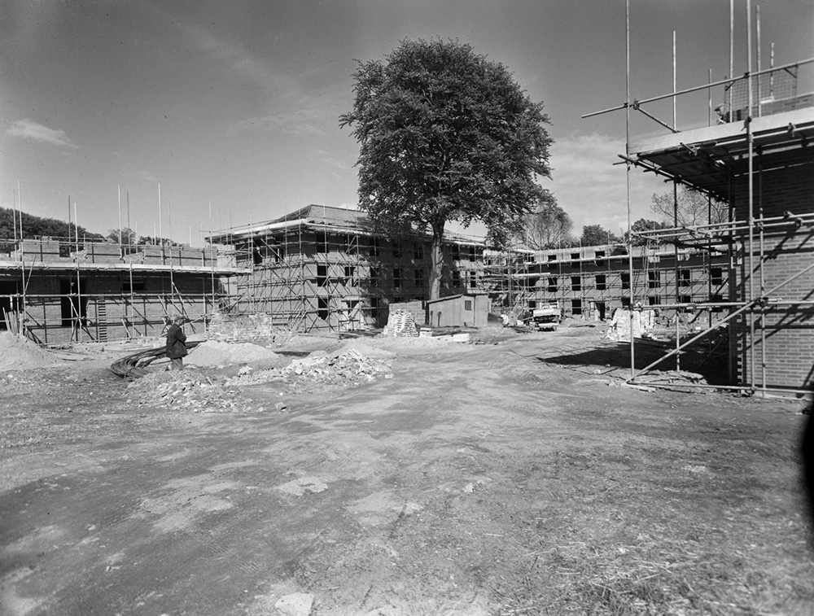
Notes:
A black and white view of Cripps Hall under construction at the University of Nottingham. © Historic England Archive.John Laing Photographic Collection - JLP01/08/051694 - 21 May 1958

Slide 17
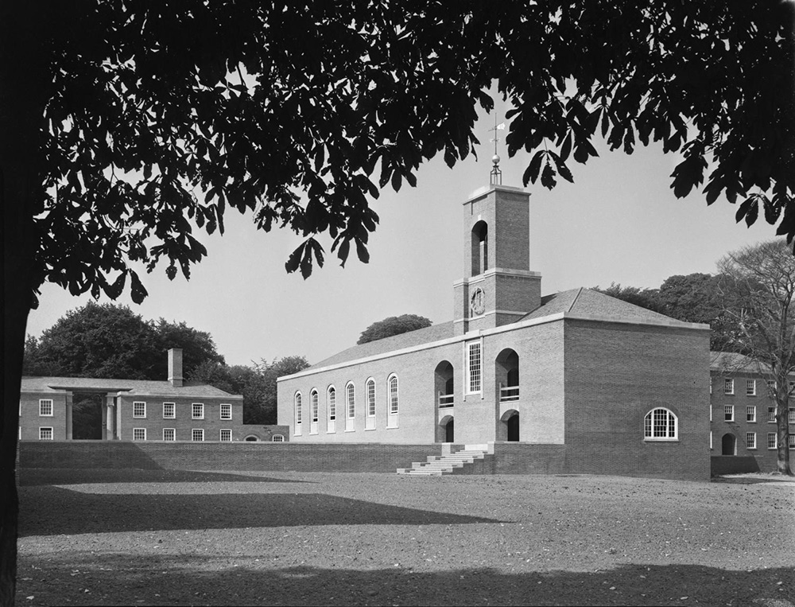
Notes:
A black and white view from the south of Cripps Hall at the University of Nottingham. © Historic England Archive.John Laing Photographic Collection - JLP01/08/055358 - 11 Sep 1959

Slide 18
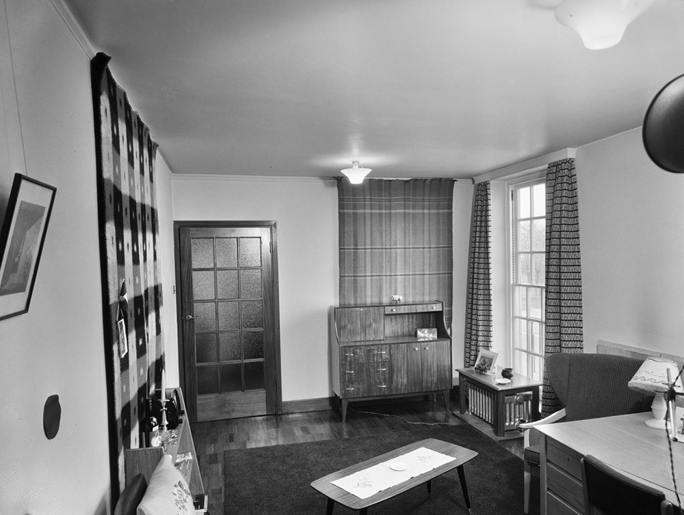
Notes:
A black and white view of the inside of a furnished study in Cripps Hall at the University of Nottingham. © Historic England Archive.John Laing Photographic Collection - JLP01/08/056656 - Jan 1960

Slide 19
Derby Cathedral
The Queen visited Derby on 28 July 1977 during her Silver Jubilee Tour and presented Letters of Patent to Derby and the town became a city. She first visited Derby in 1949, when she was still a princess.
The Church of All Saints was founded in 943 and became a Cathedral in 1927. The tower was built early in the sixteenth century, although the body of the church is Georgian and was designed by James Gibbs in 1725.
The Cathedral has many interesting features: a tomb to Bess of Hardwick, a memorial to Florence Nightingale, a wrought iron screen by Robert Bakewell and the oldest ring of ten bells in the world, which ring as a carillion 3 times a day and has seven different tunes.
Find out more on the National Heritage List.

Slide 20
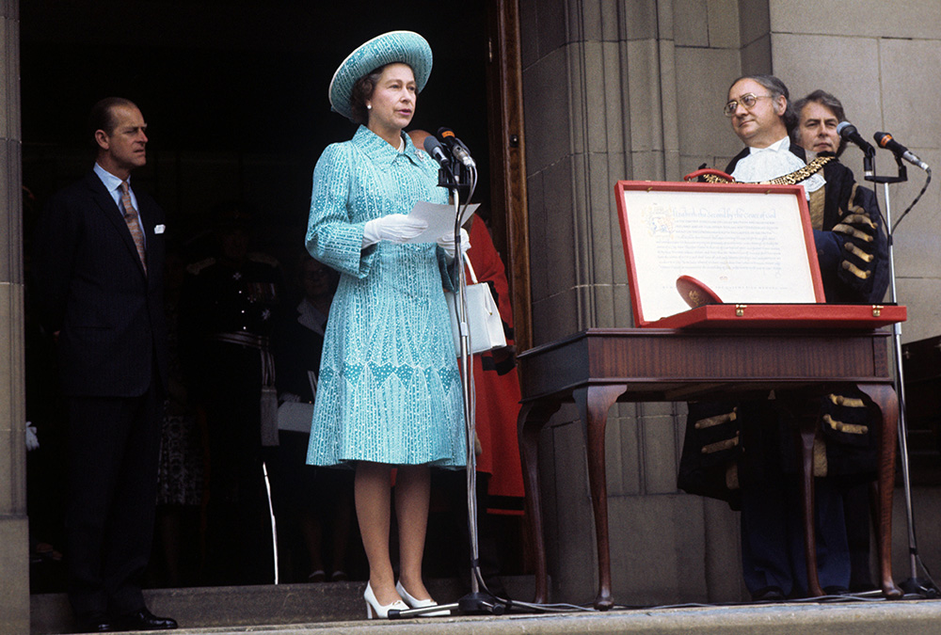
Notes:
The Queen stands in front of a microphone holding a piece of paper, with Prince Philip and other dignitaries in the background. © Alamy - G4HWH3 - 28 July 1977

Slide 21
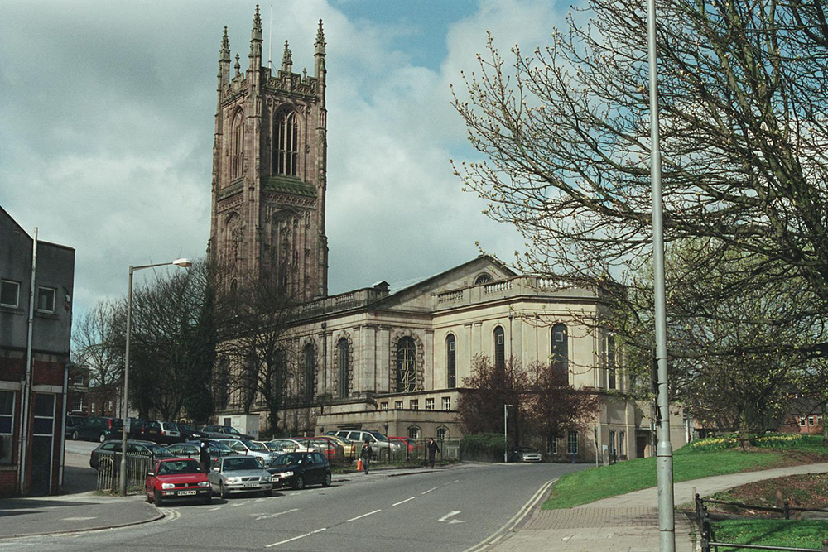
Notes:
A general view of the cathedral, with cars parked on the street in the foreground. © Mrs Gay Evans. Source:Historic England Archive - IOE01/11934/25 - 4 Apr 2004

Slide 22
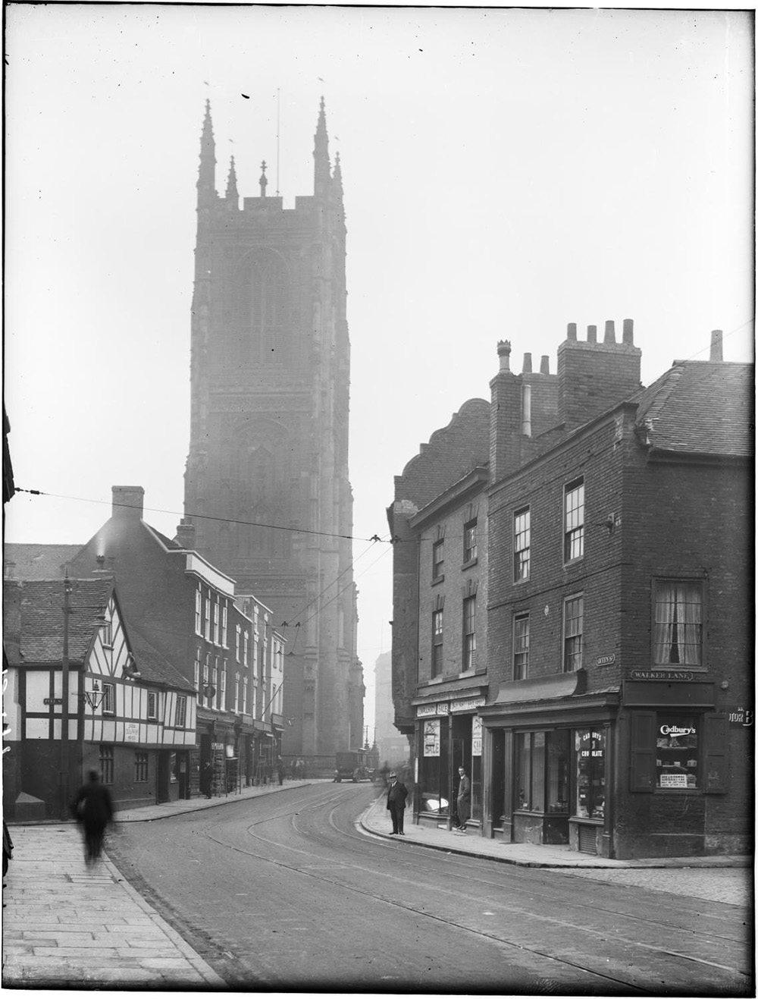
Notes:
A black and white view of Queen Street, looking south from the junction with Walker Lane towards the tower of All Saints Church (later Derby Cathedral). Source: Historic EnglandArchive - CC78/00062 - 6 Oct 1924

Slide 23
The National Space Centre, Leicester
The Queen visited the newly opened National Space Centre during her Golden Jubilee year on 1 August 2002.
The building has a semi-transparent cladding and is the only place to house upright space rockets indoors. The tower part of it is shaped like a 'rocket', and the flat roof of the other building is decorated to look like the 'swirl' of a galaxy.
As well as the Queen, the building has hosted many important visitors including the astronauts Buzz Aldrin and Tim Peake. The National Space Centre also hosts a space research project with the University of Leicester Space Research Centre.
Find out more about the Space Centre.

Slide 24
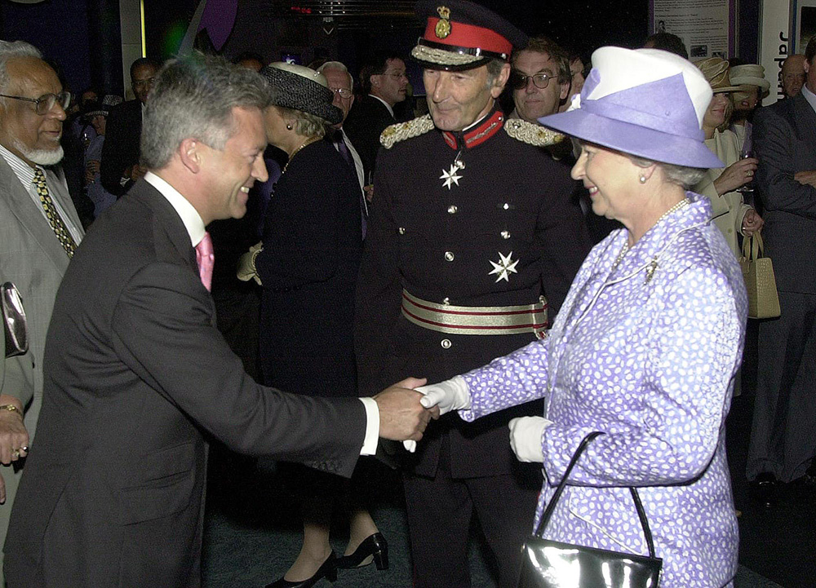
Notes:
The Queen shakes hands with Alan Duncan, the Conservative MP for Rutland and Melton, as she toured the new National Space Centre. © Alamy - G60EPM- 1 August 2002

Slide 25
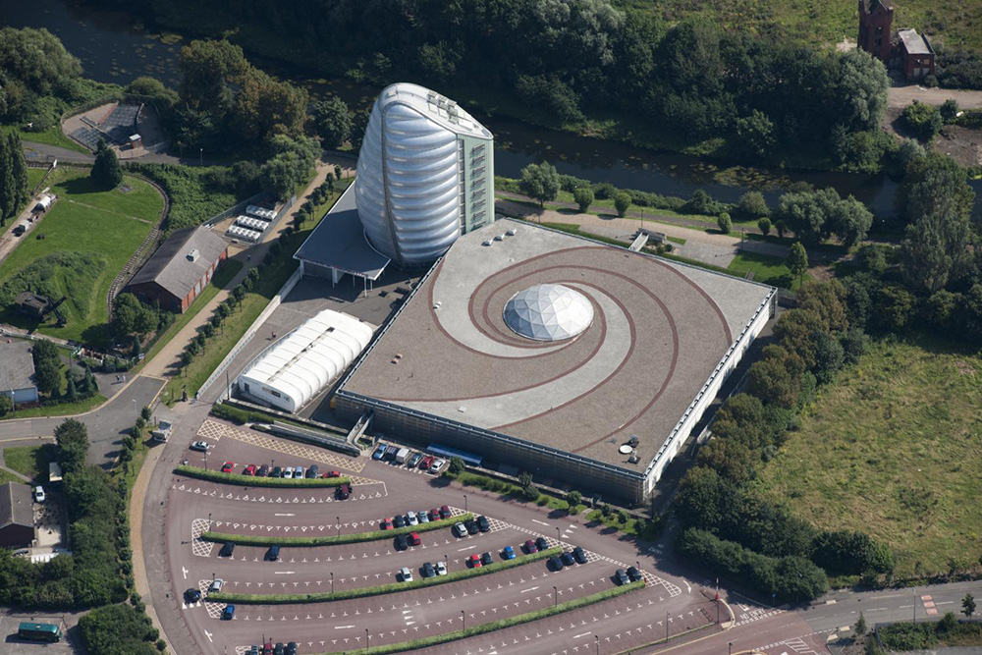
Notes:
An aerial view of the space centre, showing how the tower part of it is shaped like a 'rocket', and the flat roof of the other building is decorated to look like the 'swirl' of a galaxy. © Historic England Archive - 27591_024 – 3 September 2012

Slide 26
St Martin's Cathedral, Leicester
The Queen, accompanied by Prince Philip, visited Leicester Cathedral for the annual Royal Maundy Service on 13 April 2017, during which she gave Maundy Money to 91 men and 91 women – one for each of The Queen's 91 years of age.
The cathedral was originally the Parish Church of St Martin’s and is thought to be on the site of a Roman temple. It was originally built by the Saxons in the twelfth century and rebuilt and enlarged through the thirteen the fifteenth century. During this time, it was a ‘civic church’ popular with guilds and merchants and is adjacent to Leicester Guild Hall.
It was substantially rebuilt by the Victorian architect Raphael Brandon. The church officially became a Leicester Cathedral in 1929 when Leicester achieved city status.
Find out more on the National Heritage List.

Slide 27
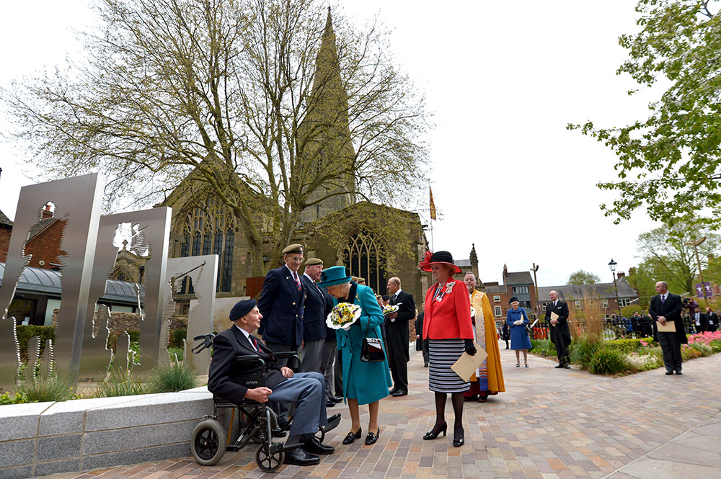
Notes:
The Queen meeting a line of former servicemen, one of which is in a wheelchair, other dignitaries and members of the clergy can be seen in the background. © Alamy – J0JPNG - 13 April 2017

Slide 28
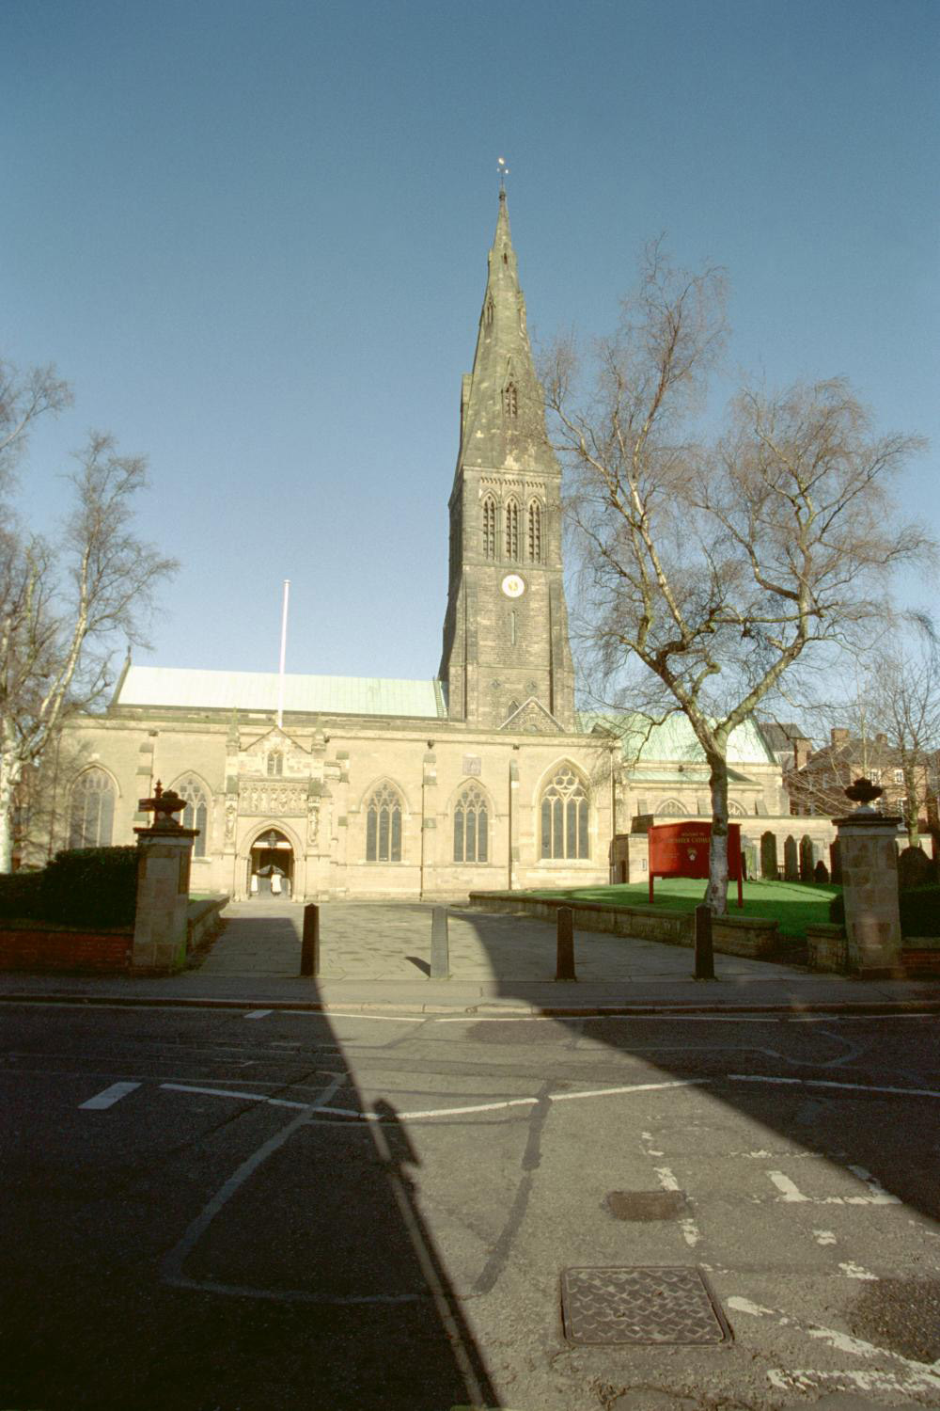
Notes:
A view of the cathedral, with its impressive spire, looking from the south. © Mr Brian Arnold. Source: Historic England Archive - IOE01/05245/13 - 30 Jun 2001

Slide 29
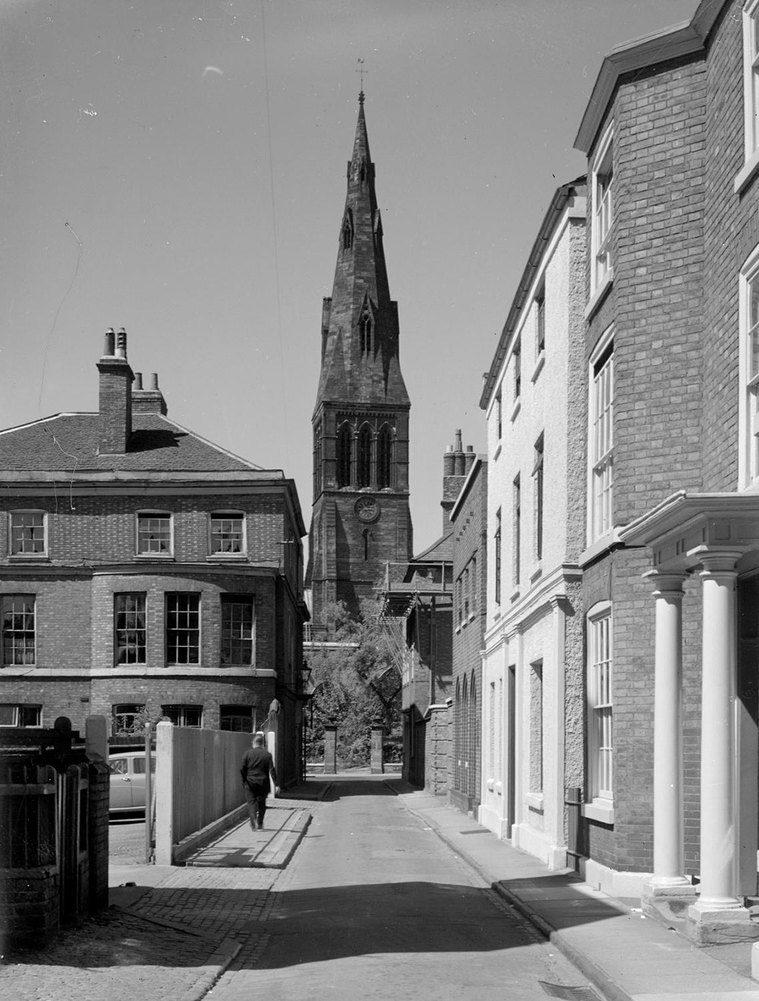
Notes:
A black and white view of St Martin's Cathedral in Leicester, seen looking up along the buildings on either side of New Street. © Historic England Archive - AA58/01768 – 1957

Slide 30
Fielding Johnson Building, University of Leicester
The Queen originally visited the University of Leicester in 1958, a year after the University received the Royal Charter. On 4 December 2008 the Queen, accompanied by Prince Philip, returned to open the David Wilson Building, which adjoins the earlier Fielding Johnson Building.
The Fielding Johnson Building, built in 1837, was originally the Leicestershire County Lunatic Asylum, the first public provision of care for pauper ‘lunatics’ (an all-encompassing term used at the time for many mentally and physically debilitating illnesses).
The University was founded as Leicester, Leicestershire and Rutland University College in 1921. The site was donated by a local businessman, Thomas Fielding Johnson, in order to create a living memorial for all local people who made sacrifices during the First World War. This is reflected in the University's motto Ut vitam habeant – 'so that they may have life’.
Find out more on the National Heritage List.

Slide 31
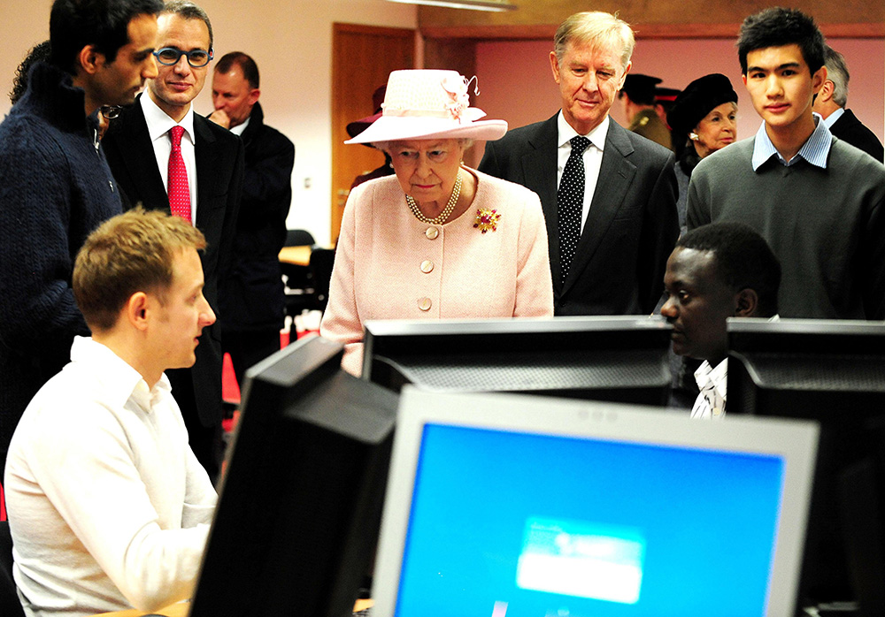
Notes:
The Queen stands amongst a group of people from the university, two of whom are sat in front of a large number of computer screens. © Alamy - GBAM1J - 4 December 2008

Slide 32
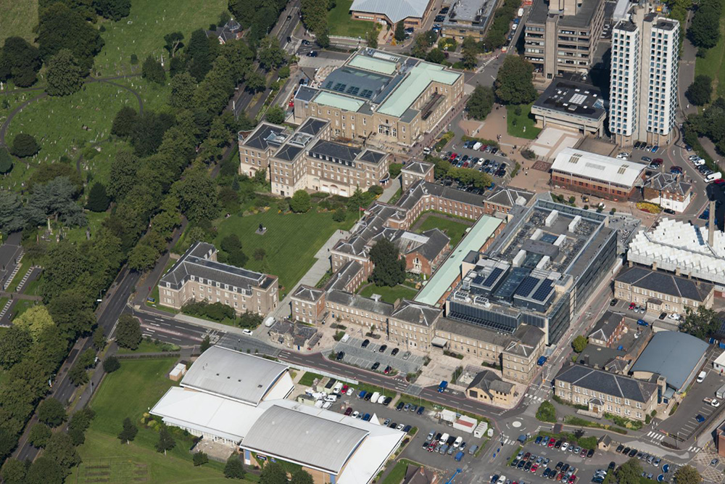
Notes:
An aerial view showing the mix of historic Victorian buildings and more modern structures, including the Fielding Johnson Building. © Historic England Archive - 27590_024 – 3 September 2012

Slide 33
Vernon Park, Nottingham
The Queen and the Duchess of Cambridge visited Vernon Park to see a children’s sports day during a Diamond Jubilee visit on 13 June 2012.
The park was originally in the grounds of Vernon House owned by Charles Cox, a local industrialist. In 1901 he sold the house and parkland to the Corporation of Nottingham, who open the whole estate as a public recreation ground. In 194 it was requisitioned by the War Department for defence purposes.
The park was awarded Fields in Trust status. The Queen Elizabeth Fields in Trust Charity exists to protect parks and green places for local communities. The charity was founded by the Duke of York, later King George VI, in 1925, who became the first President. This royal link continues today with Her Majesty the Queen as Patron since 1952.
Find out more about Vernon Park.

Slide 34
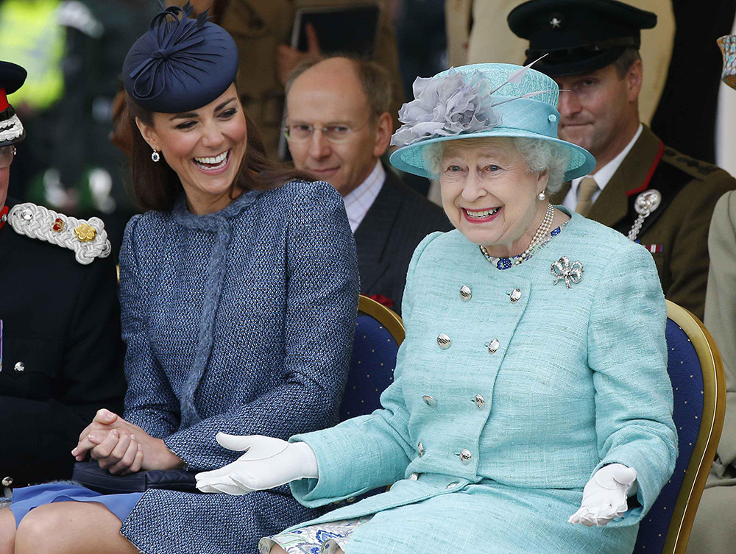
Notes:
The Queen sits smiling, with her arms outstretched, as the Duchess of Cambridge sits next to her laughing. © Alamy - G5787A - 13 June 2012

Slide 35
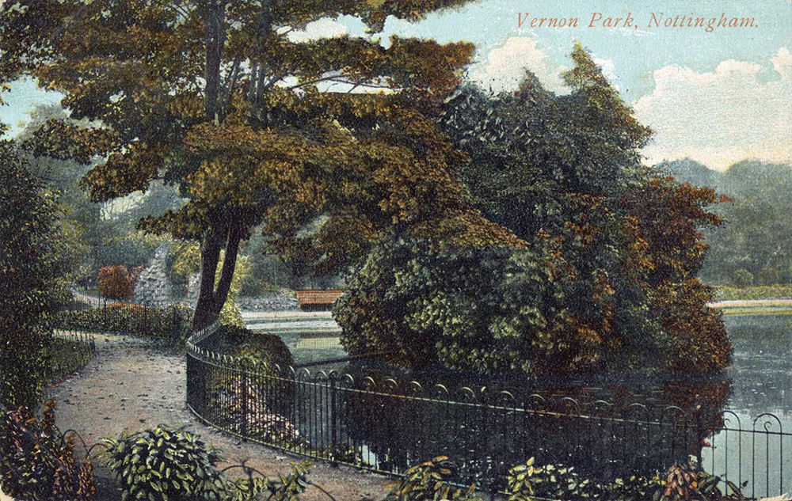
Notes:
A hand coloured photo showing the tress and edge of the lake in the park. Source: Historic England Archive - PC06873 - 1901 - 1906

Slide 36
Leicester Station
The Queen, Prince Philip and the Duchess of Cambridge arrived at Leicester station for a visit to the city as part of the Diamond Jubilee Tour on 8 March 2012.
The present Leicester Station was opened in 1892 and completed in 1895. It was designed by the architect Charles Trubshaw. An earlier Midland Railway was first used on 4 May 1840, when a train of four first and six second-class carriages, pulled by the Leopard steam engine, arrived from Nottingham.
Leicester was one of the first cities to be served by a railway, when the Leicester and Swannington Railway built its terminus station at West Bridge on the western side of Leicester in 1832. The Leicester and Swannington Railway was later absorbed by the Midland Railway. Between 185 and 1950 Leicester had seven railway stations, the current Leicester Station is the only one still in use.
Find out more on the National Heritage List.

Slide 37
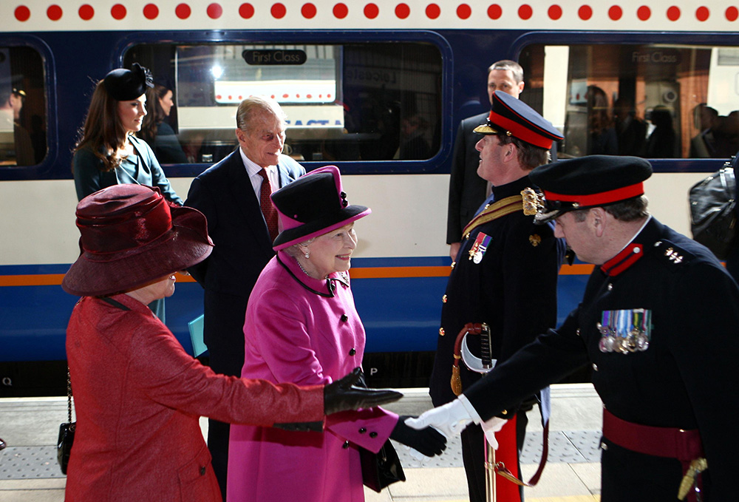
Notes:
The Queen, Prince Philip and the Duchess of Cambridge arrive at Leicester station for a visit to the city as part of the Diamond Jubilee Tour. The Queen is shaking hands with a man in military uniform. © Alamy - G51C0G - 8 March 2012

Slide 38
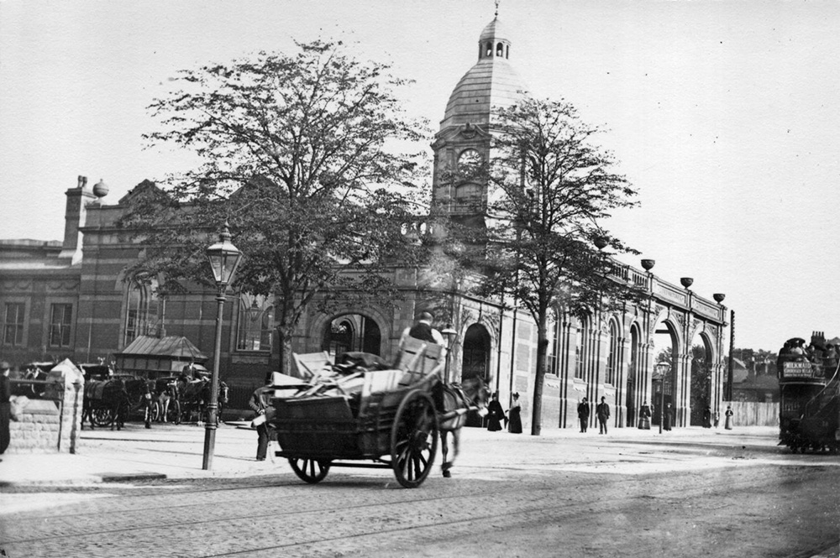
Notes:
A black and white view from the north-west of London Road Station, showing the building partly completed, with a man driving a horse and cart in the foreground. Source: Historic England Archive - OP23154 – 1892

Slide 39
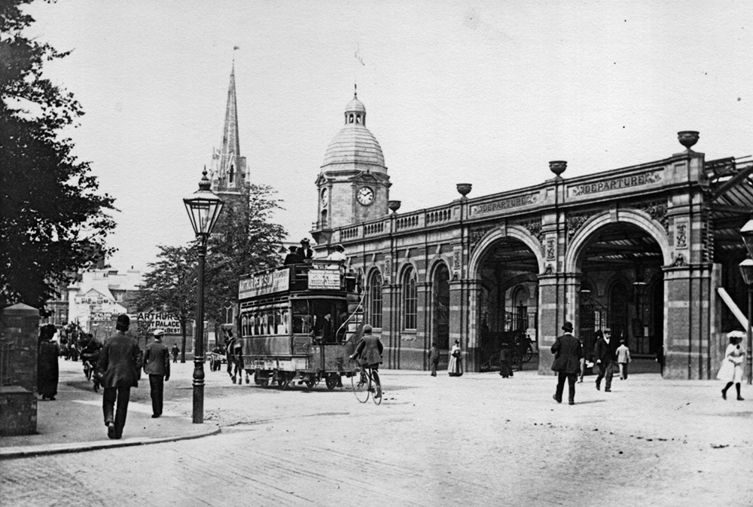
Notes:
A black and white view from the south of London Road Station, showing the building partly completed, with a horse-drawn omnibus passing in the street. Source: Historic England Archive - OP23155 - 1892

Slide 40
The Curve Theatre, Leicester
The Queen and Prince Philip officially opened the Curve theatre during a visit to Leicester on 4 December 2008. She met the Mayor of Leicester Manjula Sood during a visit to the city's new Curve theatre.
The project started in 2005 and in 2008 it won the RIBA award for its innovative design. A cornerstone for regeneration of the St George’s Conservation area, in the heart of Leicester’s Cultural Quarter, the £61 million project contains an auditorium with up to 800 seats and a studio which seats up to 400.
Find out more about The Curve.

Slide 41
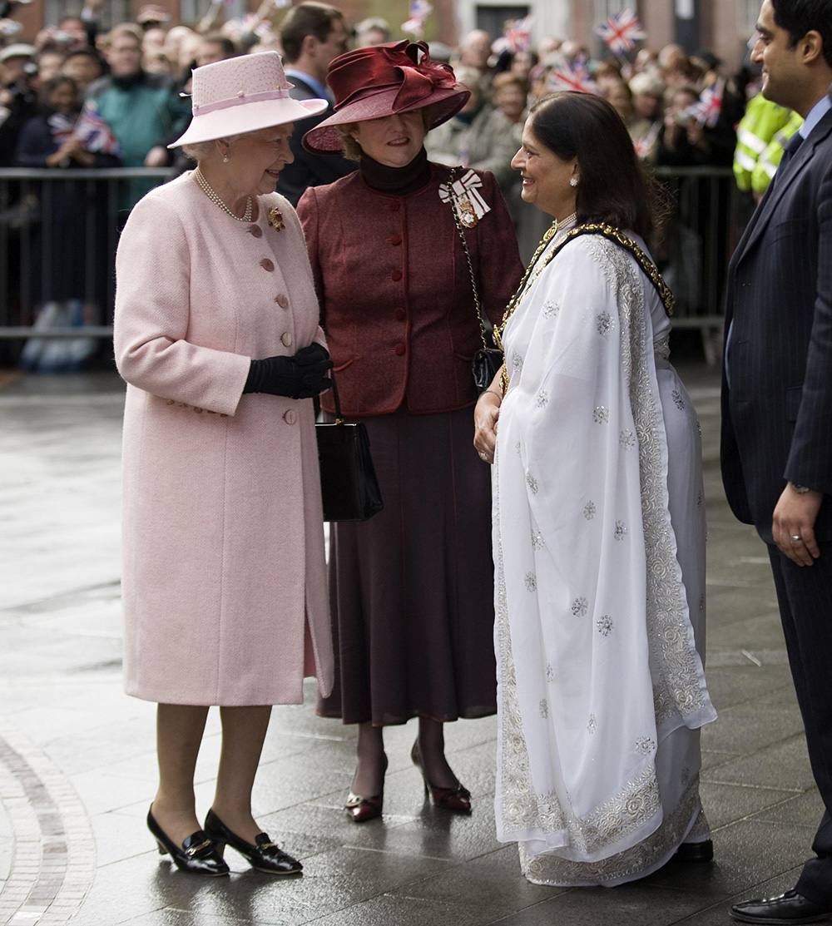
Notes:
The Queen and other dignitaries, including the Mayor of Leicester Manjula Sood, meet outside The Curve Theatre. © Alamy - GBAM8X - 4 December 2008

Slide 42
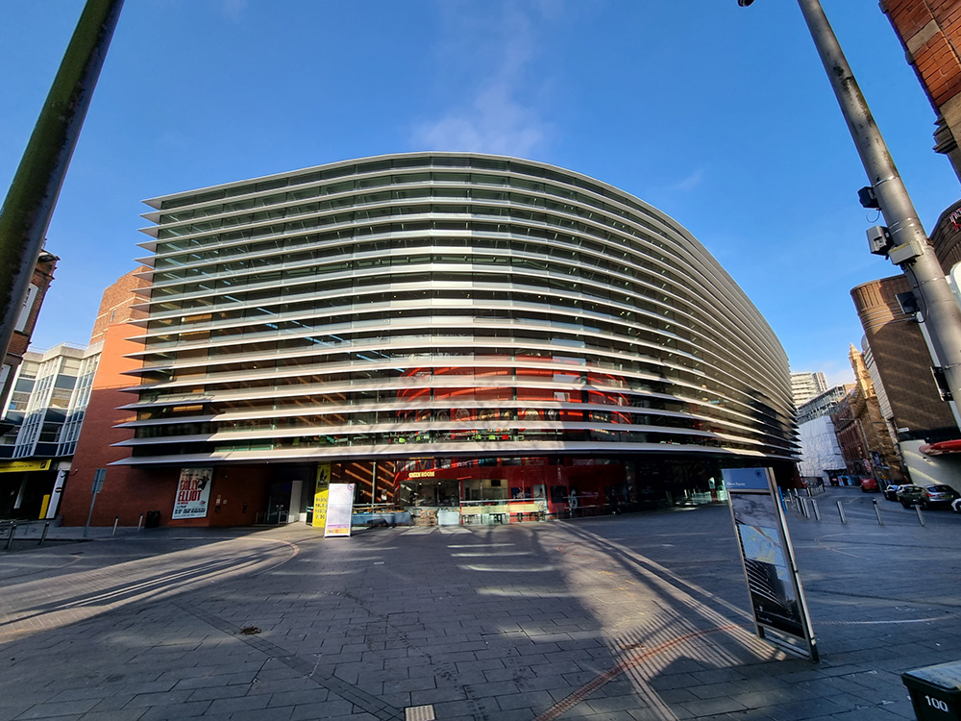
Notes:
A view of the strikingly designed Curve Theatre. Ismail Dale, Historic England - 11 ‎February ‎2022

Slide 43
National Cricket Academy
The Queen visited the English Cricket Board national Cricket Academy at the University of Loughborough on 14 November 2003.
The National Cricket Performance Centre first came into existence in the winter of 2001–200 and has been based at Loughborough University since 2003. It consists of a state of the art £4.5 million indoor training complex.
Facilities include lanes enabling full runups for fast bowlers and wicket-keepers stood back, Hawk-Eye cameras and advanced biomechanics analysis equipment. In addition to the indoor complex the academy also provides top class outdoor training facilities.
Find out more about the English Cricket Board.

Slide 44
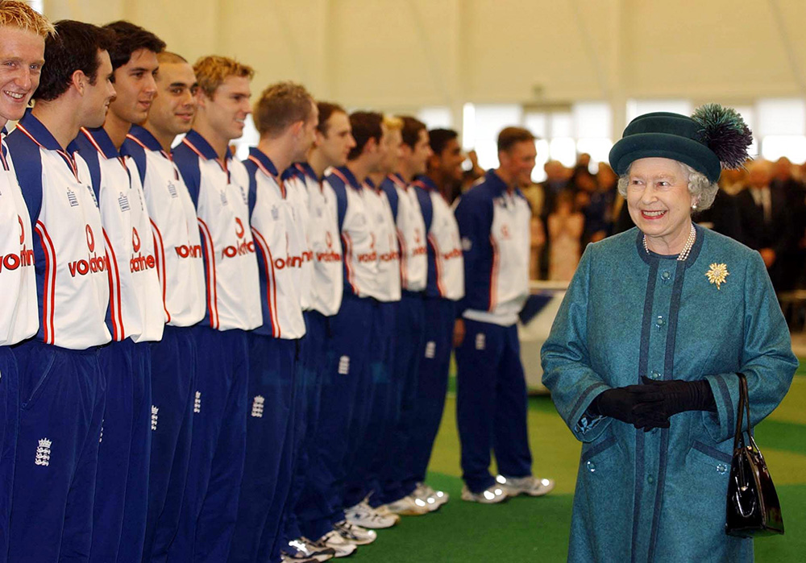
Notes:
The Queen smiles as she walks past a line of young men dressed in their blue and white cricket kit. © Alamy - G6JN94 - 14 November 2003

Slide 45
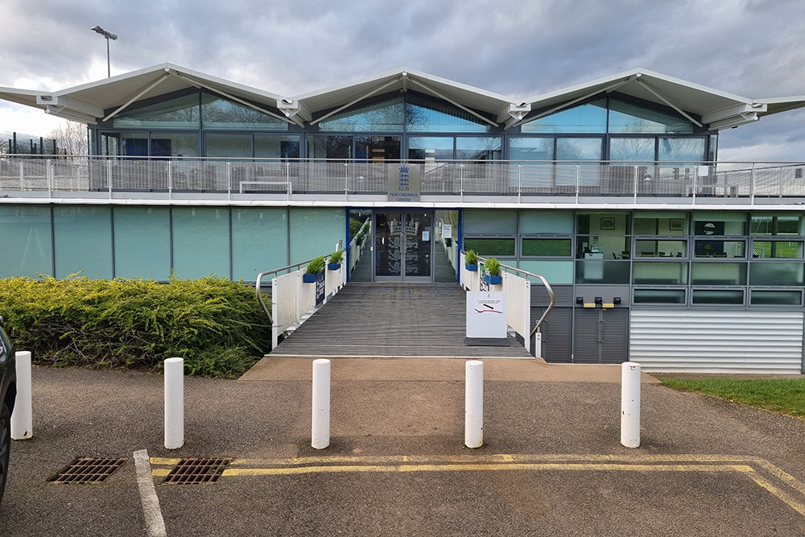
Notes:
A view looking up the steps to the entrance to the modern Sir John Ferguson Building. Ismail Dale, Historic England - 15 ‎February ‎2022

Slide 46
National Ice Centre
The Queen visited the National Ice Centre during her Golden Jubilee Tour on 31 July 2002 and met Olympic Gold Medallists Christopher Dean and Jayne Torville.
The National Ice Centre was constructed on the site of the former Nottingham Ice Stadium, which opened in 1939, situated close to the Lace Market. It was the first Olympic sized ice-rink in the UK.
During excavation for the new building in July 1998, a rare 1,100-year-old Saxon jug was found, which is on display at the Nottingham Castle Museum. A 19th-century graveyard was also found under the car park, from which the bodies were then exhumed. The NIC was opened in April 2001 by Jayne Torville.
Find out more about the NIC.

Slide 47
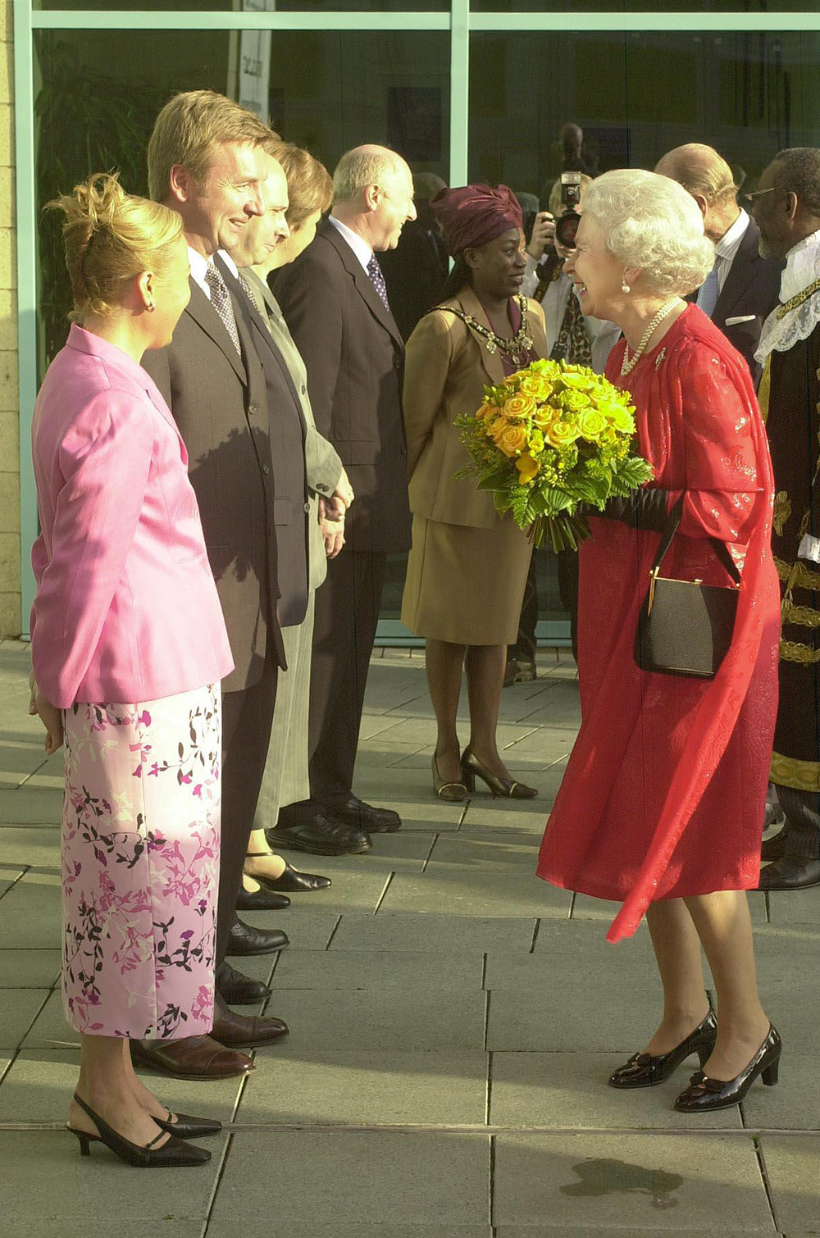
Notes:
The Queen, holding a bouquet of flowers, talks to Olympic Gold Medallists Jayne Torville and Christopher Dean. © Alamy - G60EEN - 31 July 2002

Slide 48
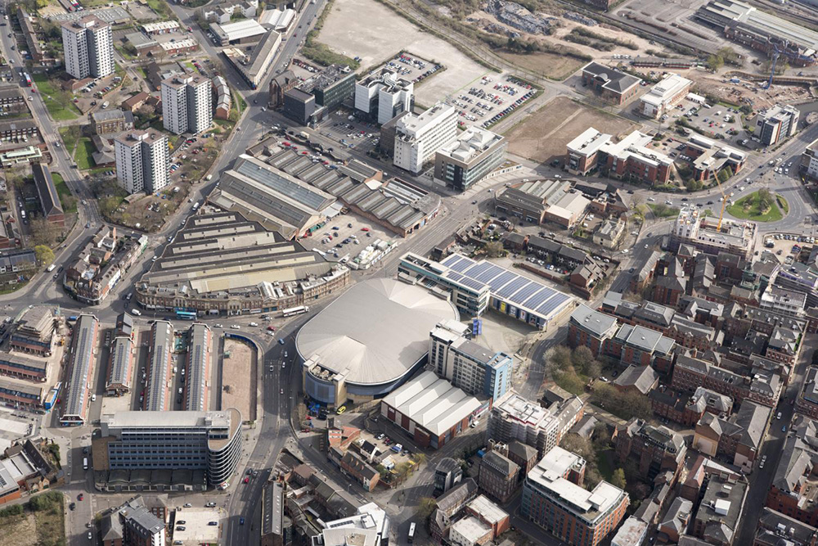
Notes:
An aerial view showing the Ice Centre in the heart of Nottingham City centre. © Historic England Archive - 35013_021 - 31 March 2021.

Slide 49
Market Place, Uppingham
The Queen met members of the Rutland Morris men, wearing their white costumes with colourful bells and sashes, after they’d danced ‘The Queens Delight’ in Uppingham Market Place on 28 June 2001.
Uppingham gained its Market Charter in 1281 and there has been one held here ever since, though it’s likely a market had existed long before it received the official charter.
In the centre of the Market Place is the Grade II listed Queen Victoria Jubilee Fountain. It has the inscription "This monument is erected by the inhabitants of Uppingham in loving and loyal commemoration of the fiftieth year of the reign of Her Most Gracious Majesty Victoria June 1887 Long Live the Queen.“
Find out more on the National Heritage List.

Slide 50
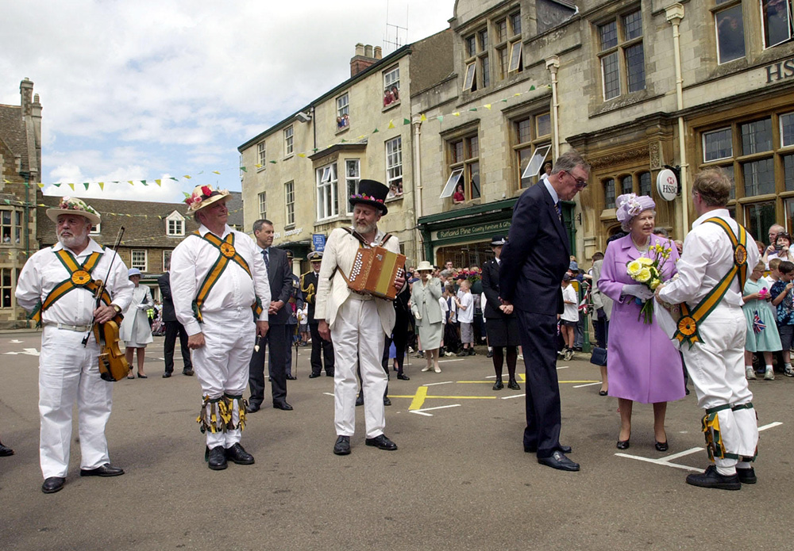
Notes:
The Queen stands in a market place meeting members of the Rutland Morris men, wearing their white costumes with colourful bells and sashes. © Alamy - G5E738 - 28 June 2001

Slide 51
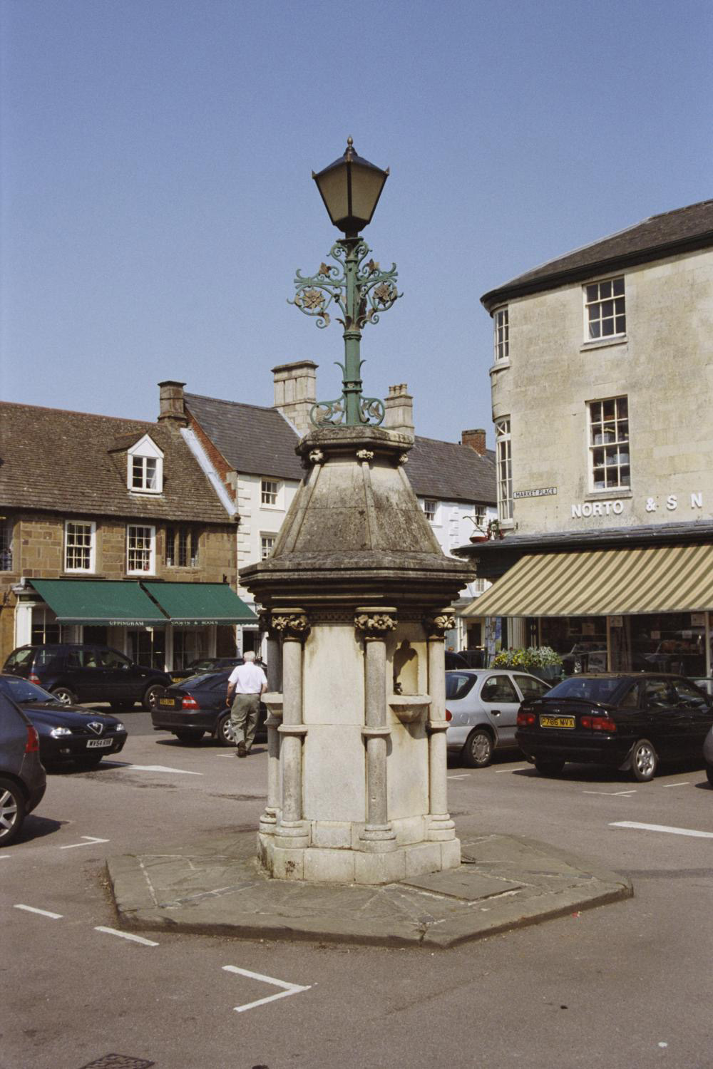
Notes:
A view of the beautiful Victorian drinking fountain, which has a lamp on top, that sits in the centre of the Market Place. © Mr Peter J Ellis. Source: Historic England Archive - IOE01/15325/12 - 10 May 2006

Slide 52
Rockingham Motor Speedway
The Queen looked at a NASCAR racing car during a visit to Rockingham Speedway on 23 June 2005.
The circuit was one of only two American style banked oval tracks in Europe. It was built on the site of a disused quarry from the former British Steelworks.
The steelworks in Corby expanded from the 1930s onwards, with the construction of the Stewarts and Lloyd’s. At one time the towns steelworks were the largest in Europe and dominated the industry of Corby until their closure in the 1970s.
Find out more about Rockingham Motor Speedway.

Slide 53
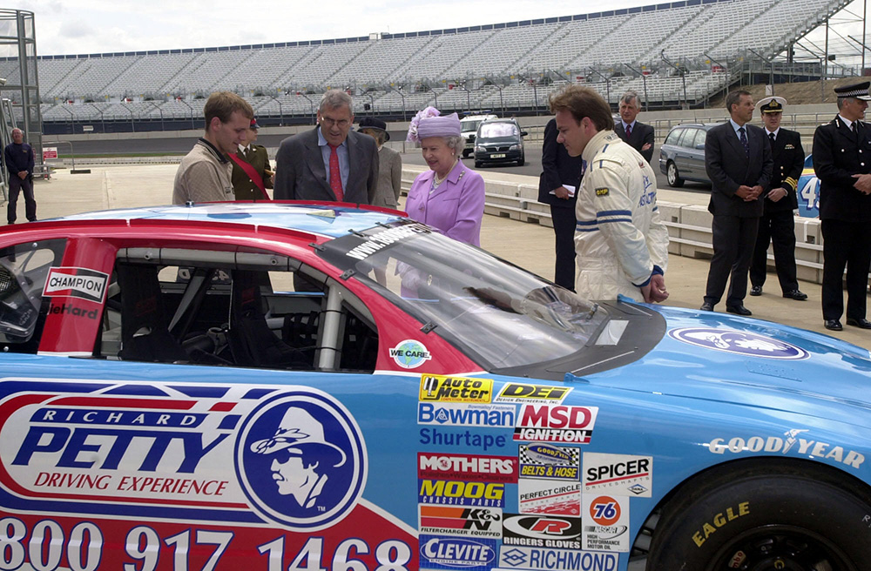
Notes:
The Queen stands amongst dignitaries and drivers whilst being shown a blue NASCAR racing car on the track at Rockingham Speedway. © Alamy - G5E703 - 28 June 2001

Slide 54
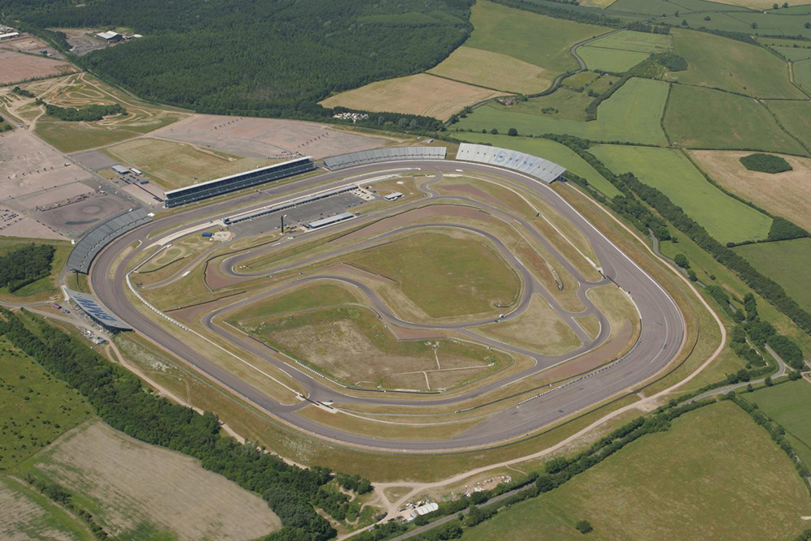
Notes:
An aerial view showing the speedway car racing track and spectator stands. © Historic England Archive - 23953_006 – 23 June 2005

Slide 55
All Saints' Church, Lubenham
The Queen and Prince Philip, accompanied by Prince Charles and Princess Anne, attended a service at Lubenham parish church on 25 March 1956.
The current church dates to the late 12th century and is a rare example of a Norman church, hence it is a Grade I listed building. A church here is first mentioned in 1109, when Robert son of Vitalis, lord of Foxton, gave the church and tithes from his fee in Lubenham to St. Augustine's Priory, Daventry.
It has been adapted many times over the centuries. It was first restored in 1900 by Gotch and Saunders of Kettering, who unlike many restorers of the time, did it in a sympathetic manor keeping many of the Norman and Medieval features.
Find out more on the National Heritage List.

Slide 56
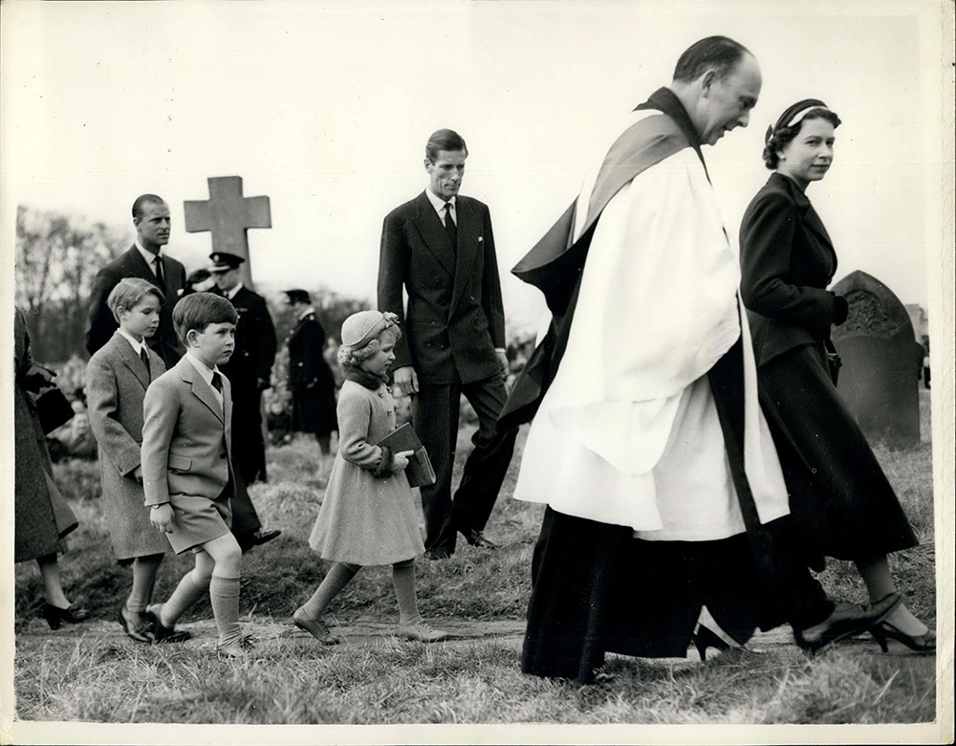
Notes:
A black and white image of The Queen with the Rev. B. Moffat-Pe arriving for a church service, followed by Lieut-Col Phillips, Princess Anne, Prince Charles, one of Lieut-Col Phillips children and Prince Philip. © Alamy - E0MNG9 – 25 March 1956

Slide 57
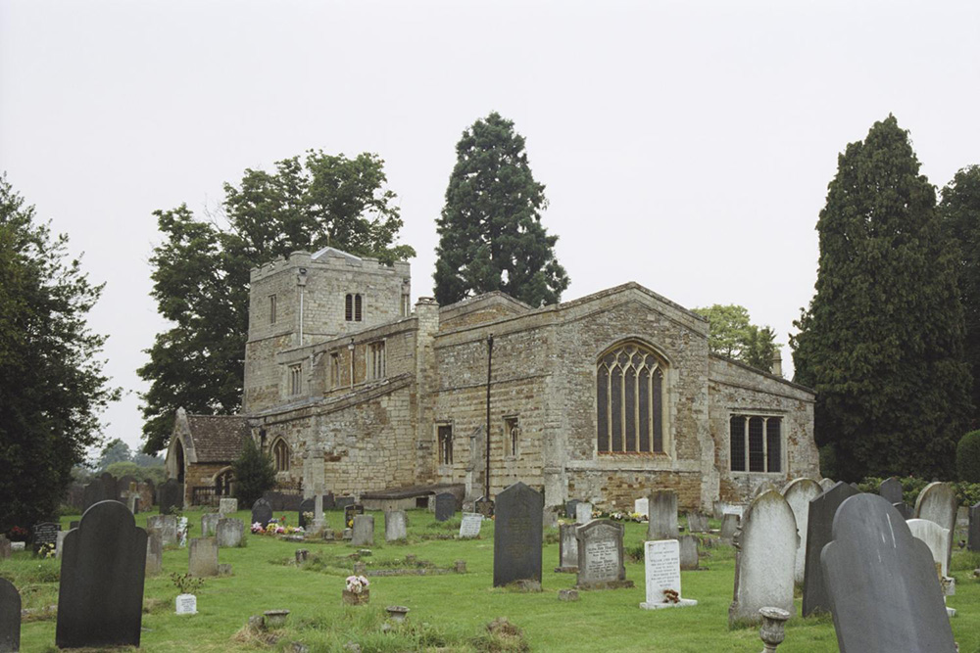
Notes:
A view across the churchyard, looking towards the Norman church with its characteristic short square tower. © Mrs Anne French. Source: Historic England Archive - IOE01/12918/12 - 3 Aug 2004

Slide 58
Kettering Station
The Queen, walking with Earl Spencer, on her arrival at Kettering Railway Station at the start of her visit to Northamptonshire on 9 July 1965.
Kettering station was built in 1857 to the designs of C H Driver. It was built for Midland Railway company, one of the most important and ambitious companies of the era of railway development in England.
It was expanded in 1879 and the main station building was built in1895-8 by C Trubshaw, a significant railway architect responsible for other important railway buildings such as the Midland Hotel in Manchester. In 1999–2000 the station underwent a programme of refurbishment, including the erection of a new footbridge, to replace an earlier subway.
Find out more on the National Heritage List.

Slide 59
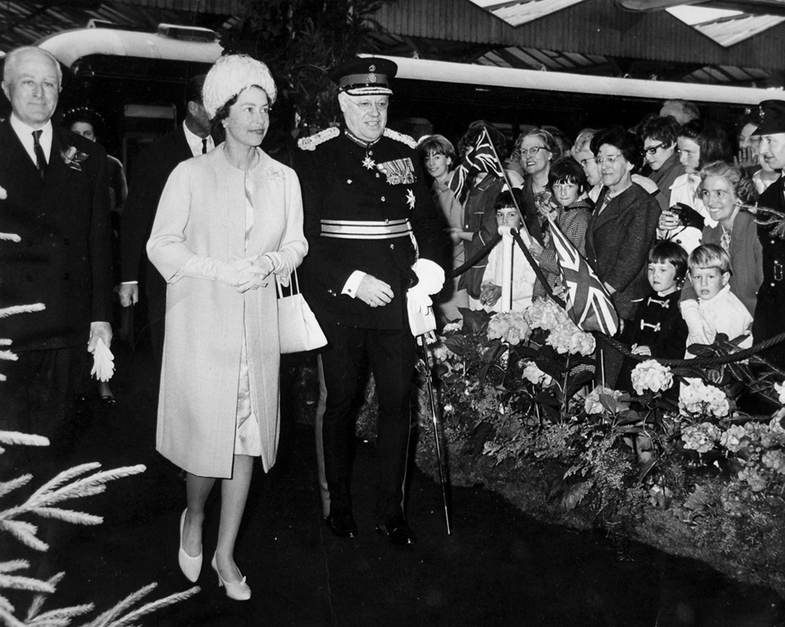
Notes:
A black and white image of the Queen, walking next to Earl Spencer in his full military uniform, as they go past crowds of well-wishers outside Kettering Station. © Alamy - G520TK - 9 July 1965

Slide 60
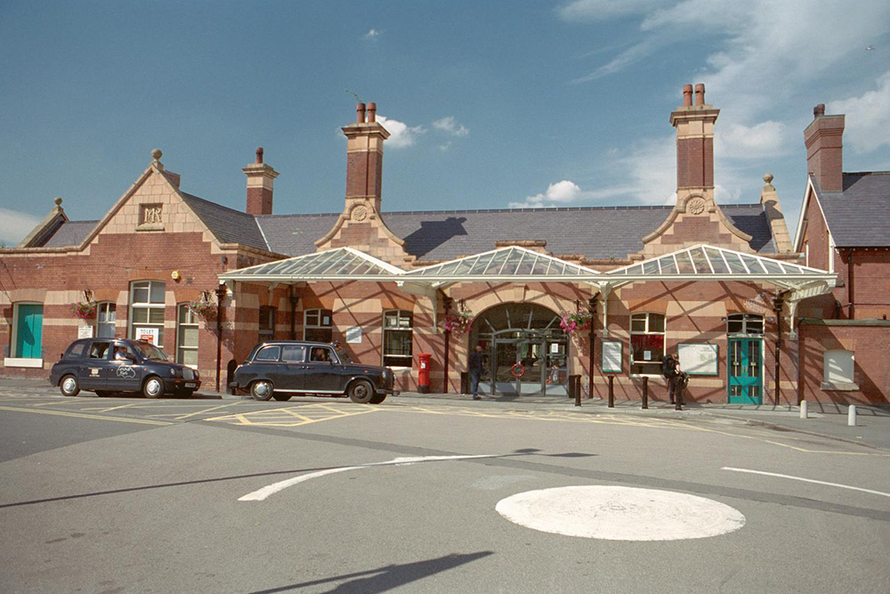
Notes:
A view of the ornate red brick Victorian station with its tall decorative chimneys. © Mr Roger Ashley. Source: Historic England Archive - IOE01/08379/22 - 8 Feb 2002

Slide 61
Matlock Station
The Queen meets members of the crowd as she arrives at Matlock Station for an official visit to Derbyshire on 10 July 2014.
The station was opened by the Manchester, Buxton and Midlands Junction Railway in 1849 and was known as Matlock Bridge. The station buildings, designed by Sir Joseph Paxton who also designed the Crystal Palace in London, were opened in 1850. The importance of the line was increased in 1871 when it became part of a main line connecting London and Manchester.
The Station Master's house at Matlock Station was built in c1850. It is also attributed to Sir Joseph Paxton, for The Midland Railway Company. The house forms part of the station complex developed by the Midland Railway Company on the route between Derby and Buxton.
Find out more on the National Heritage List.

Slide 62
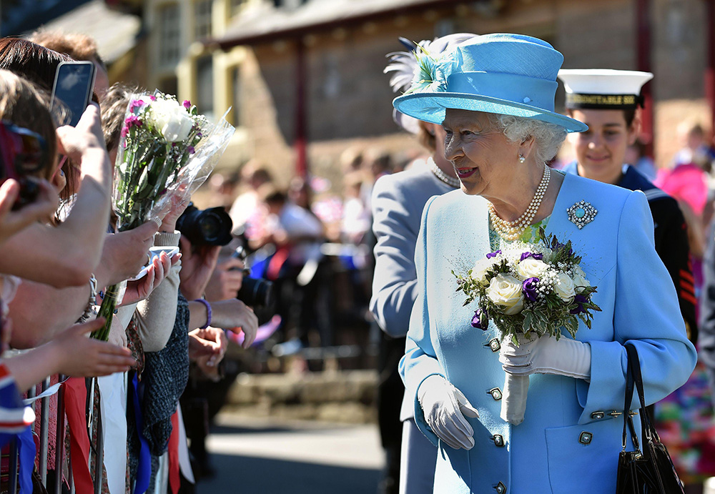
Notes:
The Queen, holding a bunch of flowers, greets well-wishers outside Kettering Station. © Alamy - G76MY4 - 10 July 2014

Slide 63
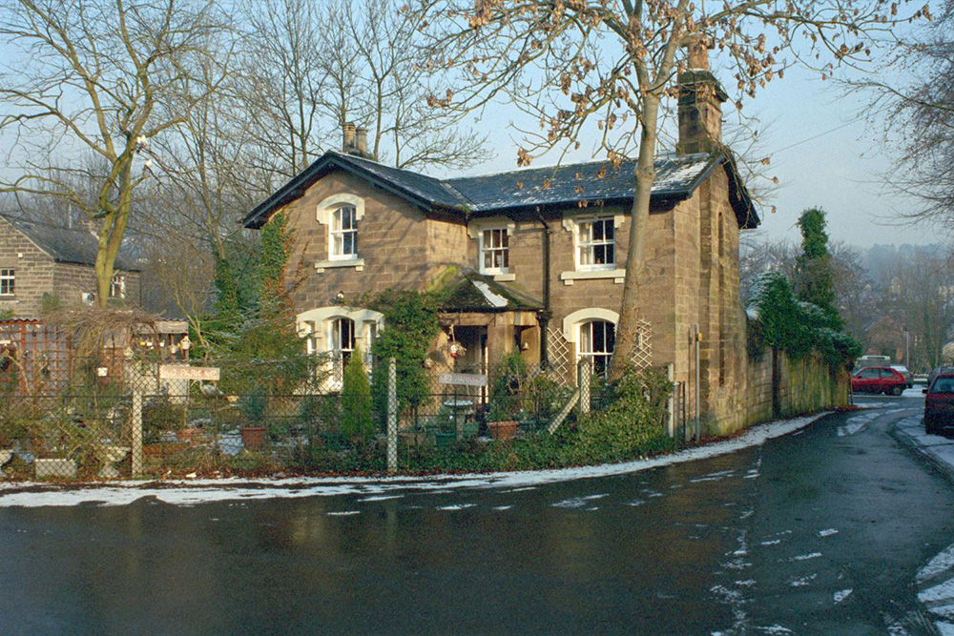
Notes:
A view of the stone-built Station Master's house at Matlock Town Station. © Ms Julie Woodhouse. Source: Historic England Archive - IOE01/02412/23 - 19 Jan 2001

Slide 64
Express (National) Lift Tower, Northampton
The Queen opened the Express Lift Tower at Northampton before travelling the 19 floors up to the top on 12 November 1982. The tower was dubbed 'Northampton's Lighthouse' by disc jockey Terry Wogan.
The lift testing tower was commissioned in 1978 and built 1980-2 by Stimpson and Walton for the Express Lift Company Limited. It’s made of concrete and is 127m tall. The highspeed lift shaft runs the full height of the tower and determined the tower's height. It is for testing lifts at speeds of up to 7 metres per second.
This is the only lift testing tower in Britain and one of only two in Europe. The building is important as a demonstration of the importance of the lift technology to all modern tall building construction. It is for these reasons that it is now a Grade II listed building.
Find out more on the National Heritage List.

Slide 65
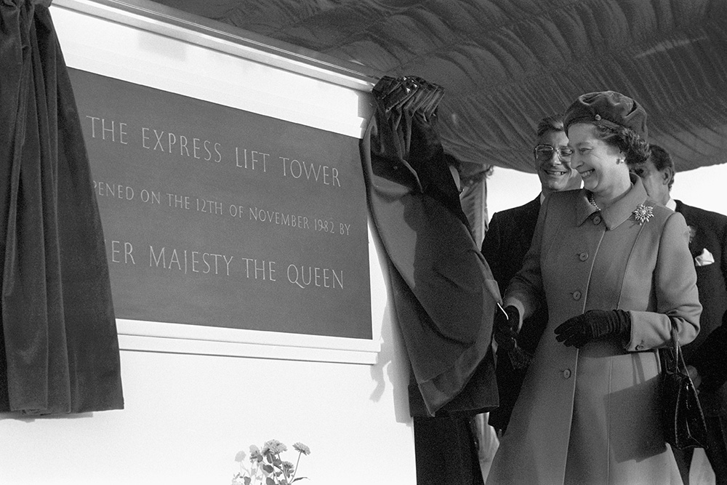
Notes:
A black and white image of the Queen opening a curtain to reveal a plaque commemorating the opening of the lift tower. © Alamy - G7TKBT - 12 November 1982

Slide 66
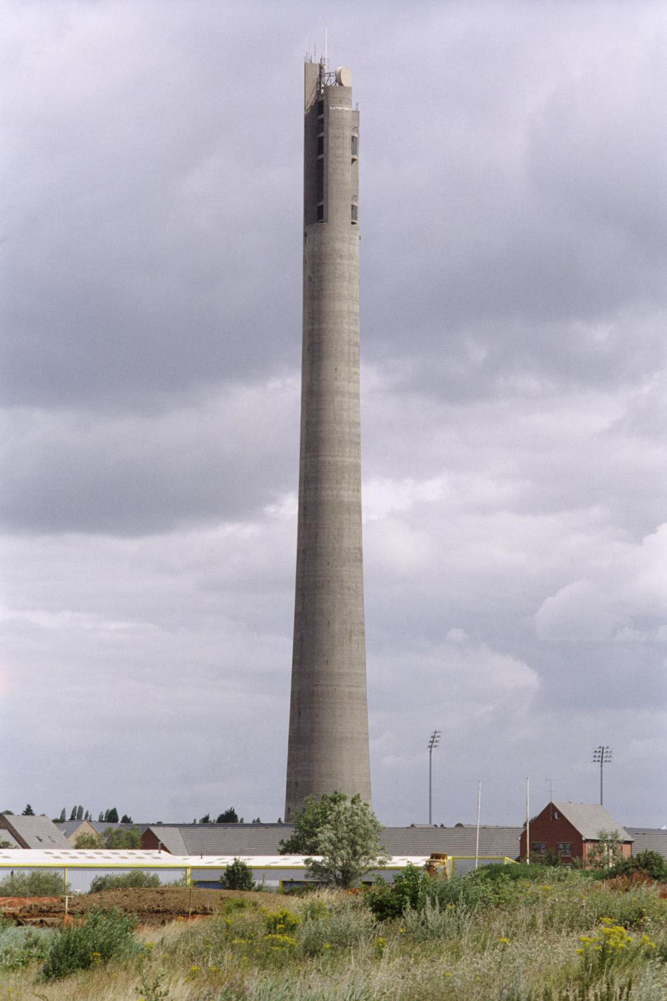
Notes:
A view of the 127m tall concrete lift tower, towering above the other buildings around it. © Mr Roger Ashley. Source: Historic England Archive - IOE01/14549/01 - 19 Jul 2005

Slide 67
Guru Nanak Gurdwara, Leicester
The Queen, having removed her shoes, received a ceremonial sword (tulwar) as a gift, at the end of her visit to the Sikh Gurdhwara Temple on 1 August 2002. The sword is also known to Sikhs, renowned for their martial qualities, as a 'kirpan' or 'Siri-Sahib’.
Guru Nanak was the first Sikh Gurdwara in Leicester. It began in the 1960s then in 1989 it moved to its current site, a converted textiles factory close to the Roman Jewry Wall remains.
Alongside its prayer room the Gurdwara also has a fascinating museum. This gives information about the Sikh religion, as well as Indian history in general, with particular emphasis on India in Imperial Britain and Indian regiments of the British Army before and during both World Wars.
Find out more about Guru Nanak Gurdwara.

Slide 68
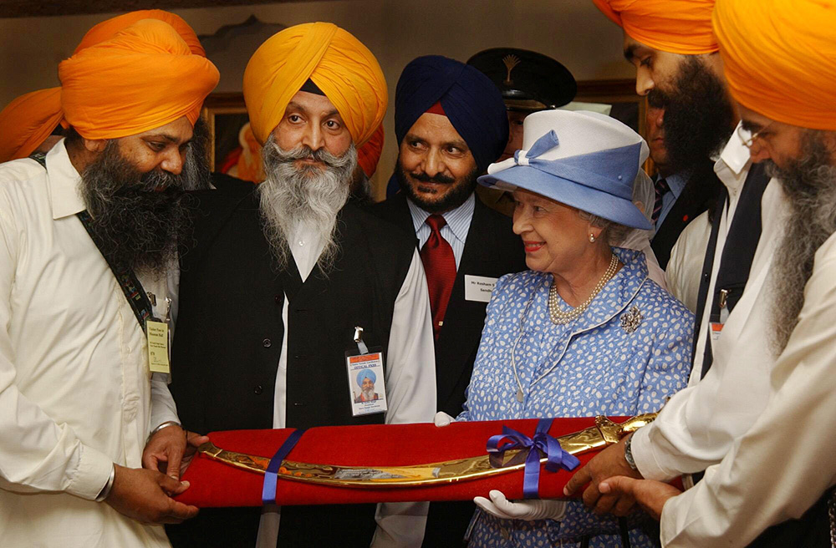
Notes:
The Queen smiles as she is presented with a ceremonial sword by member of the local Sikh community, several of whom are wearing beautiful bright orange turbans. © Alamy - G60EK3 - 1 August 2002

Slide 69
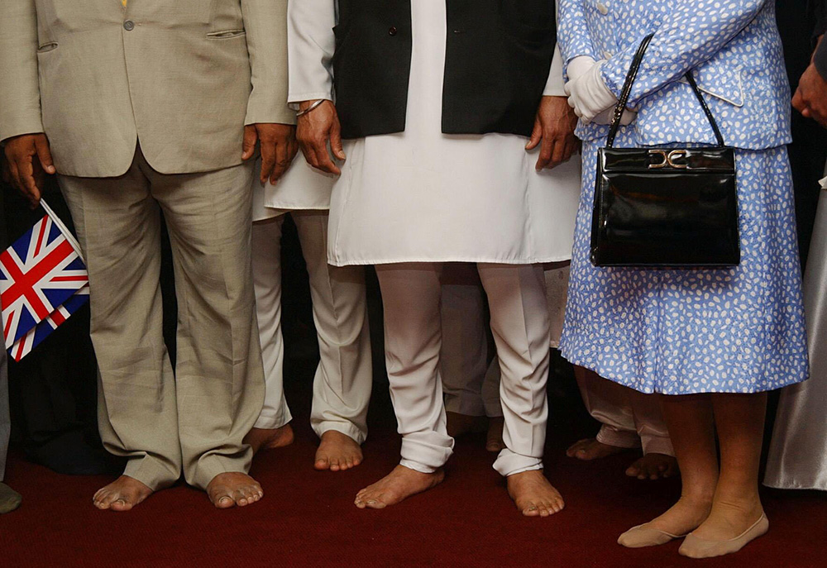
Notes:
An image of the feet of Queen and 3 members of the Sikh community. Their feet are bare and the Queen is wearing skin coloured pop-socks. © Alamy - G60EMK- 1 August 2002

Slide 70
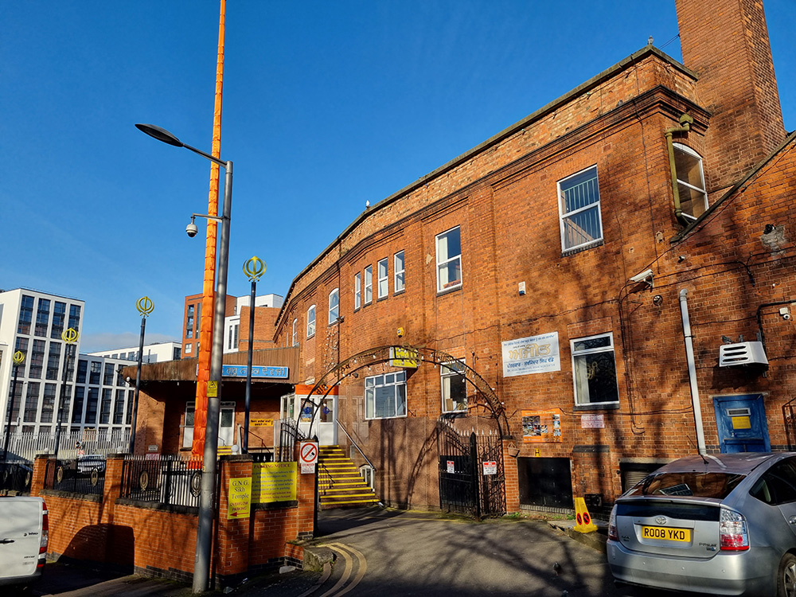
Notes:
An image of the red brick, converted textile factory, that is now the Guru Nanak Gurdwara. Ismail Dale, Historic England - 11 ‎February ‎2022

Slide 71
Lincoln Cathedral
The Queen visited in April 2000 to mark Maundy Thursday by distributing Maundy Money to pensioners at Lincoln Cathedral.
Lincoln Cathedral, famous for the Lincoln imp, sits high on a hill and dominates the city and surrounding fenland. Construction began in 1072 but was mostly destroyed by an earthquake in 1185. The different phases of rebuilding can be seen in the architectural styles throughout the cathedral. In 1311, it claimed to be the tallest building in the world on the completion of a 160m spire until this collapsed in 1548.
A centre for worship and pilgrimage, it was also a seat of power, hosting parliaments in the chapter house. Lincoln Cathedral holds one of the four remaining copies of the original Magna Carta.
Find out more on the National Heritage List.

Slide 72
Notes:
The Queen stands in front of an archway within Lincoln Cathedral to hand out Maundy money to pensioners. She's surrounded by other people, including Yeomen of the Guard dress is their colourful red and gold uniforms. © Alamy - G50HF1 - 20 April 2000

Slide 73
Notes:
A black and white view looking across the nave of Lincoln Cathedral from an elevated position at the west end. Source: Historic England Archive - CC80/00269 - 1 Jun 1892

Slide 74
Notes:
A black and white view of the West Front over the surrounding rooftops. Source: Historic England Archive - CC98/00004 - 1896 - 1920

Slide 75
Notes:
An aerial view of Lincoln Cathedral from the south. © Historic England Archive - nmr 17307/13 – July 1999

Slide 76
RAF College Cranwell
The Queen speaks with Sleaford and Grantham Air Cadets at RAF Cranwell, Lincolnshire.
RAF College Cranwell was founded as a Royal Navy Training Establishment in 1916. It became the world’s first Air Academy to train RAF officers on the lines of Sandhurst or Dartmouth and today, it continues to select and train the next generation of officers and aircrew. The motto, Altium Altrix, meaning "Nurture the highest" appears above the main doors.
The principal college building was built 1929-33, designed by Officer of Works architect J G West, FRIBA. Ingeniously planned around very complex requirements, the Cadet College uses first class materials both externally and within. The architecture was intended to reflect the importance of Britain's new independent air force.
Find out more on the National Heritage List.

Slide 77
Notes:
The Queen speaks with a line of Air Cadets dressed in their blue uniforms. © Alamy - GBNPX5 - 28 May 2009

Slide 78
Notes:
A panoramic view of the college showing the main red brick wings attached to the central Hall, with its tower on top. © Historic England Archive - DP001377 - 16 Aug 2005

Slide 79
The Islamic Centre, Scunthorpe
The Queen with members of the Muslim Community in Scunthorpe, 31 July 2002. The visit to the Mosque was her first in the UK and took place during her majesty's Golden Jubilee tour of the area.
The Pakistani Islamic Centre on Parkinson Avenue, established in 1992, though an unassuming building in a 1920s terraced street, is one of the largest Islamic centres in the area. The Queen took off her shoes on a visit to the prayer room. Later she unveiled a plaque commemorating her visit.
The timing of the visit, in the wake of events of 9-11, was very important. Scunthorpe's Muslim community is the largest in the Humber region with around 3,000 members.

Slide 80
Notes:
The Queen walking into a room at an Islamic Centre in Scunthorpe, as local Muslims wait to greet her. © Alamy - G60DNK - 31 July 2002

Slide 81
Notes:
Members of the local community outside the an Islamic Centre, waving Union Jack flags, as they await the arrival of The Queen. © Alamy - G60DP8 - 31 July 2002

Slide 82
Notes:
A view of the red brick Islamic Centre. © Historic England Archive – 25 Feb 2022

