Slide 1
Knowing Bradford: How can buildings tell a story?
Key Stage 2: History, Drama, English
Learning Aims and Outcomes
Pupils will:
To know more about the built environment and how it relates to the heritage and story of a place.
To raise awareness of Bradford’s industrial and cultural heritage.
To investigate why key historical sites in a local area are important.
To create opportunities for cross curricular thinking and learning relating to the local built environment.
To think about, describe and explain how we can care about historic sites in our local area and can continue to use them in the future.
This PowerPoint relates to the Teaching Activity - Knowing Bradford: How can buildings tell a story?

Slide 2
This PowerPoint supports a script developed by Irene Lofthouse as part of the ‘Knowing Bradford’ project. The aim of the project is to explore the history of Bradford places and people with students, through the mediums of drama, literacy, art, historical enquiry and presentations.
The script is designed to be inter-active, so that when performed in schools, students are able to become one of the characters. It is also designed to enable students to perform it themselves, or to use it as a template to create their own versions.
There is also an accompanying Activity Pack to further explore Bradford’s history, with activities linked to scenes in the script and the images in this PowerPoint.

Slide 3
Scene 1
City Hall

Slide 4
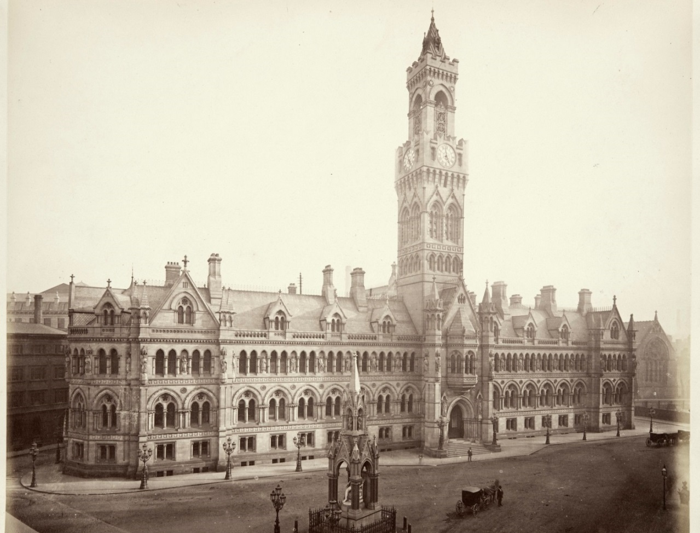
PICTURE 1
City Hall
Images: © Historic England Archive Ref:BL00866, Taken: 1875
https://historicengland.org.uk/images-books/photos/item/BL00866
Notes:
4

Slide 5
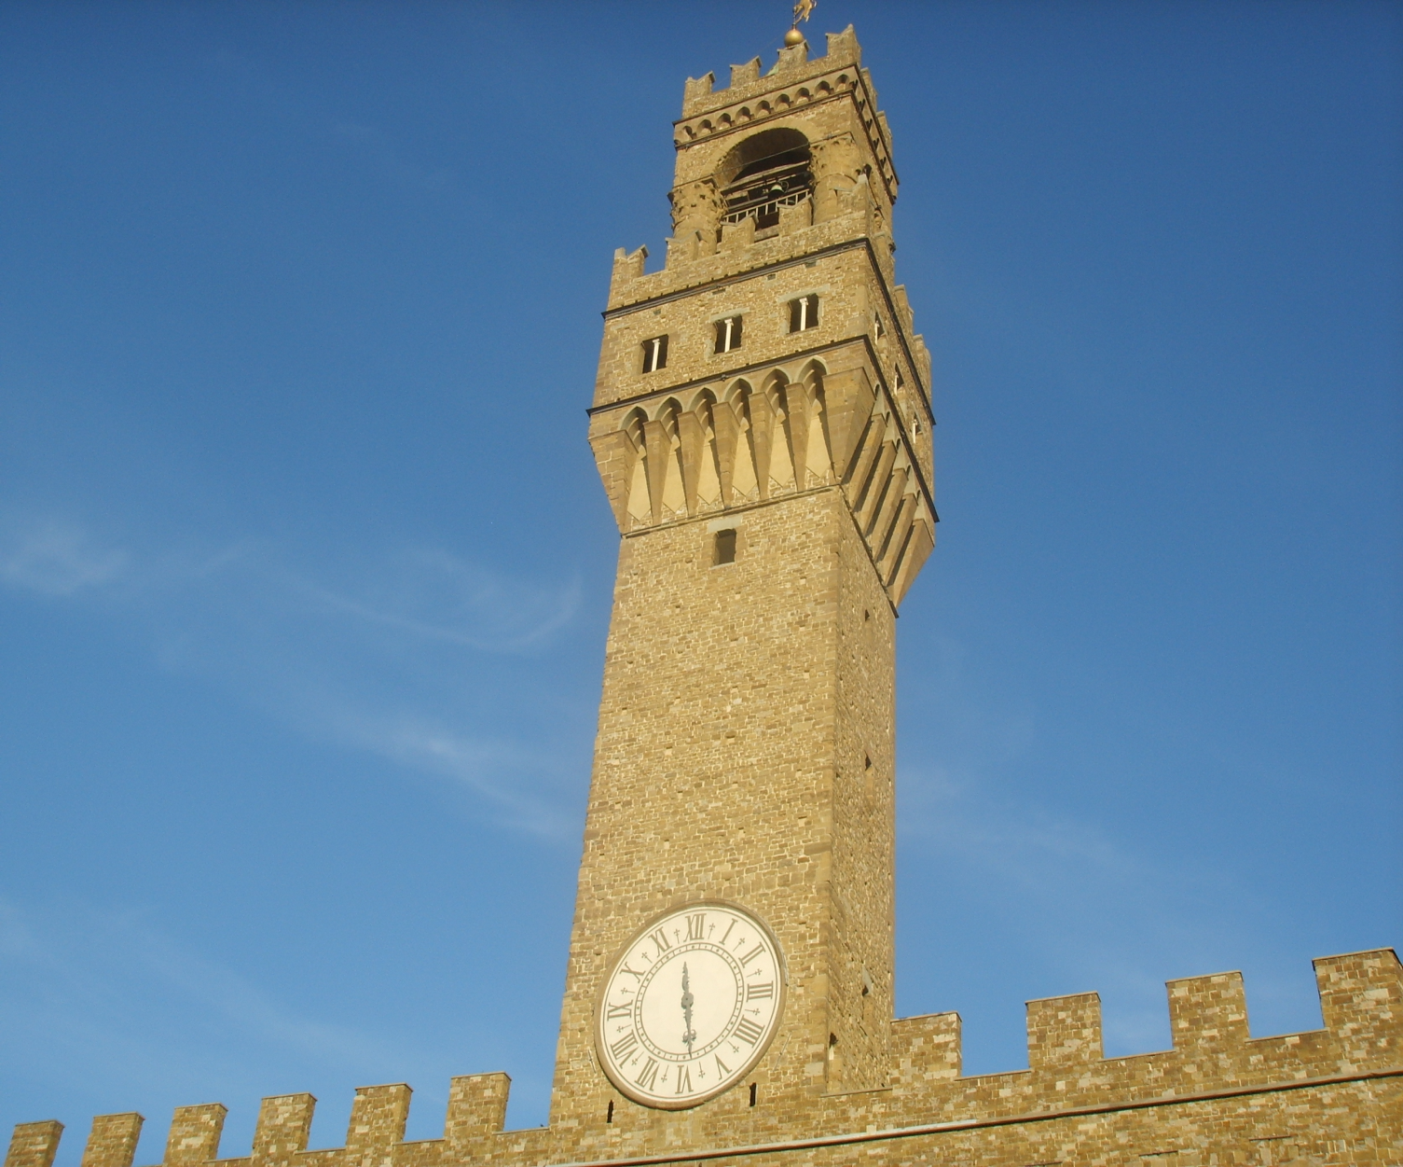
PICTURE 2
Palacio Vecchio, Florence
Images: © Sailko, CC BY-SA 3.0 <http://creativecommons.org/licenses/by-sa/3.0/>, via Wikimedia Commons
https://commons.wikimedia.org/wiki/File:Palazzo_vecchio,_torre_di_arnolfo.JPG
Notes:
5

Slide 6
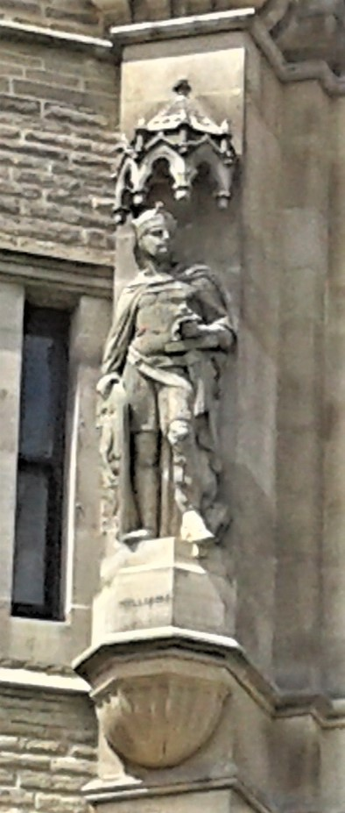
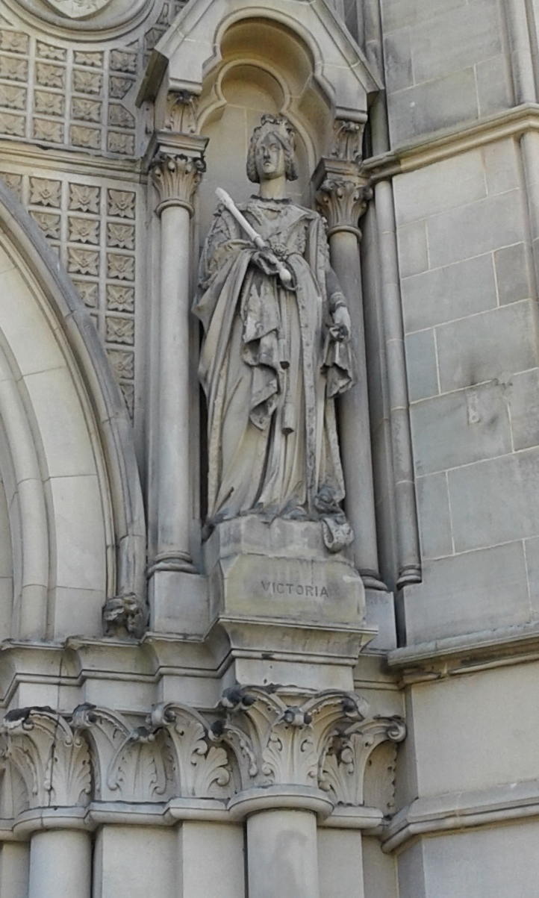
PICTURE 3
Statues on City Hall
Images: © Irene Lofthouse
Notes:
6

Slide 7
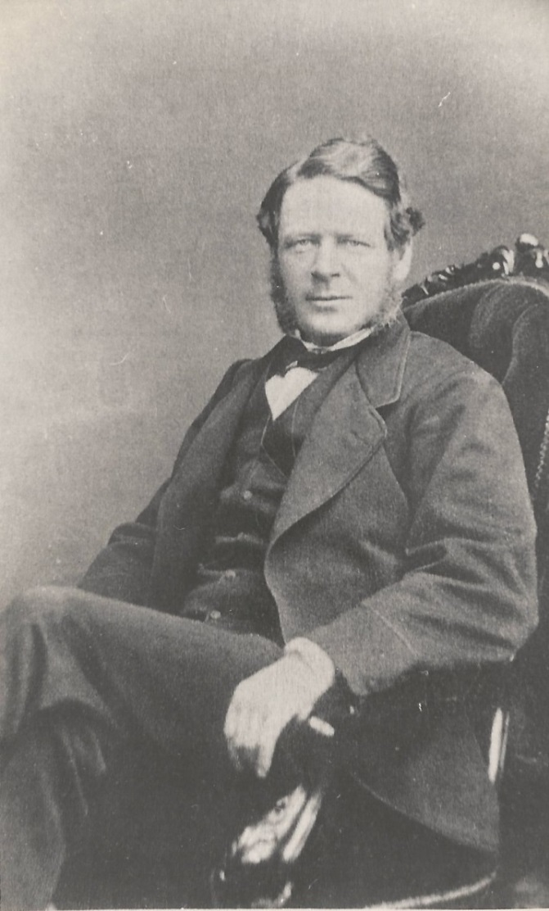
PICTURE 4
Lord Mayor Thompson
Image: © 2012 - 2020 Aireborough Historical Society
https://www.aireboroughhistoricalsociety.co.uk/yeadon/mathew-william-thompson.aspx
Notes:
7

Slide 8
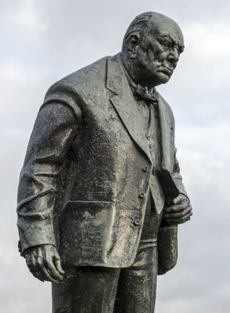
PICTURE 5
Winston Churchill
Images: © Historic England Archive Ref:DP164321, Taken: 5 Nov 2014
https://historicengland.org.uk/images-books/photos/item/DP164321
Notes:
8

Slide 9
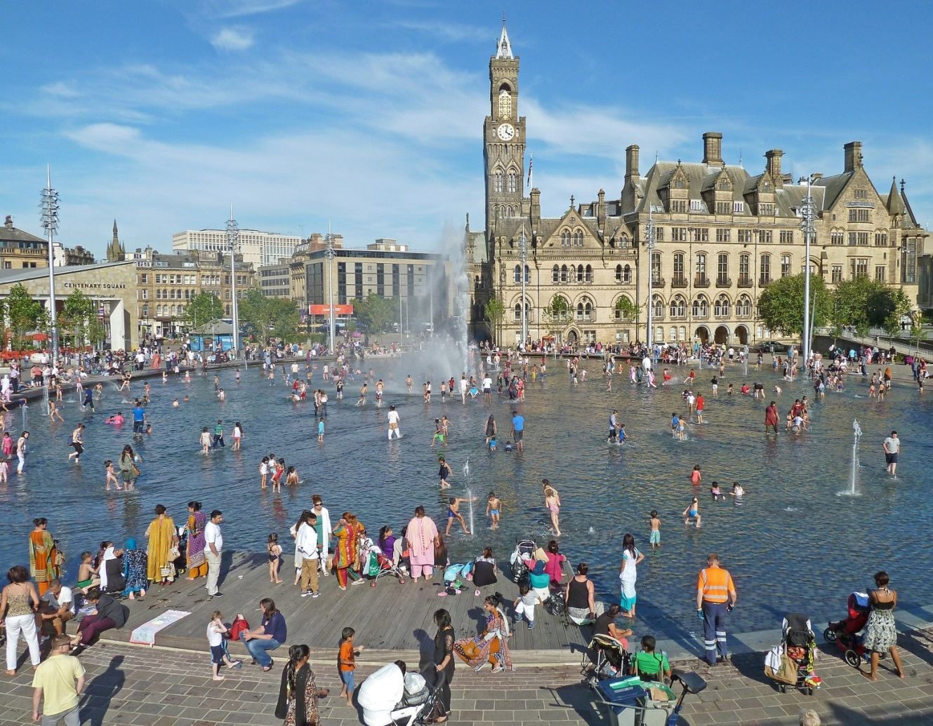
PICTURE 6
City Park & Mirror Pool
Images: © Historic England Archive Ref:BL00866, Taken: 1875
https://historicengland.org.uk/images-books/photos/item/BL00866
Notes:
9

Slide 10
TASK
City Hall Re-cap
What names and facts can you remember from City Hall?
Here are some questions that you could do in pairs.
Some answers can be written in your own words.
Some questions need factual answers.

Slide 11
TASK
City Hall Re-cap
1. How tall is the City Hall tower?
2. What does a Lord Mayor do?
3. How many statues are there on City Hall? 15 25 35
4. Name two TV shows which have been filmed there:
a)
b)
5. Where can you find fountains nearby?
6. How old is City Hall? 146 years 116 years 106 years

Slide 12
TASK
City Hall Re-cap
7. What is the name of someone who designs buildings?
8. Of the thirteen bells, one is very heavy. What weight is it? 7 tons 17 tons 27 tons
9. Where was the stone for the statues quarried?
a) Bolton Quarries
b) Cliff Wood Quarries
c) Canal Road Quarries
10. How many Lord Mayors have there been at City Hall?
75 115 150

Slide 13
Scene 2
Alhambra Theatre

Slide 14
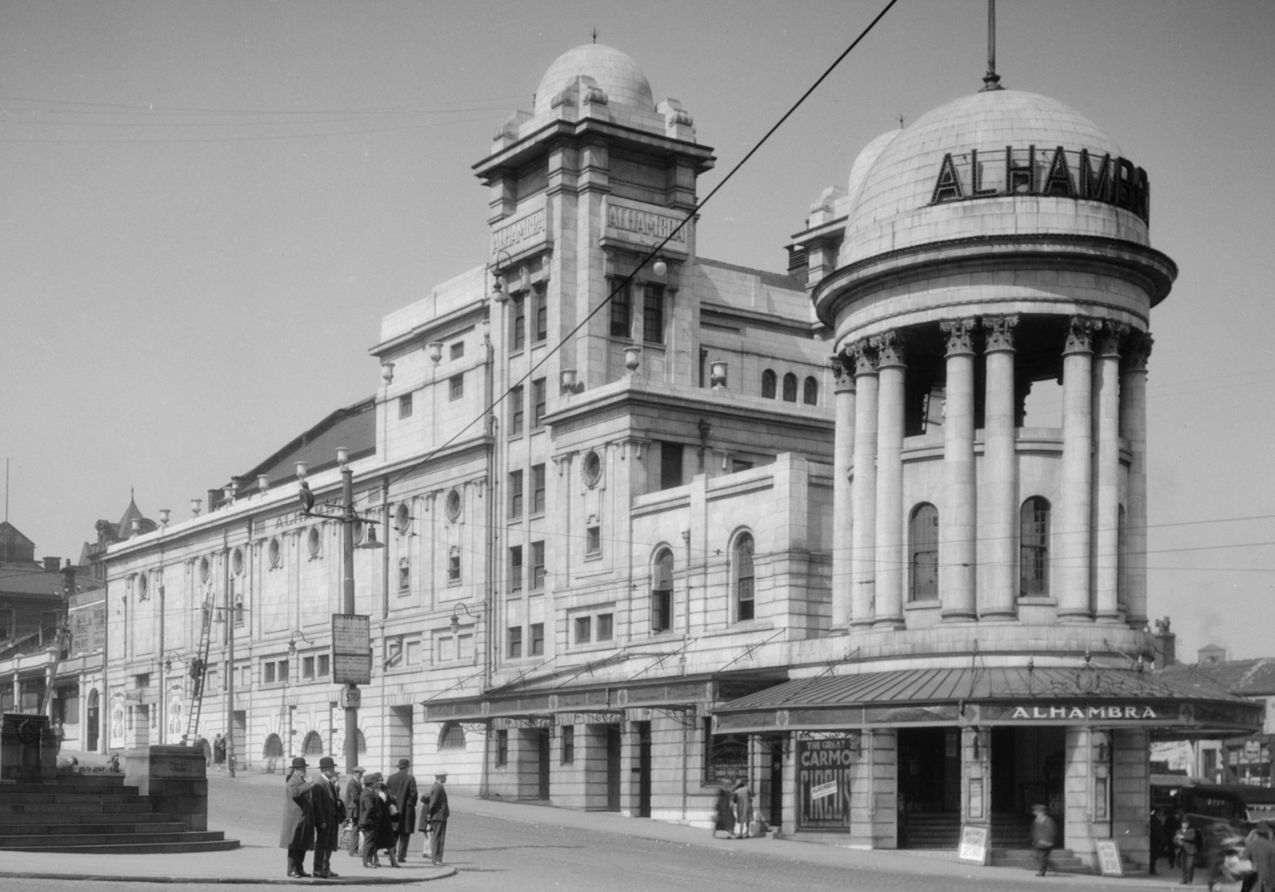
PICTURE 7
The Alhambra
Images: © Historic England Archive Ref:WSA01/01/G0410, Taken: 1925-1950
https://historicengland.org.uk/images-books/photos/item/WSA01/01/G0410
Notes:
14
Images: © Historic England Archive Ref:BL00866, Taken: 1875
https://historicengland.org.uk/images-books/photos/item/BL00866

Slide 15
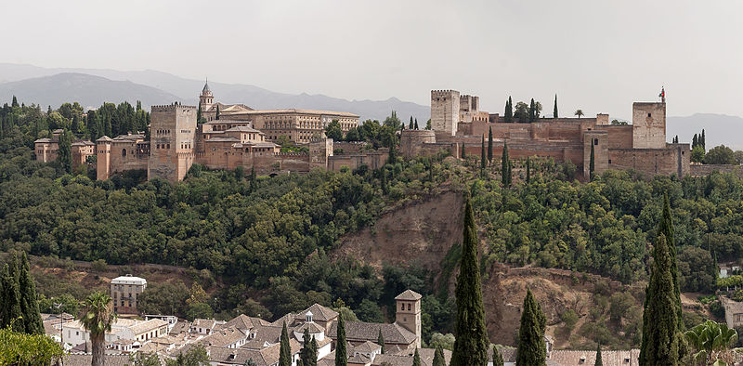
PICTURE 8
The Alhambra, Spain
Images: © Mgimelfarb, CC BY-SA 4.0 <https://creativecommons.org/licenses/by-sa/4.0>, via Wikimedia Commons
https://commons.wikimedia.org/wiki/File:Alhambra_Granada_Spain.jpg
Notes:
15

Slide 16
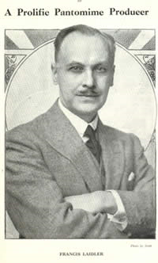
PICTURE 9
Francis Laidler
Images: Source: http://its-behind-you.com/francislaidler.html
Notes:
16

Slide 17
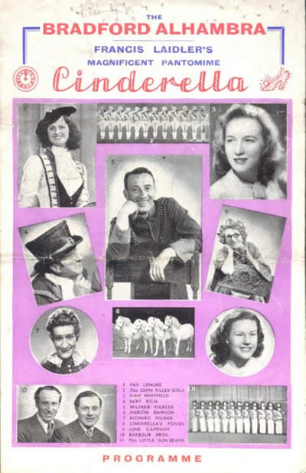
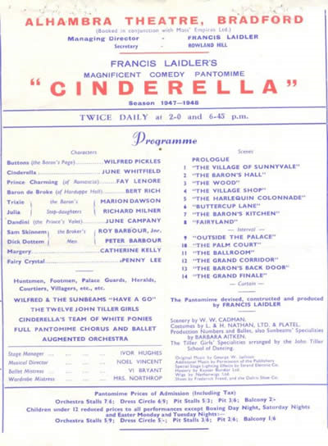
PICTURE 10
Past Panto Programme
Images: Source: http://its-behind-you.com/francislaidler.html
Notes:
17

Slide 18
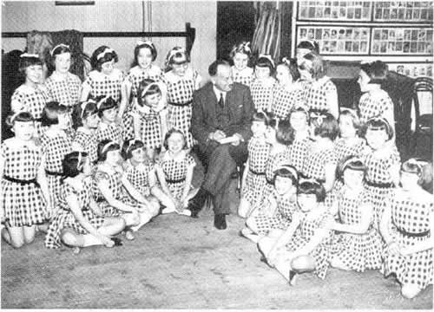
PICTURE 11
Sunbeams
Images: Source: http://www.its-behind-you.com/chorus.html
Notes:
18

Slide 19
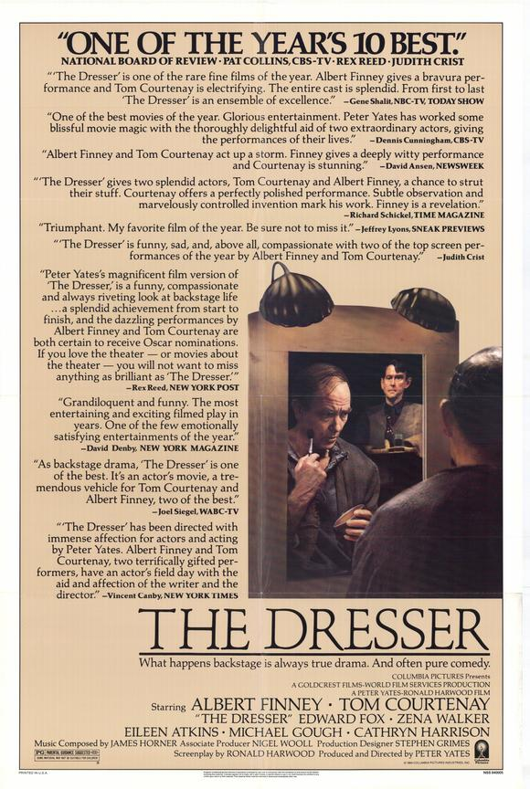
PICTURE 12
The Dresser
Images: https://www.joblo.com/movie-posters/1983/the-dresser/image-25423
Notes:
19

Slide 20
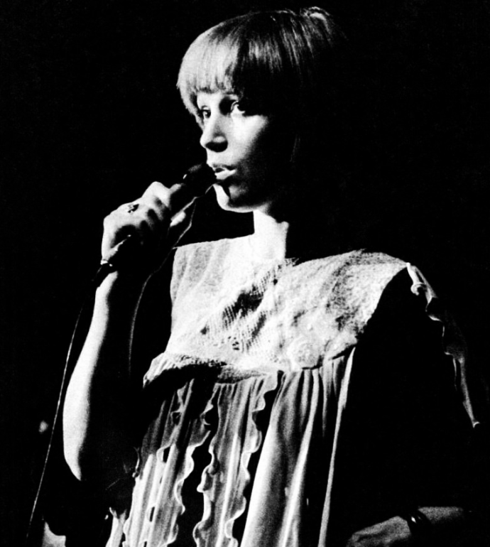
PICTURE 13
Bradford Singers
Kiki Dee
Kimberley Walsh
Images: Image: © SATURDAYmight., CC BY 3.0 <https://creativecommons.org/licenses/by/3.0>, via Wikimedia Commons https://commons.wikimedia.org/wiki/File:Kimberley_Walsh_2008.jpg
© MCA Records, Public domain, via Wikimedia Commons https://commons.wikimedia.org/wiki/File:Kiki_Dee_(1974).png
Notes:
20

Slide 21
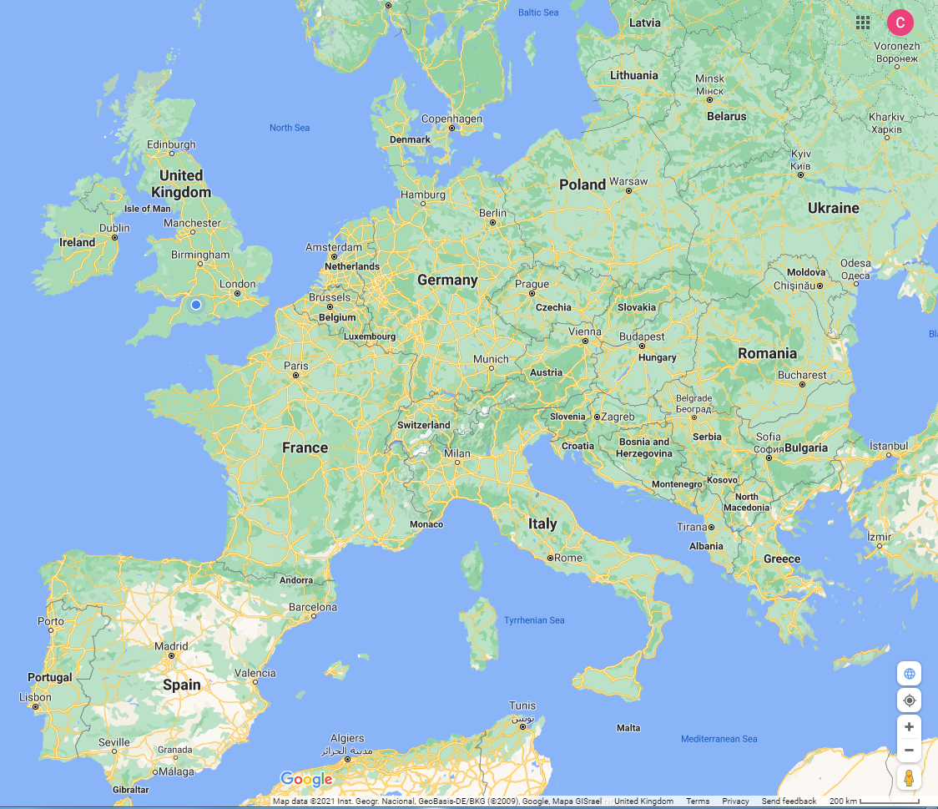
TASK
Alhambra Re-cap
Use an online map to find Spain. Then find Granada.
Circle it, like this:
This is where the palace that gave it’s name to the Alhambra Theatre can be visited.
Then find Bradford and circle it too.
Now draw a line to connect them.

Slide 22
TASK
Alhambra Re-cap
Who and what can you remember from The Alhambra?
Can you match the names and statements together?
Here’s an example:
Mr Chadwick Architect
Now have a go at the list on the next slide.

Slide 23
TASK
Alhambra Re-cap
Name Statement
Mr Laidler Music Hall song
Sunbeams A singer from Bradford
Mr Watson A city in Spain
Kiki Dee First opened in 1980s
‘Moving pictures’ Cost £20, 000
Alhambra Theatre Architect
Billy Pearce Owner of the Alhambra Theatre
Henery the Eighth Is in many Pantos
Granada Dance and sing
Science Museum First shown 1914

Slide 24
Scene 3
The Midland Hotel

Slide 25
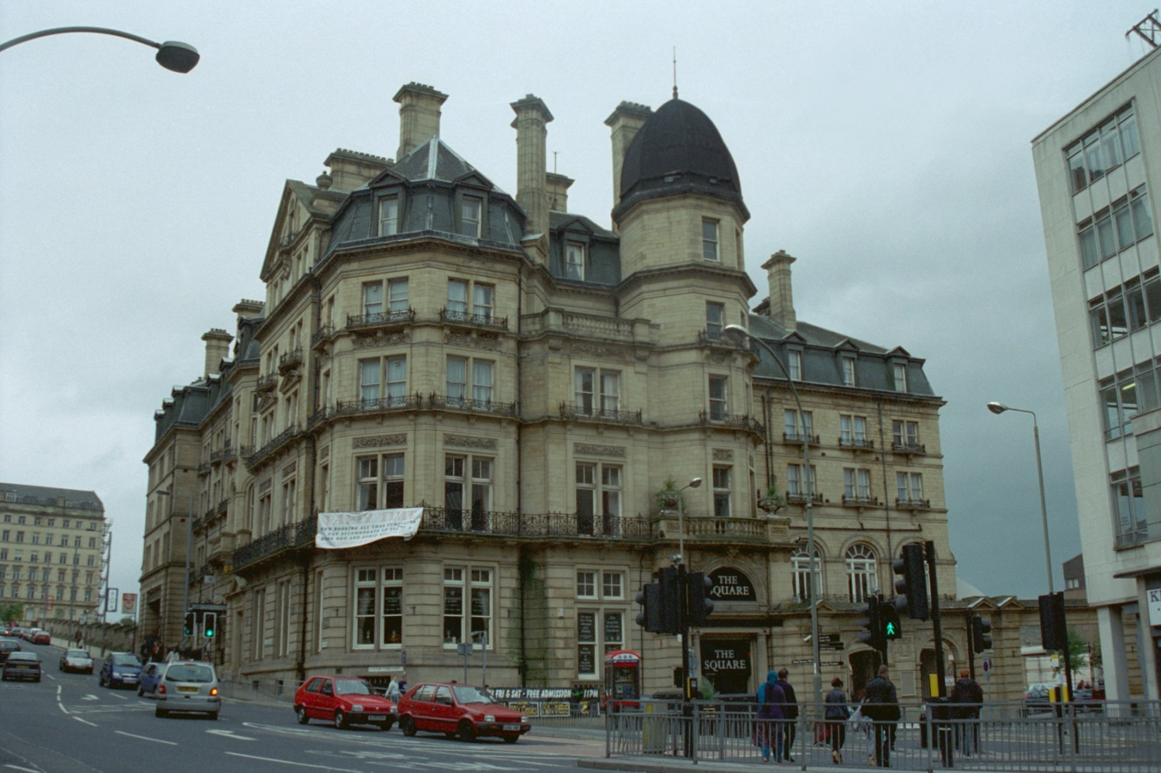
PICTURE 14
Midland Hotel
Images: © IoE Mr Martin Palliser. Source Historic England Archive Ref:IOE01/05665/29, Taken: 25 Oct 2001
https://historicengland.org.uk/images-books/photos/item/IOE01/05665/29
Notes:
25

Slide 26
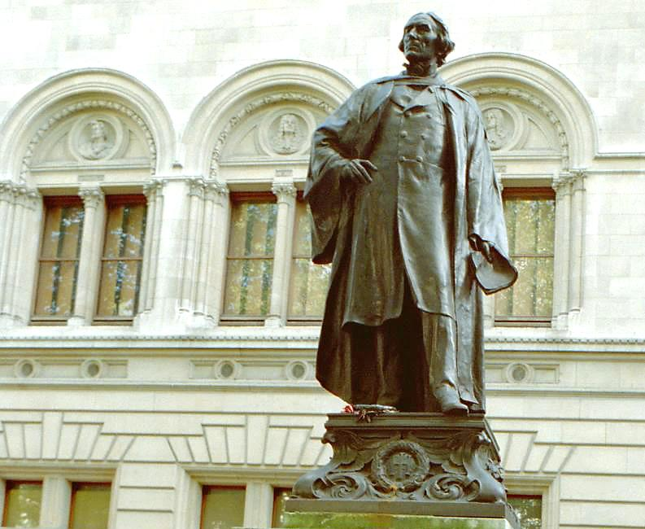
PICTURE 15
Henry Irving
Images: © IoE Mrs Marion Davies. Source Historic England Archive Ref:IOE01/02577/20, Taken: 17 Oct 2000
https://historicengland.org.uk/images-books/photos/item/IOE01/02577/20
Notes:
26

Slide 27
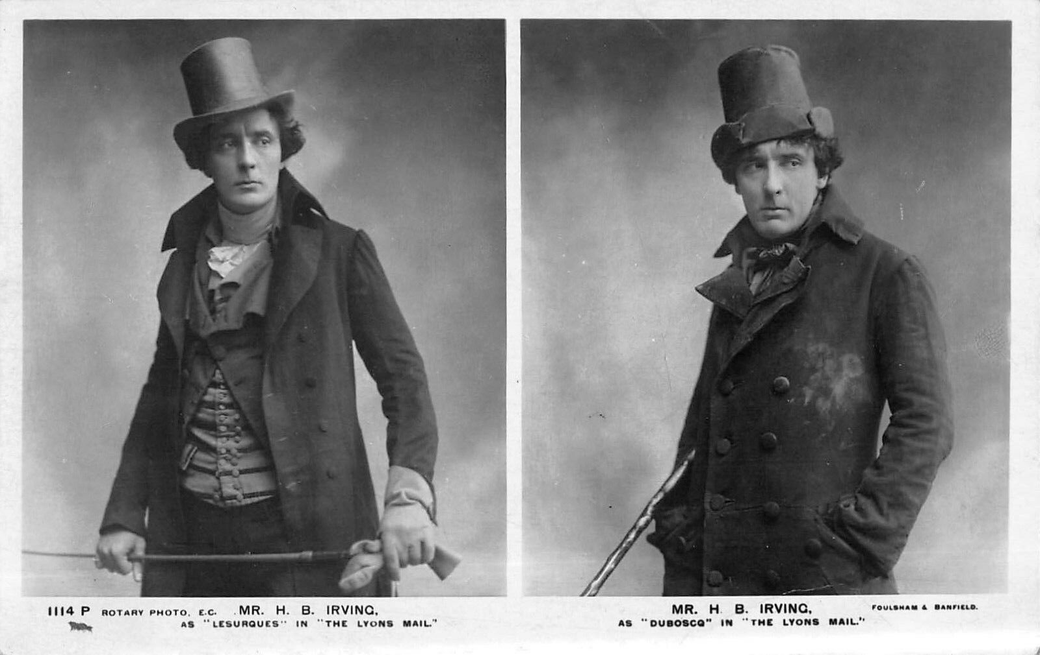
PICTURE 16
Henry Irving
Images: © Foulsham & Banfield (1906), Public domain, via Wikimedia Commons
https://commons.wikimedia.org/wiki/File:H_B_Irving_Lyons_Mail.jpg
Notes:
27

Slide 28
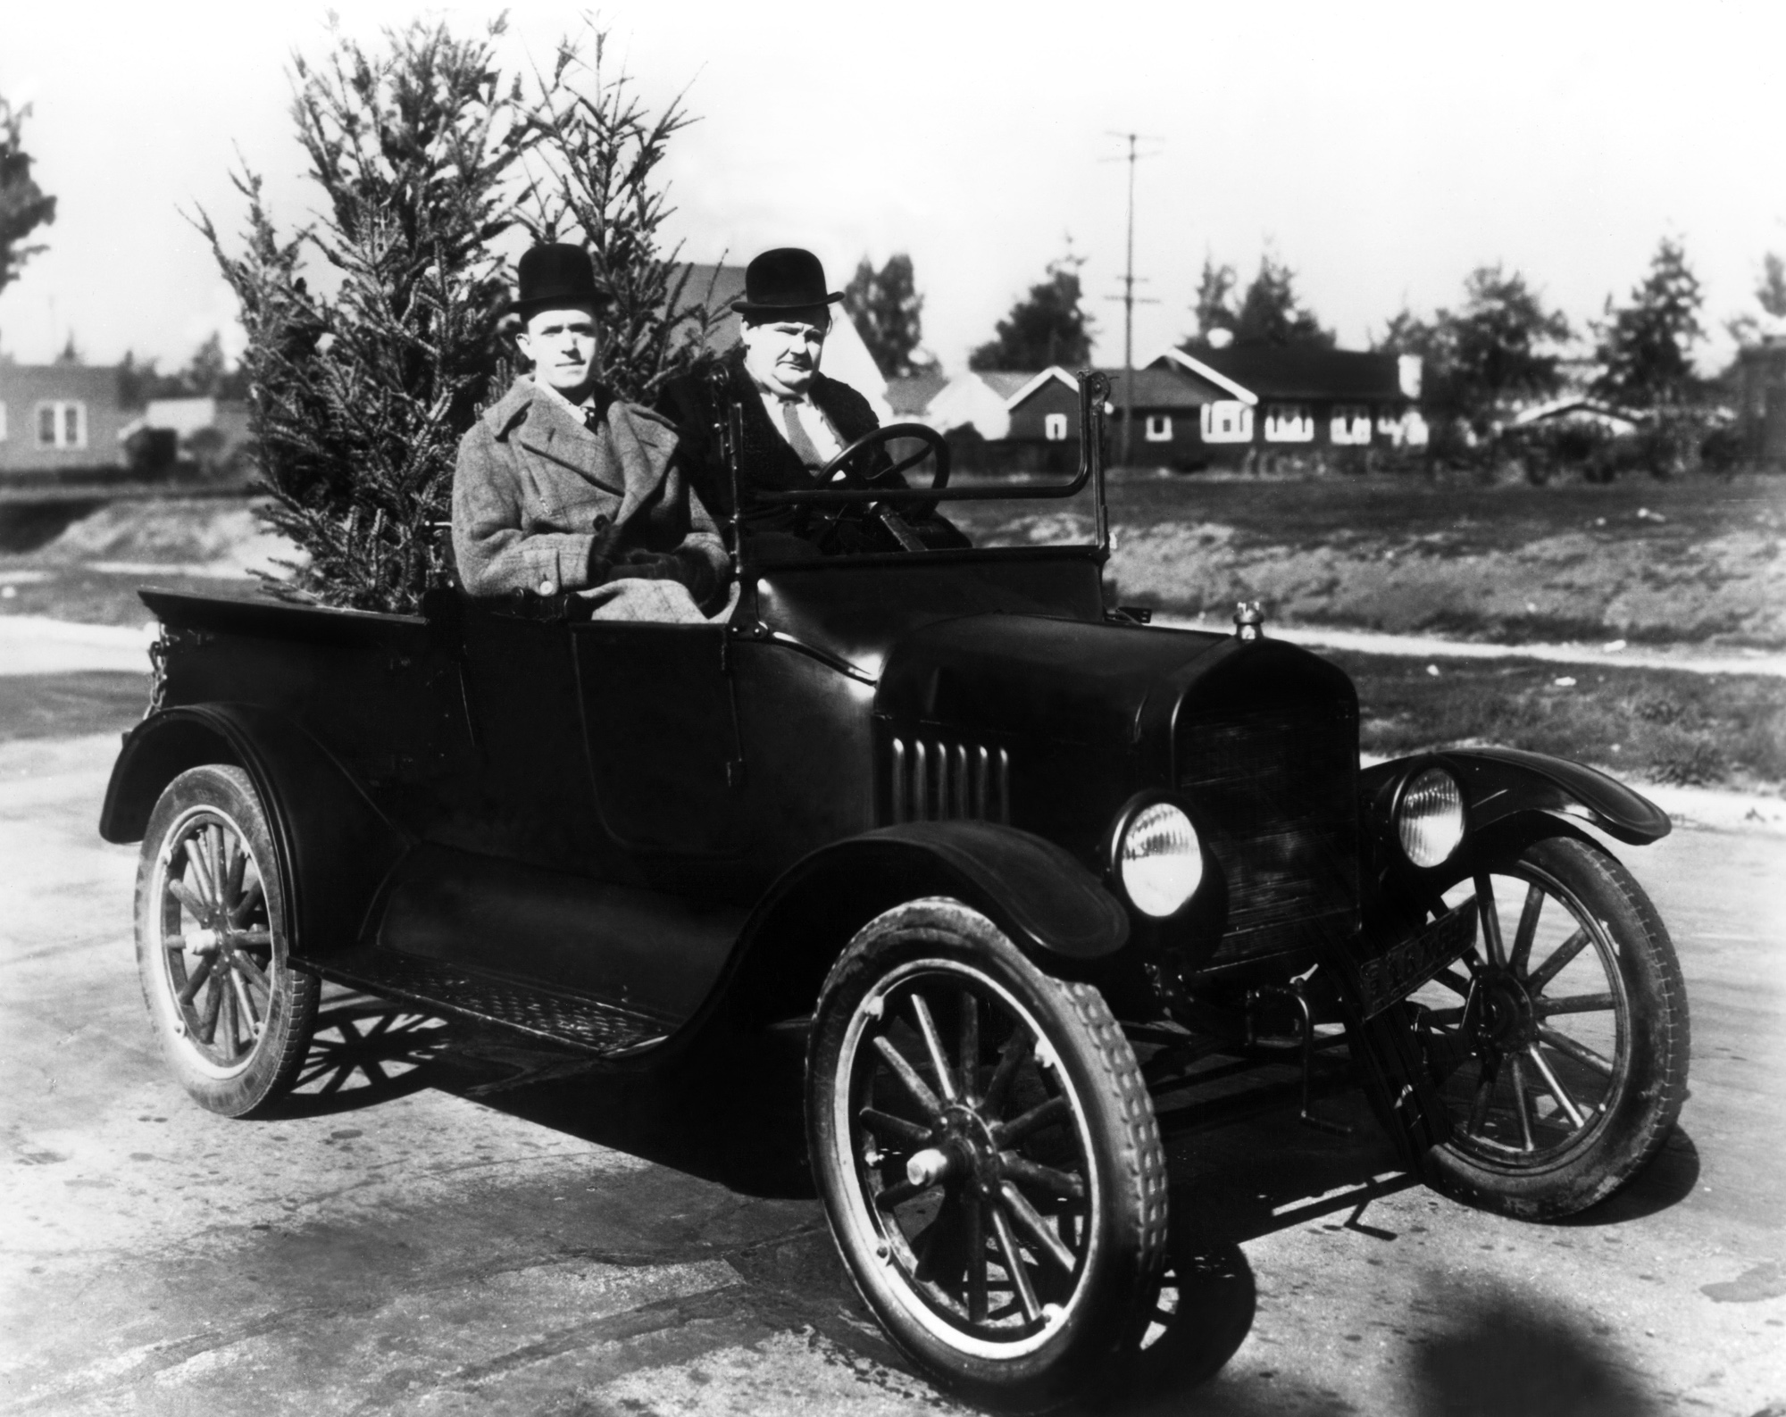
PICTURE 17
Laurel and Hardy
Images: Insomnia Cured Here, CC BY-SA 2.0 <https://creativecommons.org/licenses/by-sa/2.0>, via Wikimedia Commons https://commons.wikimedia.org/wiki/File:Laurel_%26_Hardy_in_Big_Business_(1929).jpg
Notes:
28

Slide 29
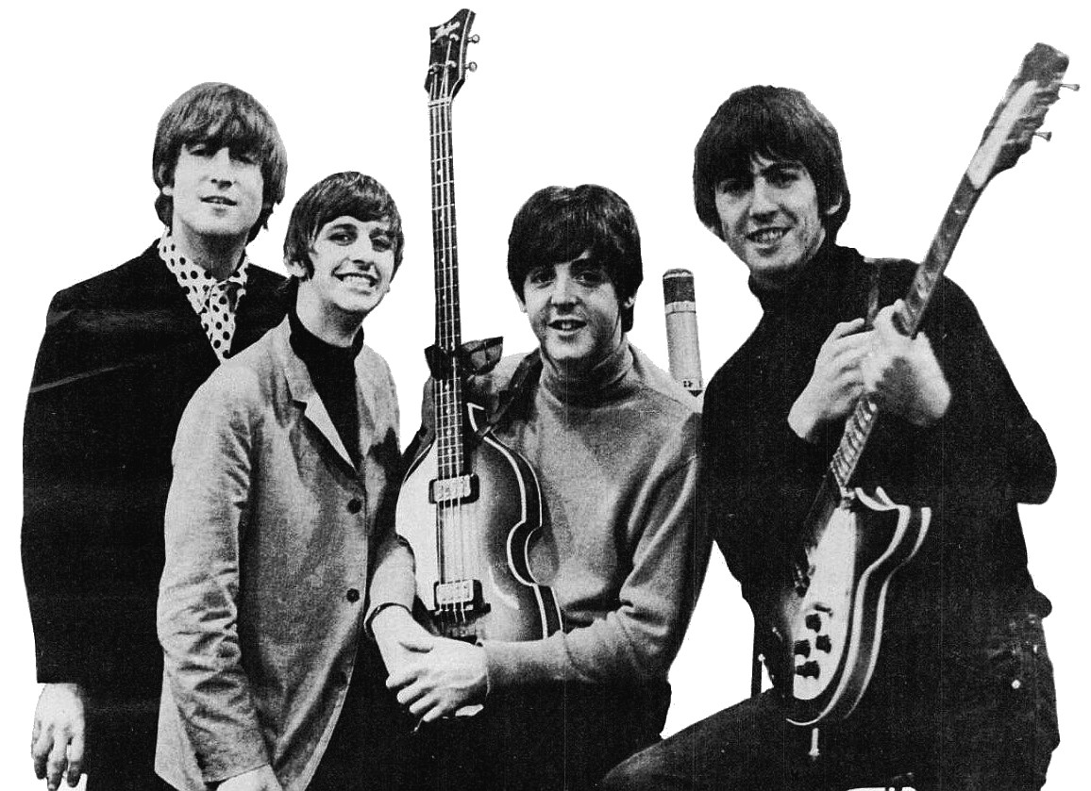
PICTURE 18
The Beatles
Images: EMI., Public domain, via Wikimedia Commons
https://commons.wikimedia.org/wiki/File:Beatles_ad_1965_just_the_beatles_crop.jpg
Notes:
29

Slide 30
Scene 4
Bradford Playhouse

Slide 31
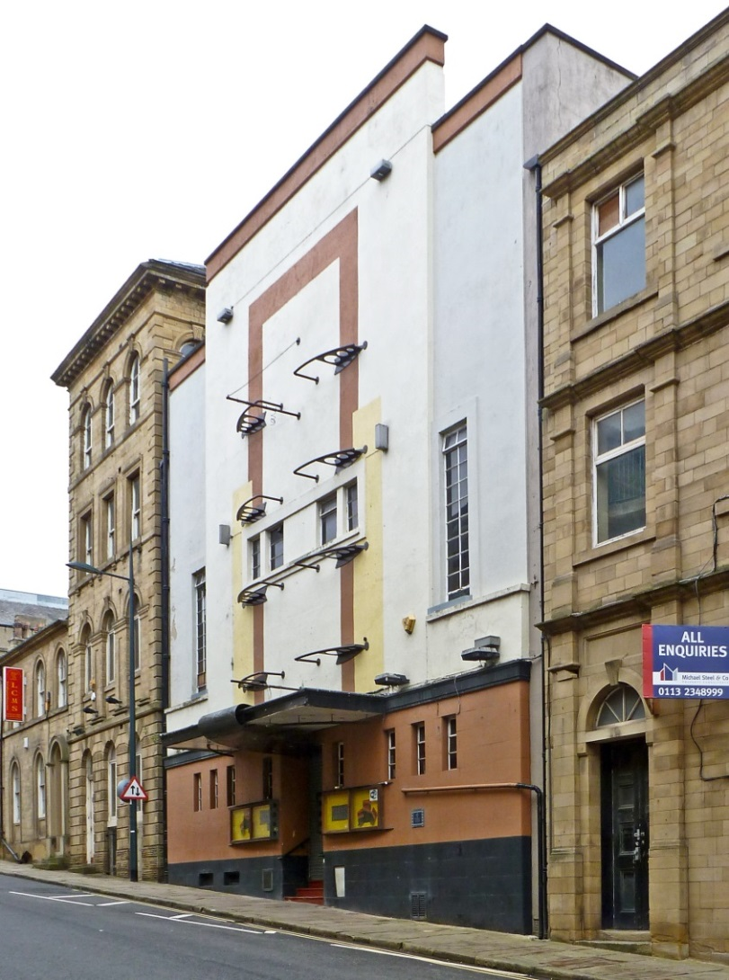
PICTURE 19
Bradford Playhouse
Image: © Tim Green from Bradford, CC BY 2.0 <https://creativecommons.org/licenses/by/2.0>, via Wikimedia Commons https://commons.wikimedia.org/wiki/File:Bradford_Playhouse_(7222490672).jpg
Notes:
31

Slide 32
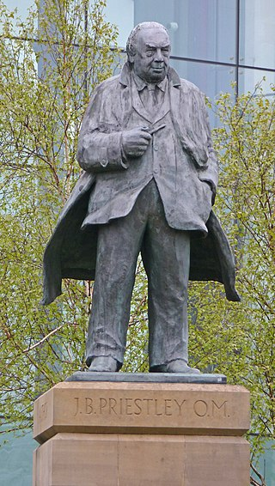
PICTURE 20
JB Priestley
Image: © Tim Green from Bradford, CC BY 2.0 <https://creativecommons.org/licenses/by/2.0>, via Wikimedia Commons
https://commons.wikimedia.org/wiki/File:Statue_of_JB_Priestley_in_Bradford.jpg
Notes:
32

Slide 33
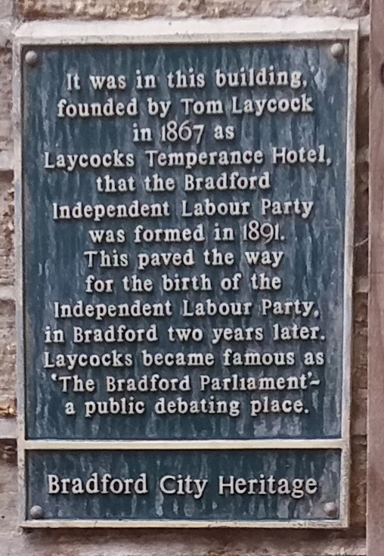
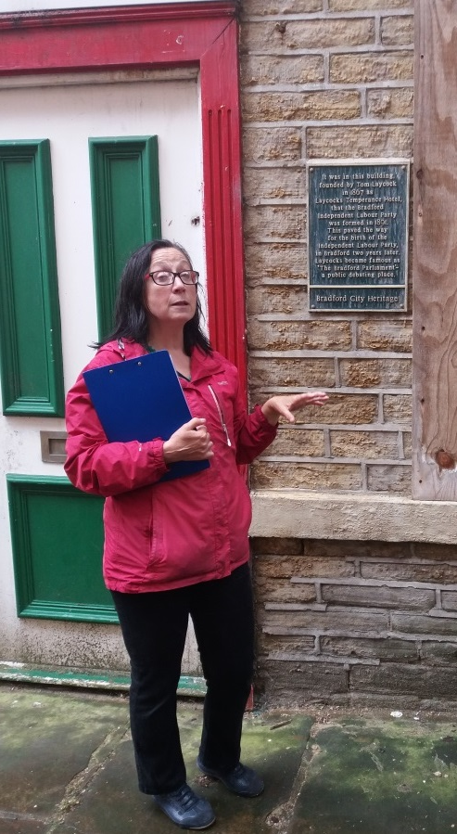
PICTURE 21
Plaque for Independent Labour Party
Images: © Irene Lofthouse
Notes:
33

Slide 34
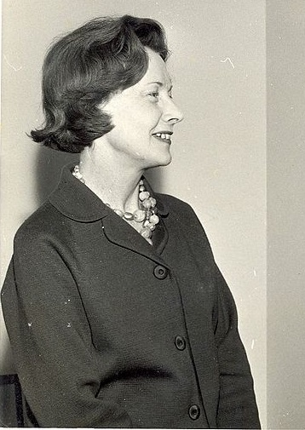
PICTURE 22
Barbara Castle
Image: © National Archives of Malawi, CC BY-SA 4.0 <https://creativecommons.org/licenses/by-sa/4.0>, via Wikimedia Commons https://commons.wikimedia.org/wiki/File:Mme_Barbara_Castle,_Ministre_britannique_du_d%C3%A9veloppement_outre-mer.jpg
Notes:
34

Slide 35
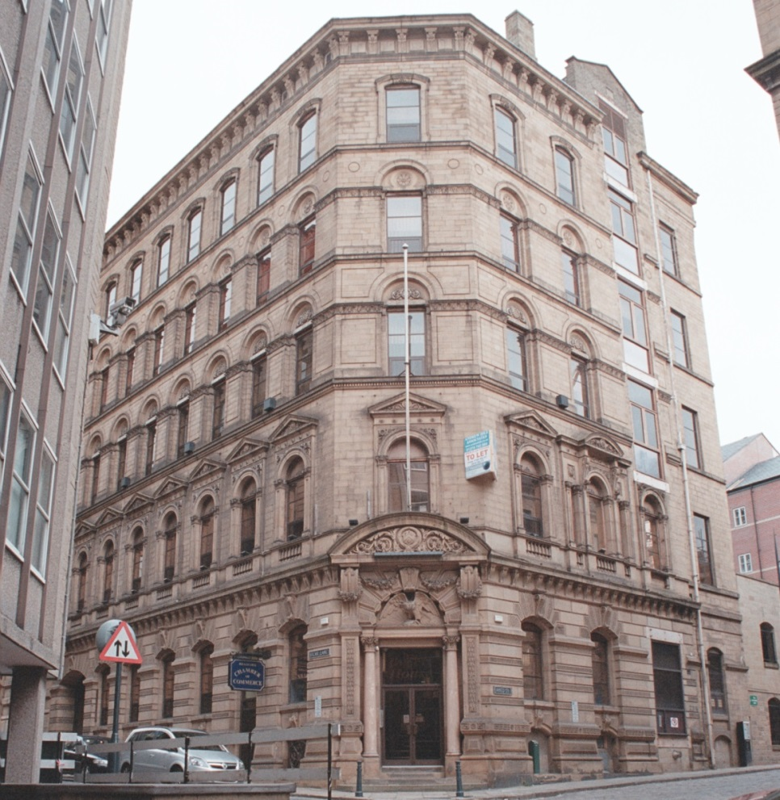
PICTURE 23
Little Germany
Image: © IoE Mr Nigel Wood. Source Historic England Archive Ref: IOE01/16978/04, Taken: 1 Nov 2007
https://historicengland.org.uk/images-books/photos/item/IOE01/16978/04
Notes:
35

Slide 36
Scene 5
Wool Exchange
and Salts Mill

Slide 37
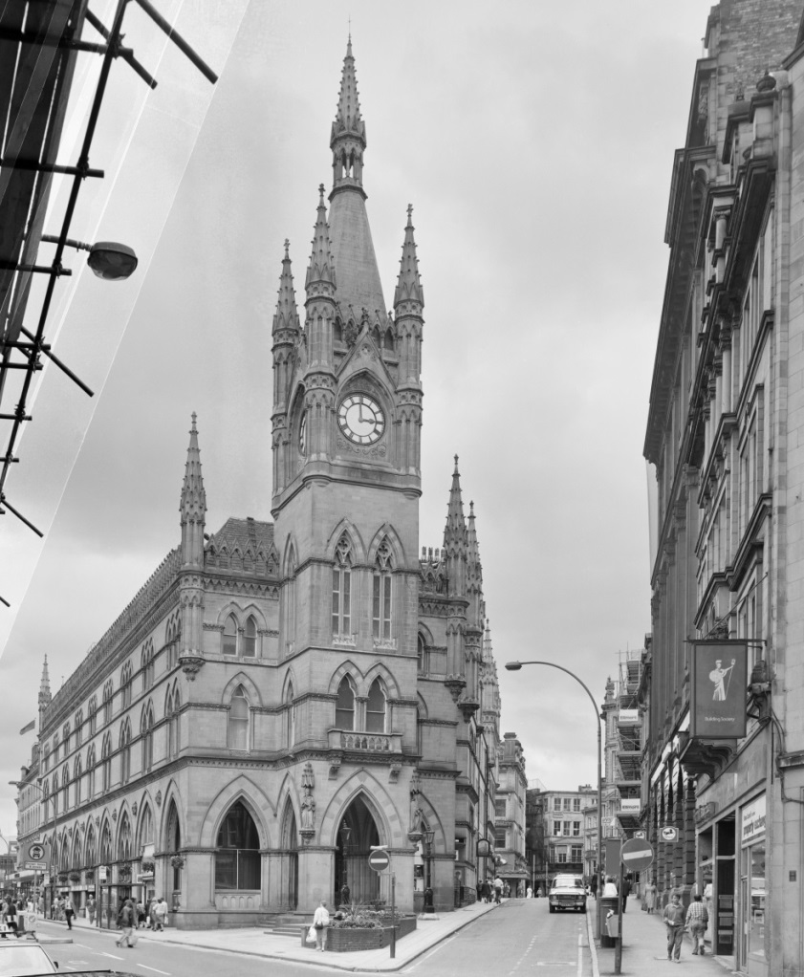
PICTURE 24
The Wool Exchange
Image: © Crown Copyright. Historic England Archive Ref: BB89/01721, Taken: Aug 1988
https://historicengland.org.uk/images-books/photos/item/BB89/01721
Notes:
37

Slide 38
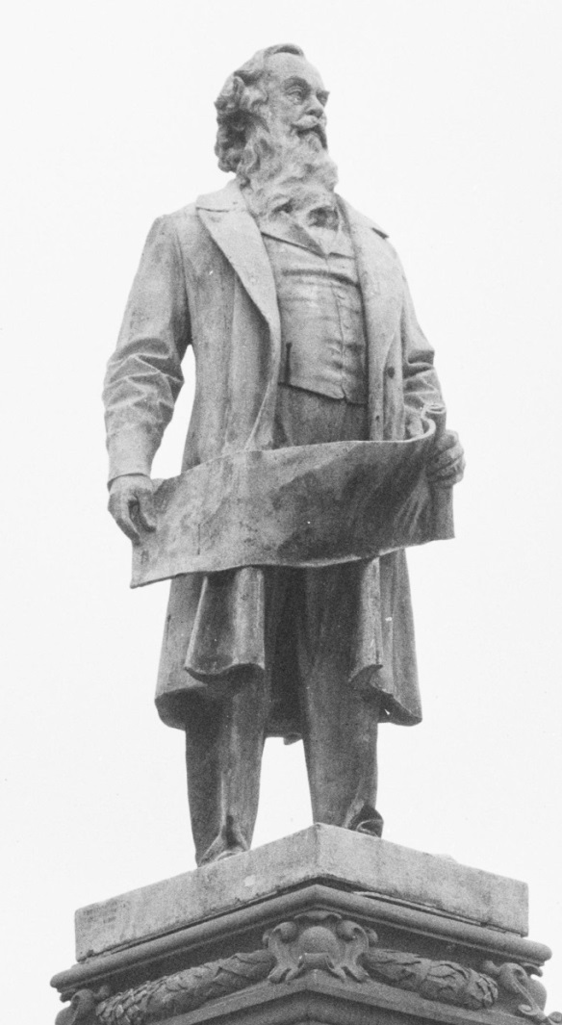
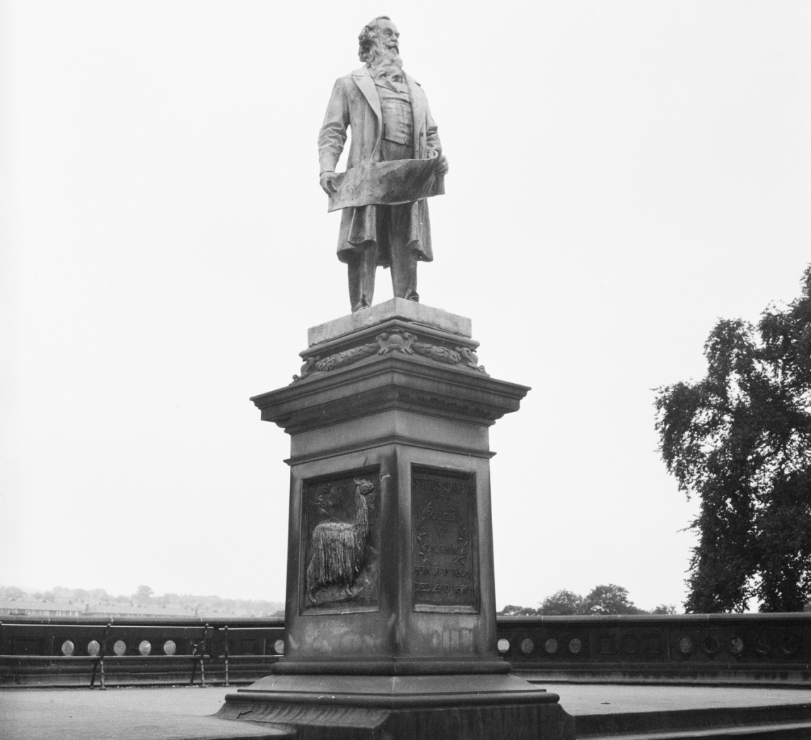
PICTURE 25
Titus Salt
Image: © Historic England Archive Ref: DES01/01/0589, Taken: 1966 – 1974
https://historicengland.org.uk/images-books/photos/item/DES01/01/0589
Notes:
38

Slide 39
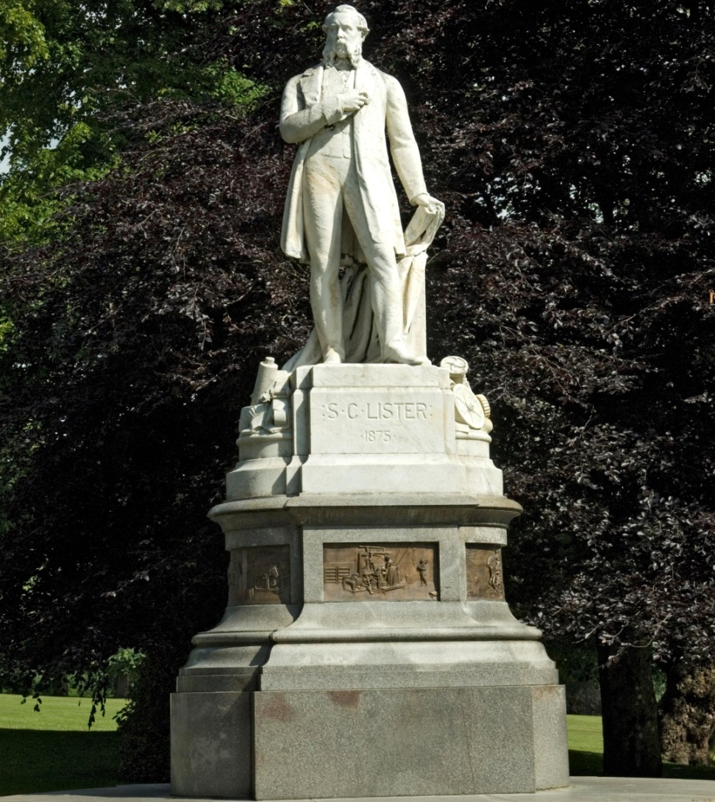
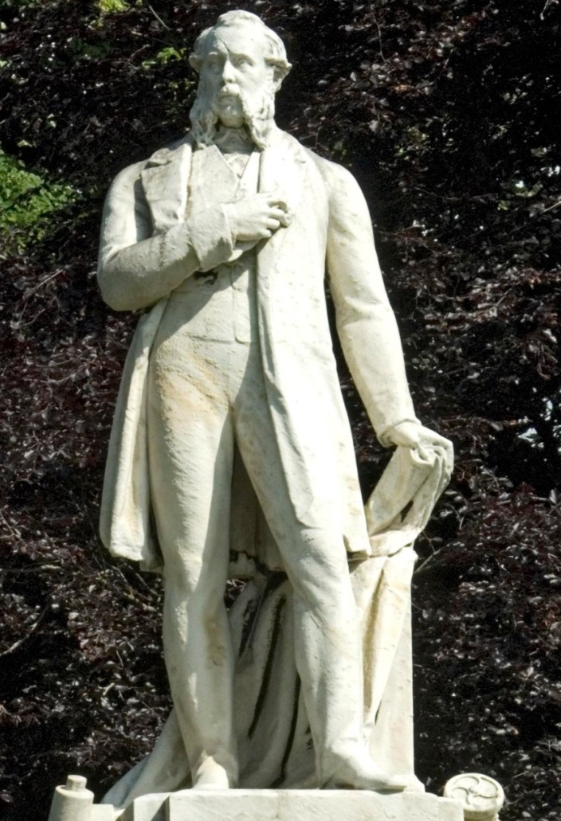
PICTURE 26
Samuel Lister
Image: © Historic England Archive Ref: DP071607, Taken: 11 Jun 2009
https://historicengland.org.uk/images-books/photos/item/DP071607
Notes:
39

Slide 40
PICTURE 27
Saltaire
Image: © Crown Copyright. Historic England Archive Ref: AA010818, Taken: Nov 1998
https://historicengland.org.uk/images-books/photos/item/AA010818
Notes:
40

Slide 41
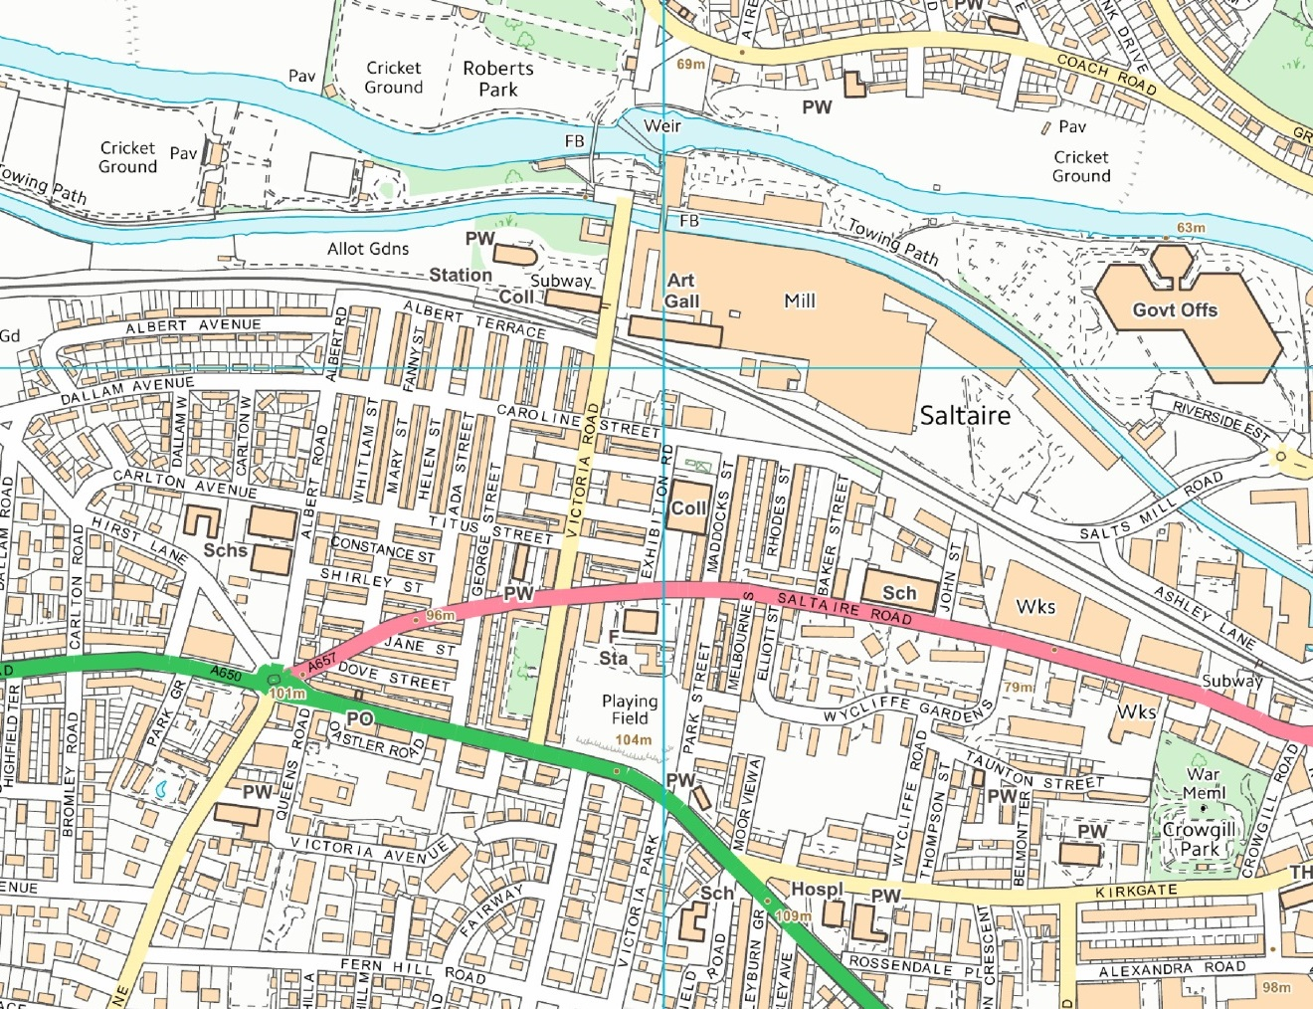
PICTURE 28
Modern map of Saltaire
Image: © Crown Copyright and database right 2020. Supplied by Historic England under Ordnance Survey Licence number 100024900
Notes:
41

Slide 42
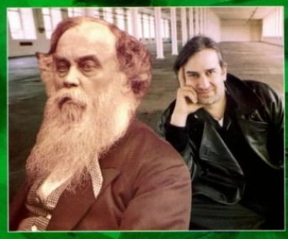
PICTURE 29
Jonathan Silver
Permission to use the screen shot of book ‘Salt and Silver’ given by Zoe Silver
Notes:
42

Slide 43
Scene 6
Manningham Lane
and Drummond Mill

Slide 44
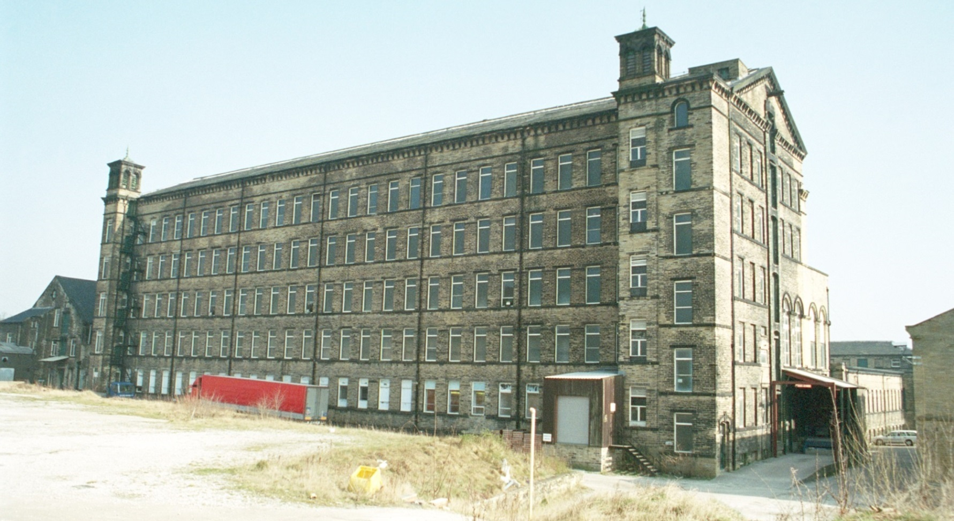
PICTURE 30
Drummond Mill
Image: © IoE Mr J A Lowes. Source Historic England Archive Ref: IOE01/10234/06 Taken: 16 Mar 2003
https://historicengland.org.uk/images-books/photos/item/IOE01/10234/06
Notes:
44

Slide 45
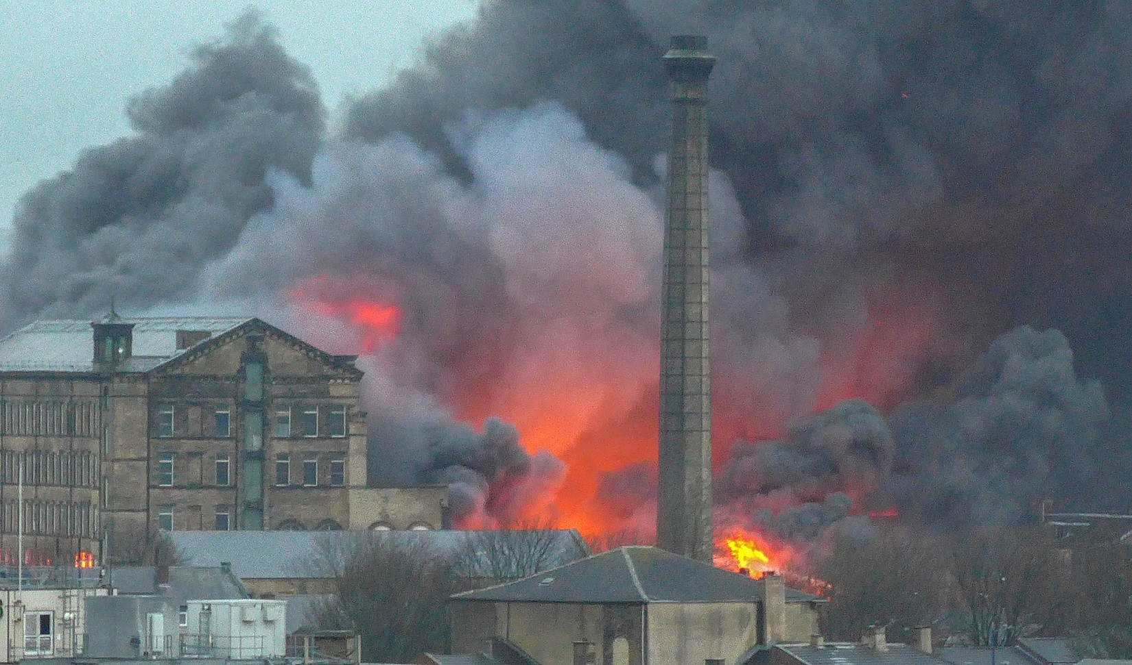
PICTURE 31
Drummond Mill
Image: © Tim Green from Bradford, CC BY 2.0 <https://creativecommons.org/licenses/by/2.0>, via Wikimedia Commons https://commons.wikimedia.org/wiki/File:Drummond_Mill_Fire_(24306234169).jpg
Notes:
45

Slide 46
Scene 7
Sport

Slide 47
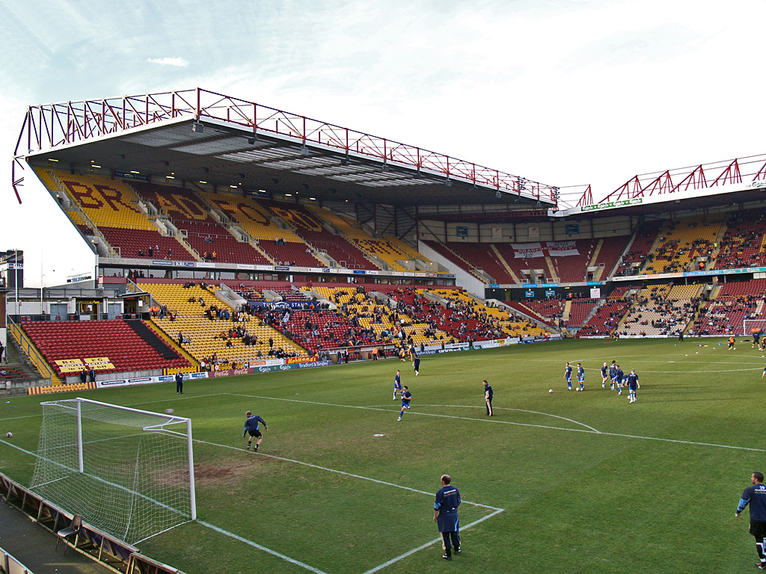
PICTURE 32
Valley Parade
Image: © David Ingham, CC BY-SA 2.0 <https://creativecommons.org/licenses/by-sa/2.0>, via Wikimedia Commons https://commons.wikimedia.org/wiki/File:Valley_Parade,_Bradford.jpg
Notes:
47

Slide 48
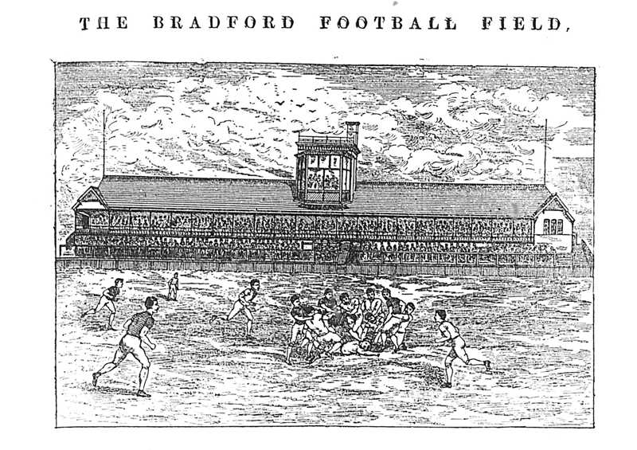
PICTURE 33
Bradford Park Avenue
Source: http://www.bradfordfc.org.uk/html/park_avenue.html
Notes:
48

Slide 49
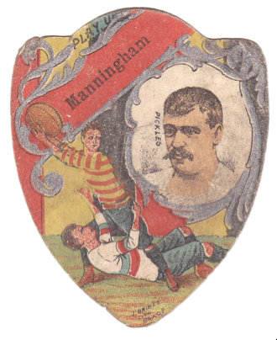
PICTURE 34
Manningham FC (Rugby Football)
Source: https://www.playingpasts.co.uk/articles/football/the-origins-of-professional-football-in-bradford/
Notes:
49

Slide 50
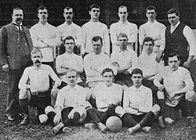
PICTURE 35
Bradford City 1903/04
Source: https://www.playingpasts.co.uk/articles/football/bradford-city-afc-held-back-by-history/
Notes:
50

Slide 51
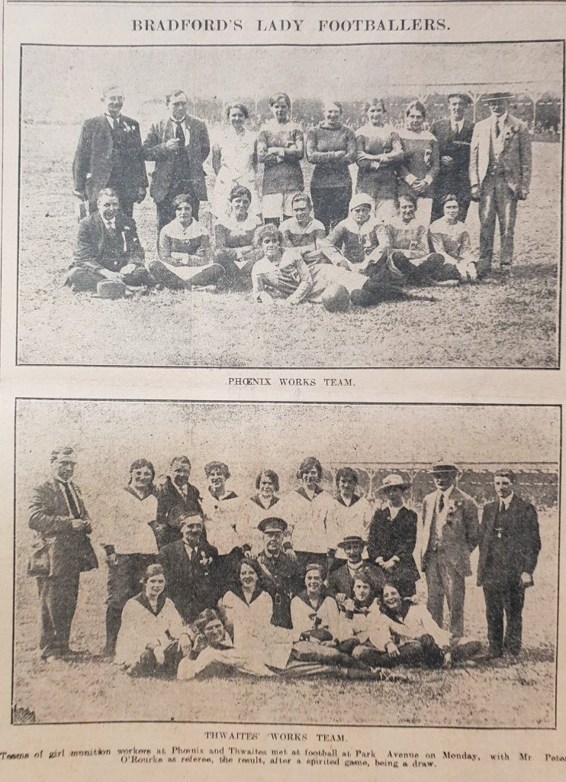
PICTURE 36
Female Footballers
Source: https://bradfordsporthistory.com/2018/09/24/21-october-2018/
Notes:
51

Slide 52
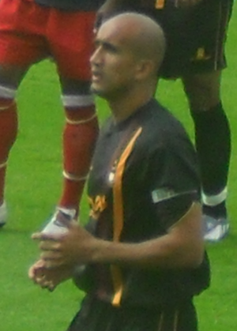
PICTURE 37
Bradford sports people
Zesh Rehman
Image: © Mattythewhite, CC BY-SA 3.0 <https://creativecommons.org/licenses/by-sa/3.0>, via Wikimedia Commons https://commons.wikimedia.org/wiki/File:Zesh_Rehman_York_City_v._Bradford_City_1.png
Notes:
52

Slide 53
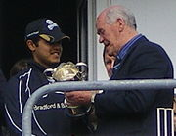
PICTURE 38
Bradford sports people
Brain Close & Azeem Rafeeq
Image: © Mdcollins1984, CC BY-SA 3.0 <https://creativecommons.org/licenses/by-sa/3.0>, via Wikimedia Commons
https://commons.wikimedia.org/wiki/File:Azeem_rafiq_and_brian_close.jpg
Notes:
53

Slide 54
TASK
Sport Re-cap
How much can you remember about Sports in Bradford?
You could answer these questions in small groups.
Some answers can be written in your own words.
Some questions need factual answers.

Slide 55
TASK
Sport Re-cap
6. What was Bradford City’s first name?
a) Manningham RC b) Manningham CF c) Manningham FC
7. Where did the women’s teams come from?
a) Hospitals & laundries
b) Breweries & mills
c) Laundries & mills
8. Who was the first South Asian captain of Bradford City?
a) Zak Rahman b) Zesh Rahimi c) Zesh Rahman
9. Which is the correct nickname for Bradford City?
a) Roosters b) Bantams c) Broilers
10. Who won 4 international karate awards?
a) Lynne Whistler b) Katy Antsel c) Katelyn Entwhistle

